Slide 1
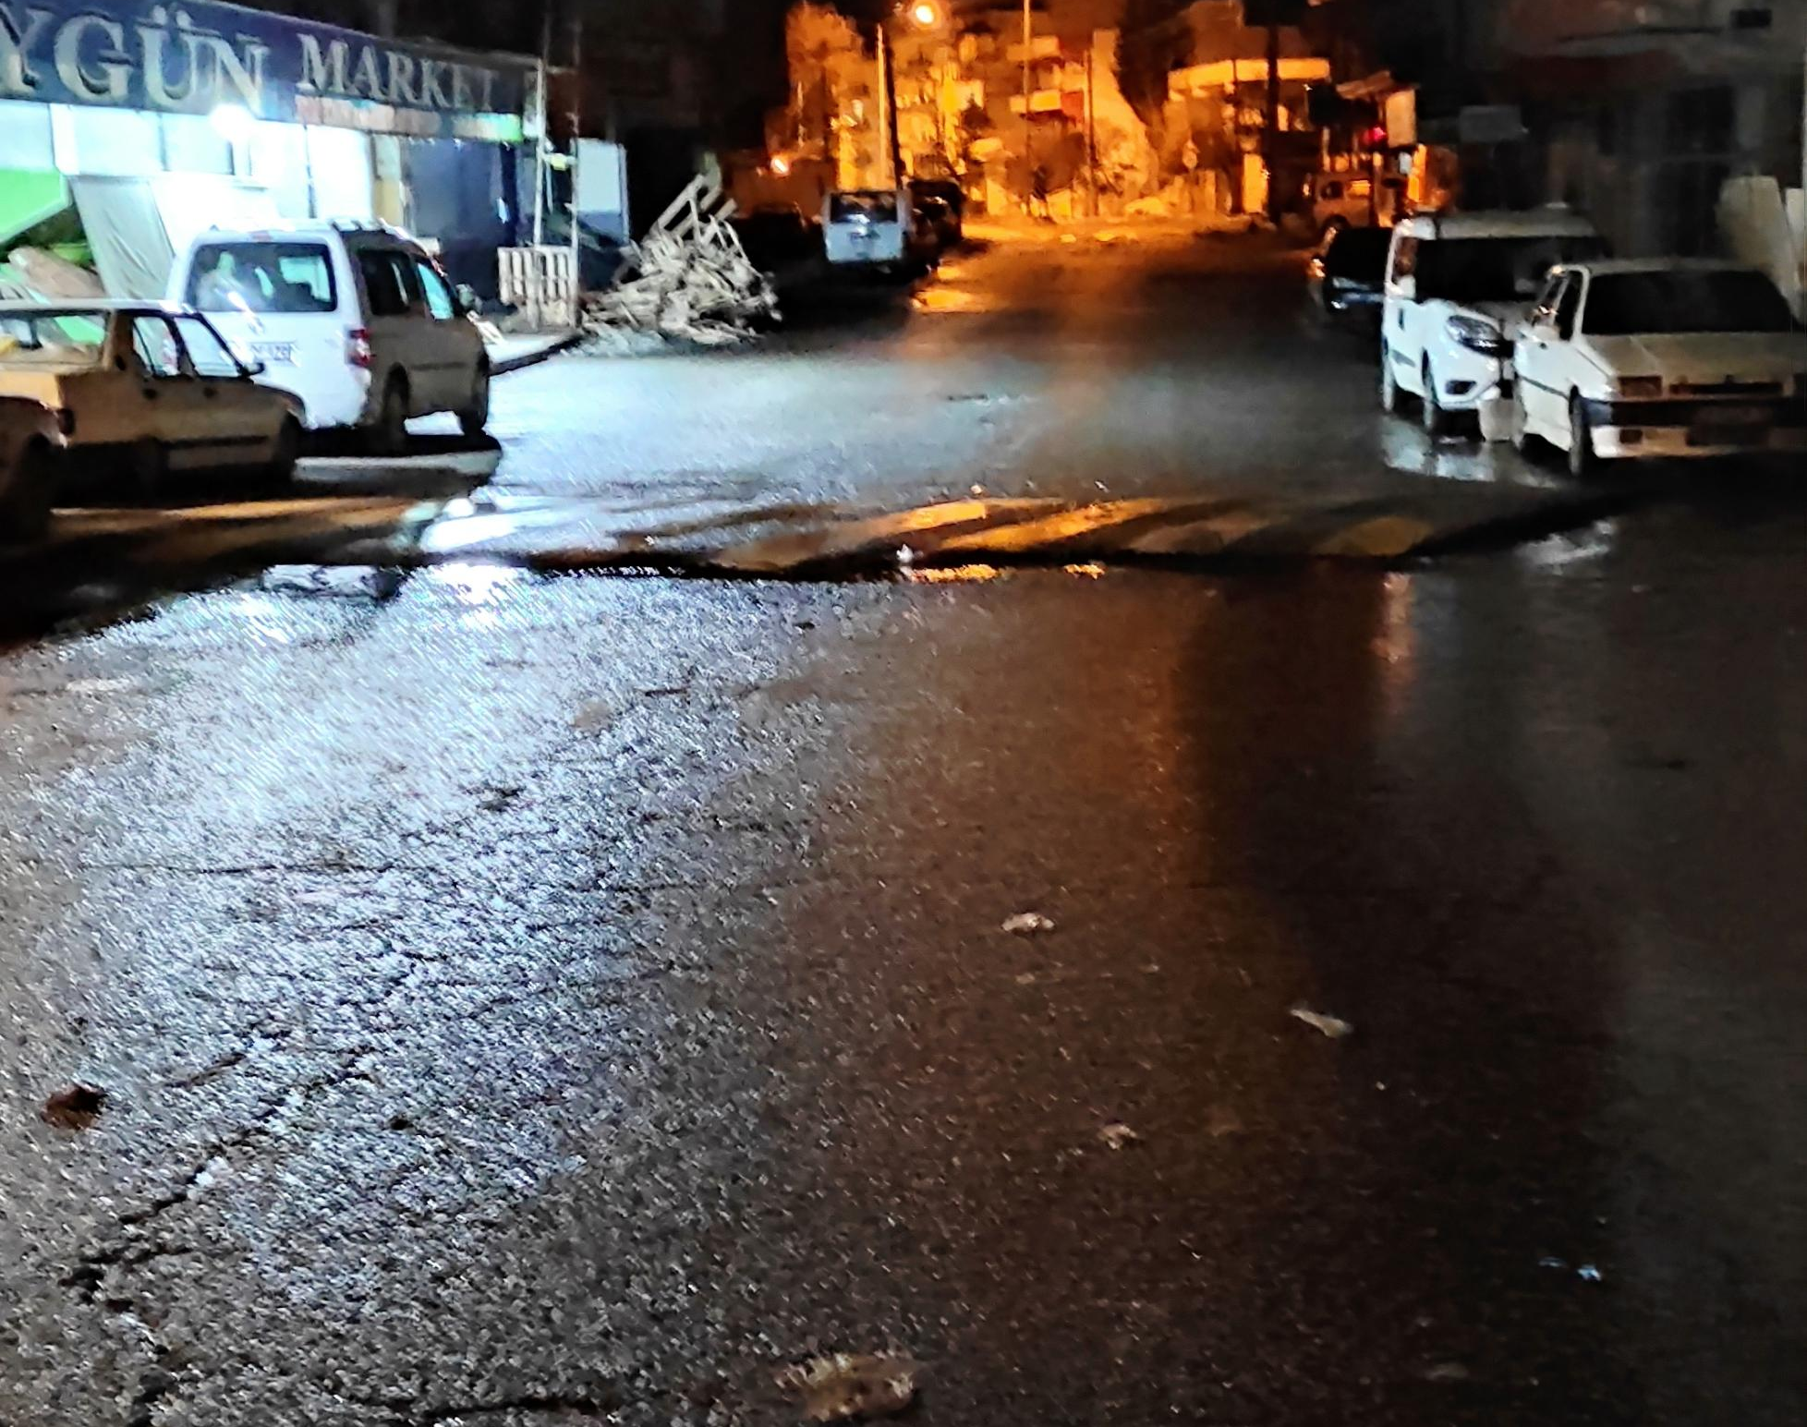
11.02
I hadn't slept much. The alarm woke me up at 4am. The whole family was asleep except me. While making the final preparations, my mother and father woke up. At 4:30, my mother, me and my father left the house. We went to school for a short walk on a long journey.

Slide 2
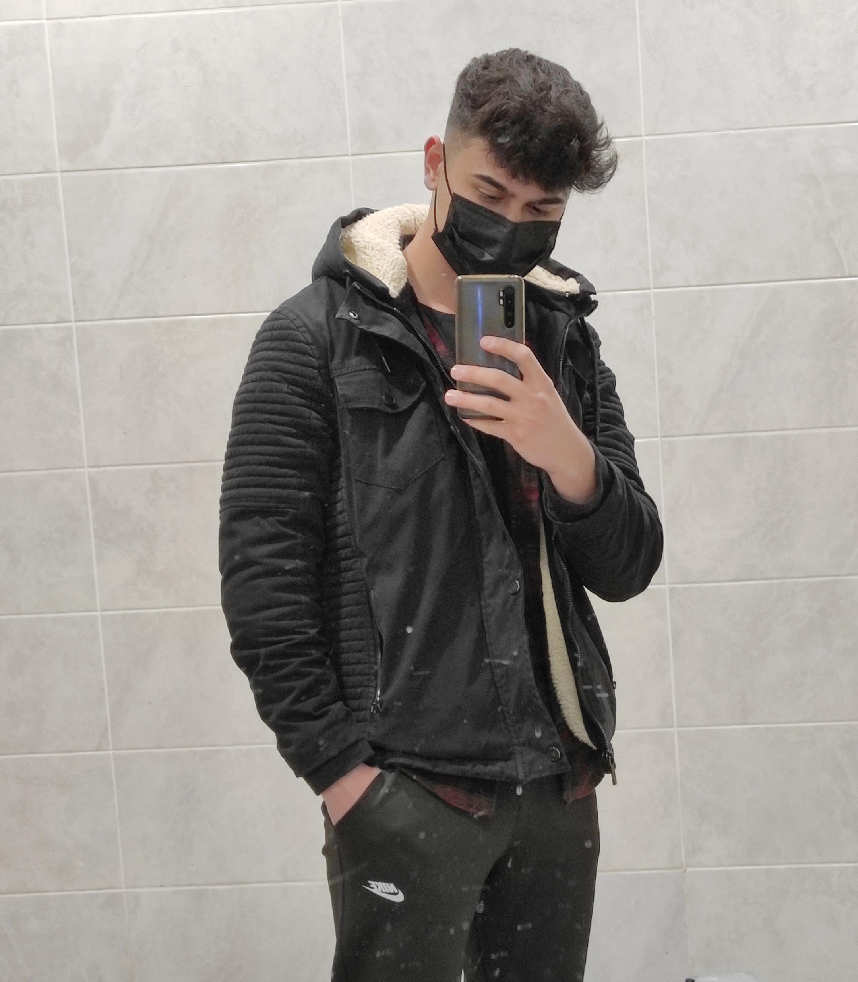
We were there almost at the same time with Durmuş and his family. After 12 minutes the bus arrived, we said goodbye to everyone and set off to pick up the teachers. There was not much on the bus other than a little chatter. After taking Gürhan Aygördüyü (our manager) and Ertuğrul Sıvakcıgil (project coordinator) respectively, we went to the airport. I was excited because it was the first time I went to the airport and it was my first time traveling by plane. I did not know what to do , so I did not leave behind the teachers . First we gave the bags and coats etc. After scanning we got the items and started to wait for the flight time. My mom is ztn excited for me 😅 that’s why she writes every minute.

Slide 3
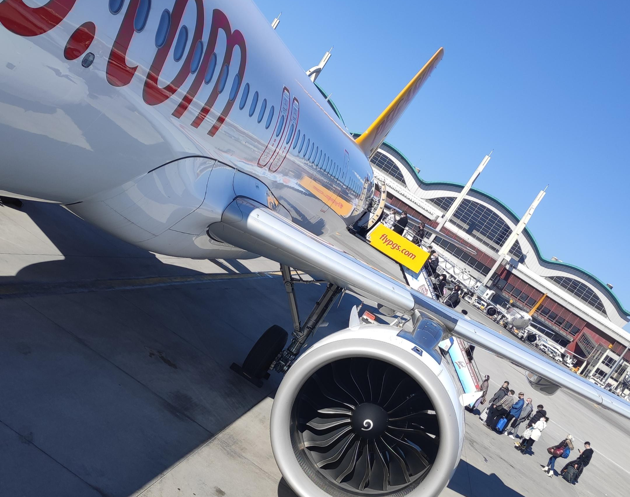
After a photo of a small mirror in the sink, we started to go to a different place to go to the plane. We packed our bags and suitcases and set off for the plane. We passed a small bridge-like place and got on the plane. While I was hoping for the window side, it was sad that the corridor side came 😅. I did not sleep on the plane, it was considered comfortable. I expected a jolt when the plane landed, but nothing much happened.

Slide 4
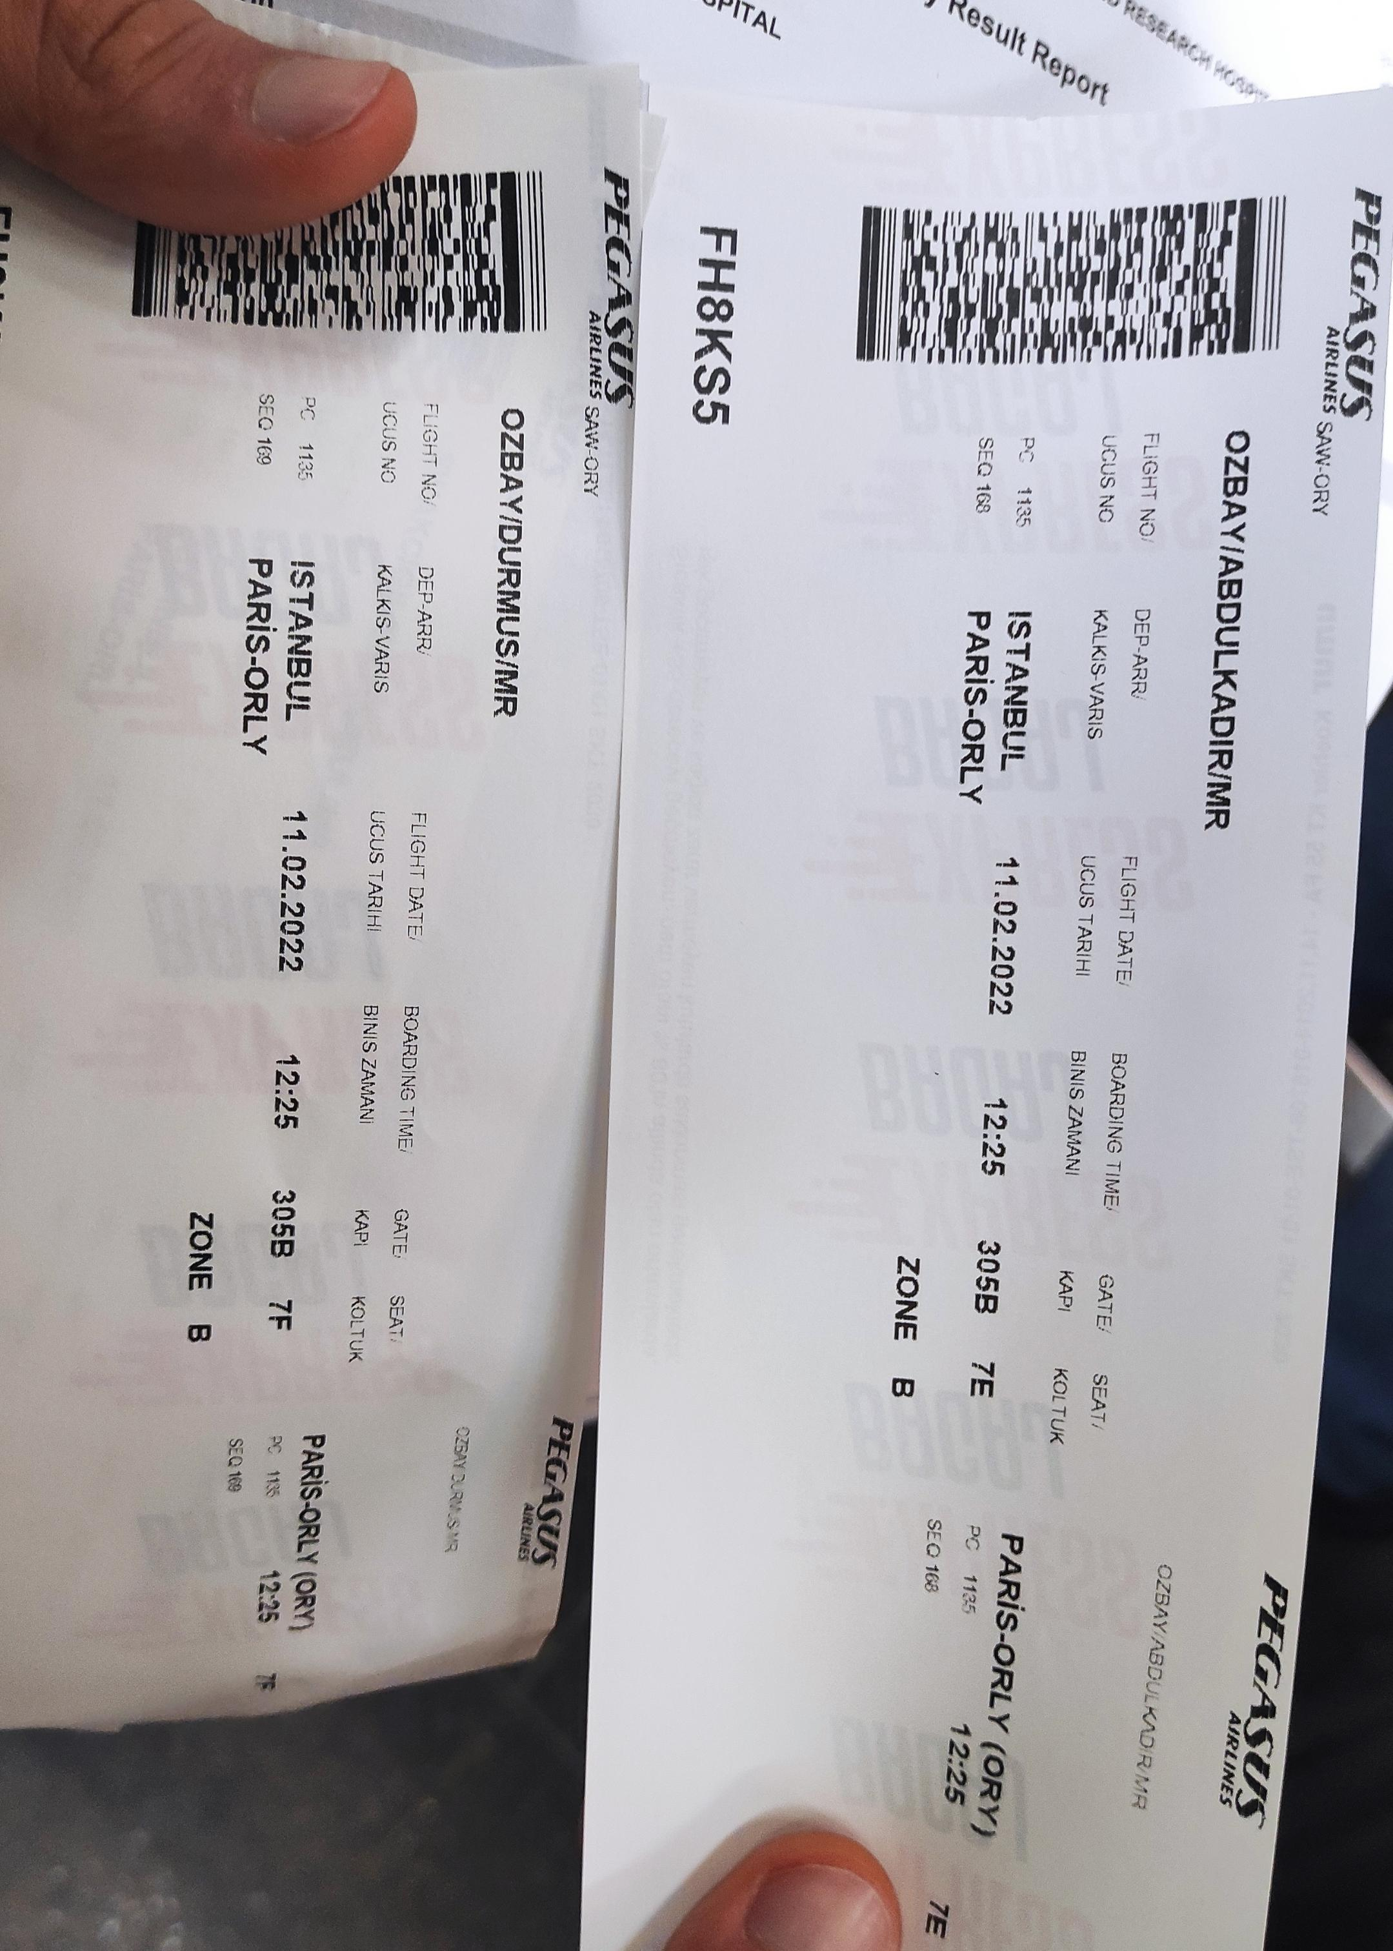
The plane stopped, landed and I went to Istanbul for the first time. We still had time for the flight to Paris, so we had a snack at the cafeterias.

Slide 5
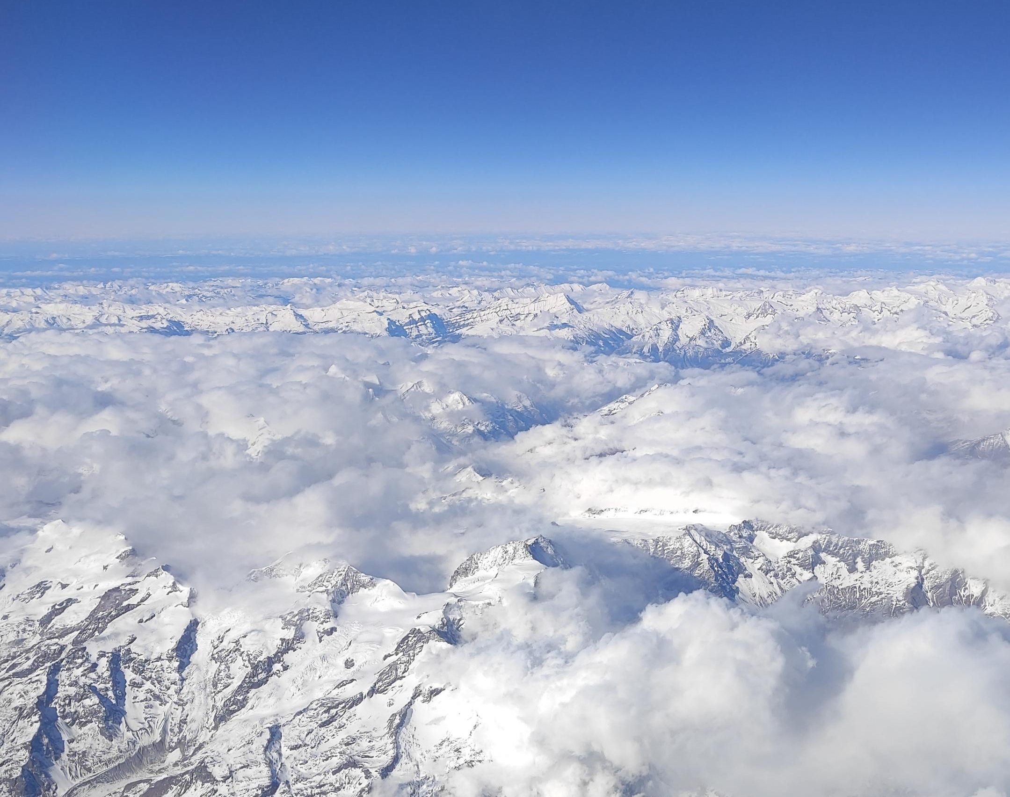
Afterwards, we got the tickets and baggage transactions and boarded the France/Paris flight, and this time it was not by the window again 🥲 luckily, he was standing next to me so I could take lots of photos.

Slide 6
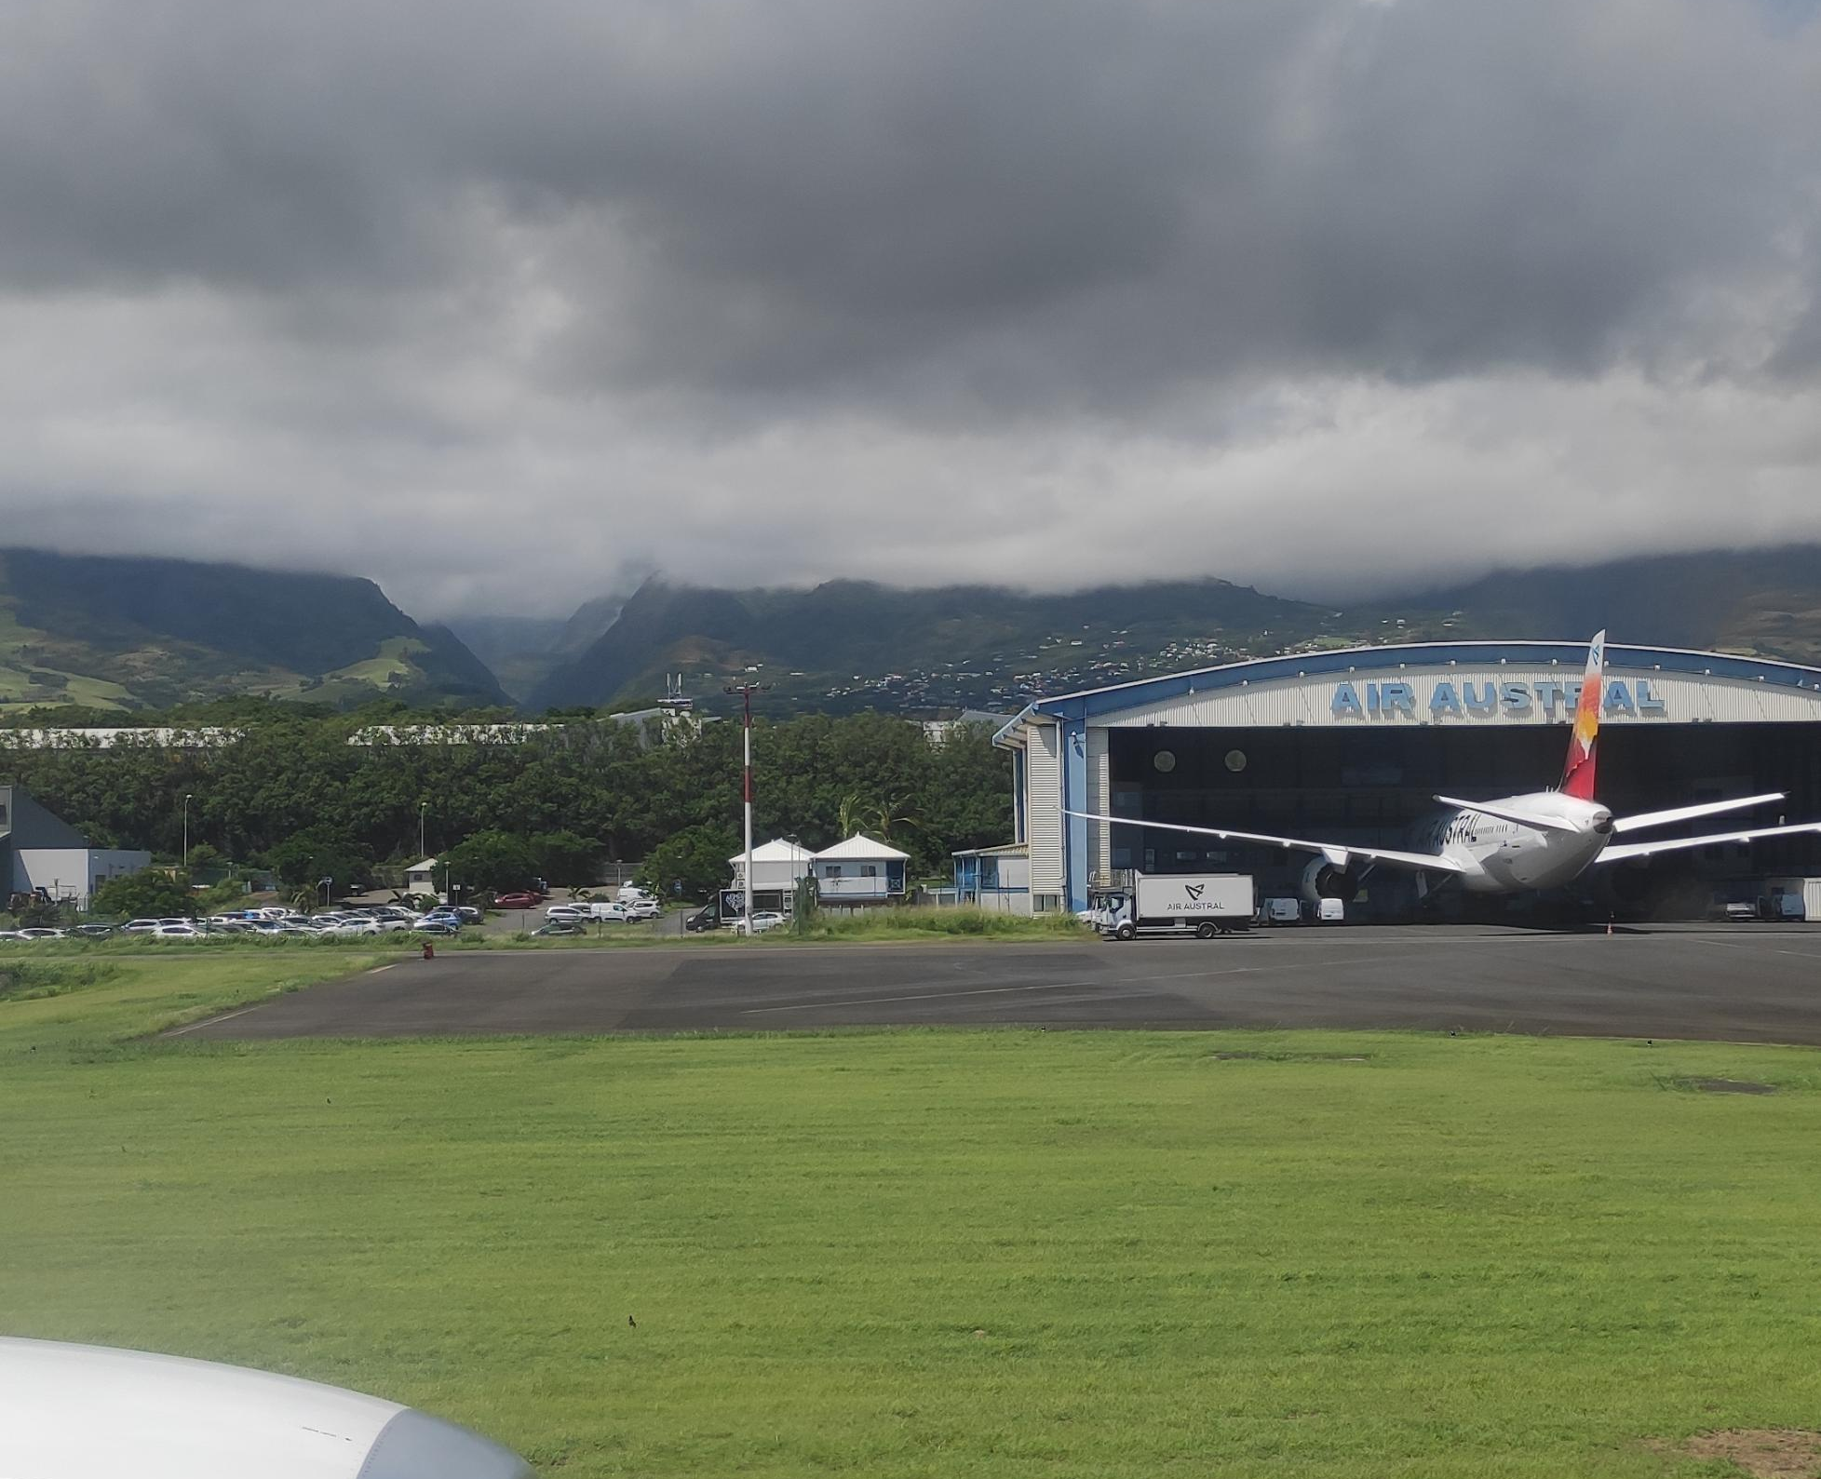
12.02
We got off the La Reunion plane. It was a very strange journey because it was the first time I had ever taken such a long journey

Slide 7
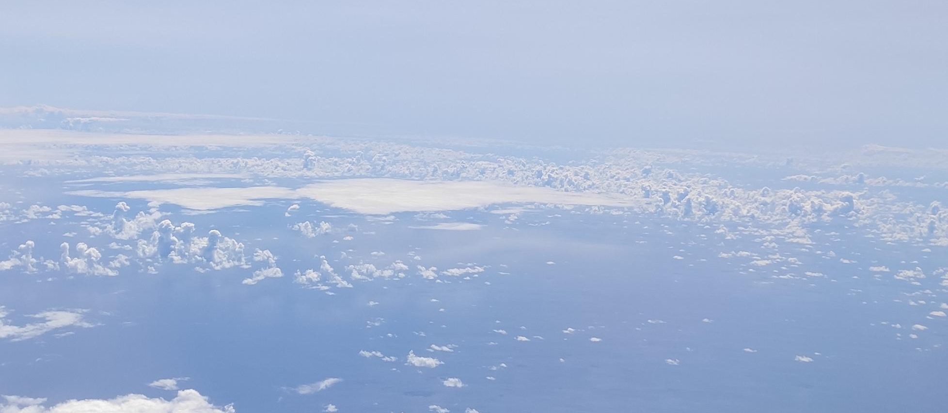
The view was magnificent , the view of the ocean , clouds and the island before landing was enchanting .

Slide 8
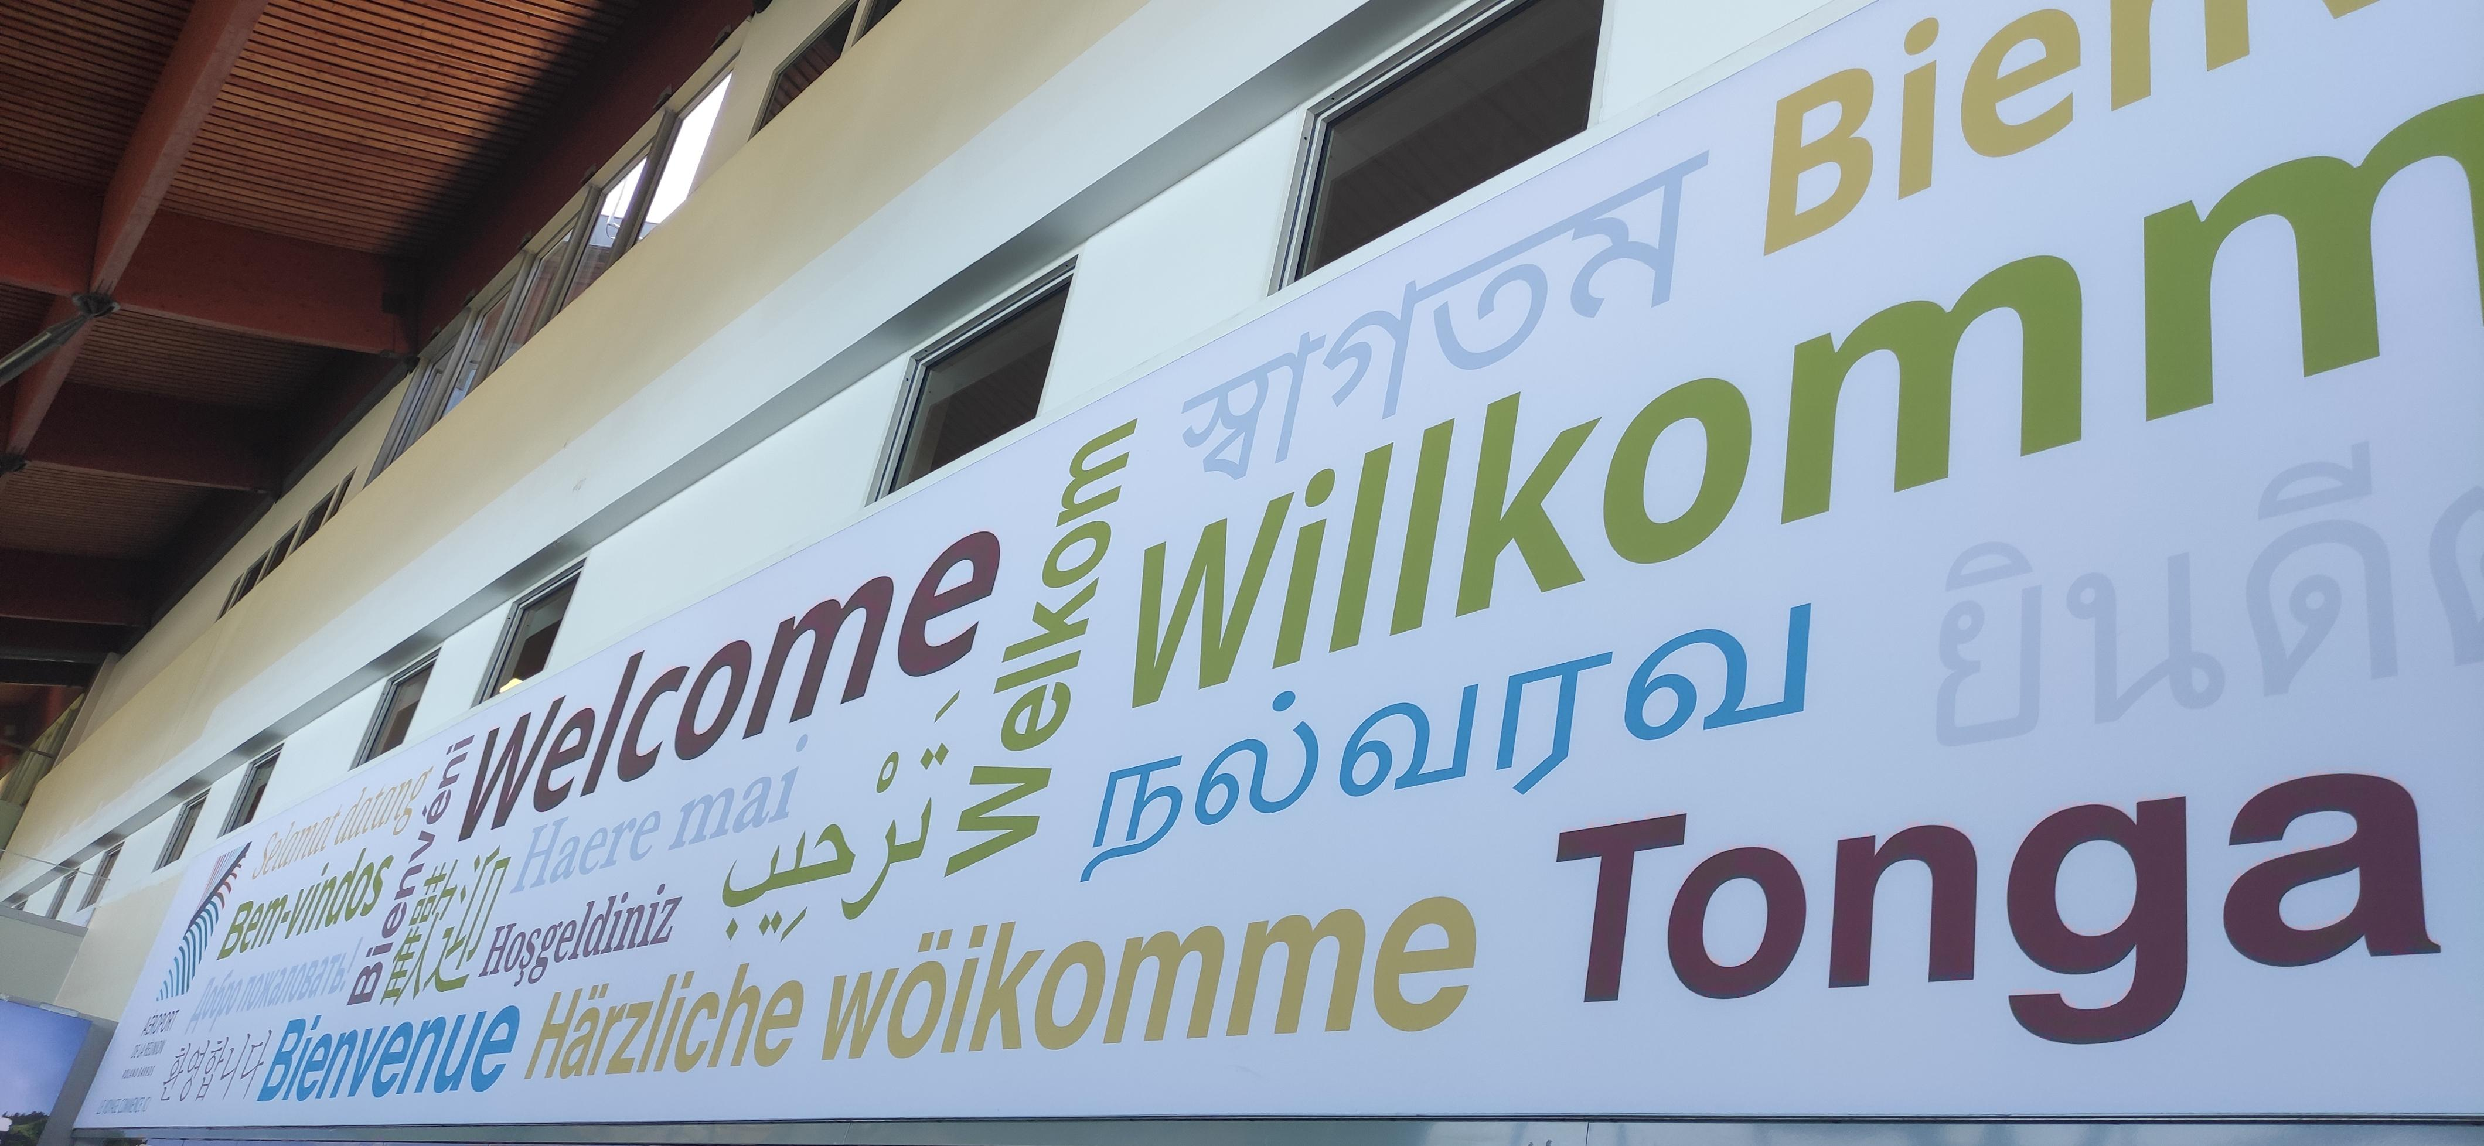
It was nice to see the welcome sign at the airport .

Slide 9
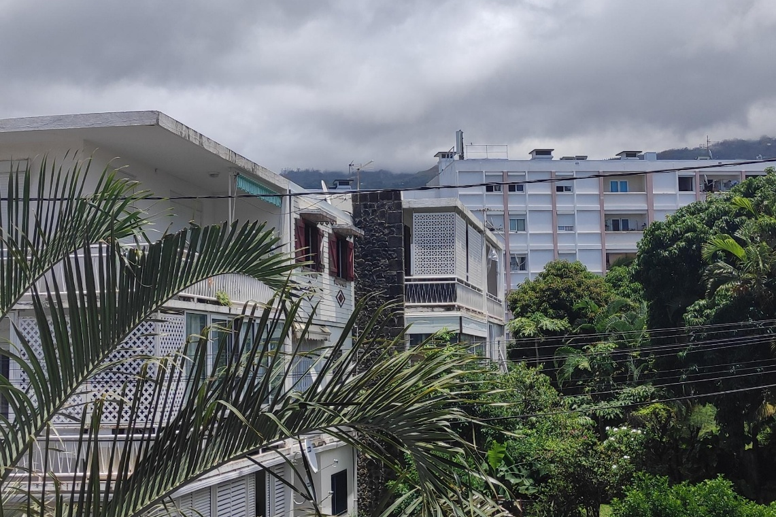
But when we landed , the humidity and temperature of the air were extremely intense . The temperature was higher than I expected. We were moving with the Estonian band. It was Saturday. It would be given to families on Sunday and the program would have started on Monday .

Slide 10
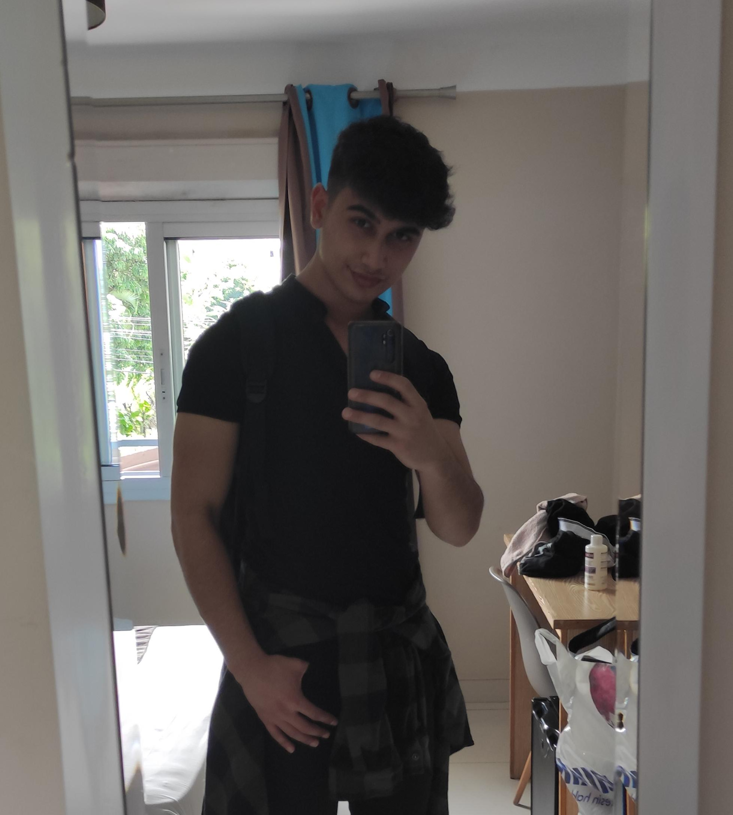
We checked out from the airport and took a taxi to the hotel. Some time after arriving at the hotel, Eston joined us in the group. We got our room numbers and settled into the rooms. We were staying in the same room as Durmus. We quickly got ready and went out to eat.

Slide 11
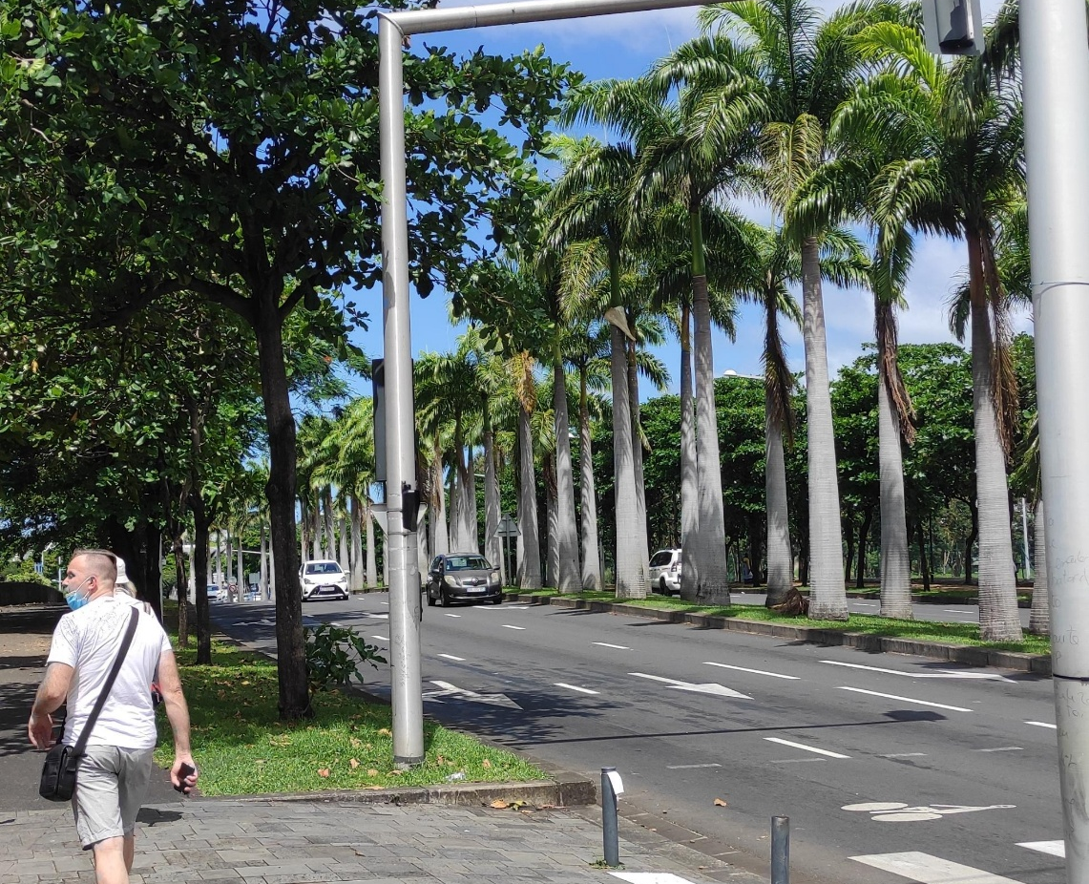
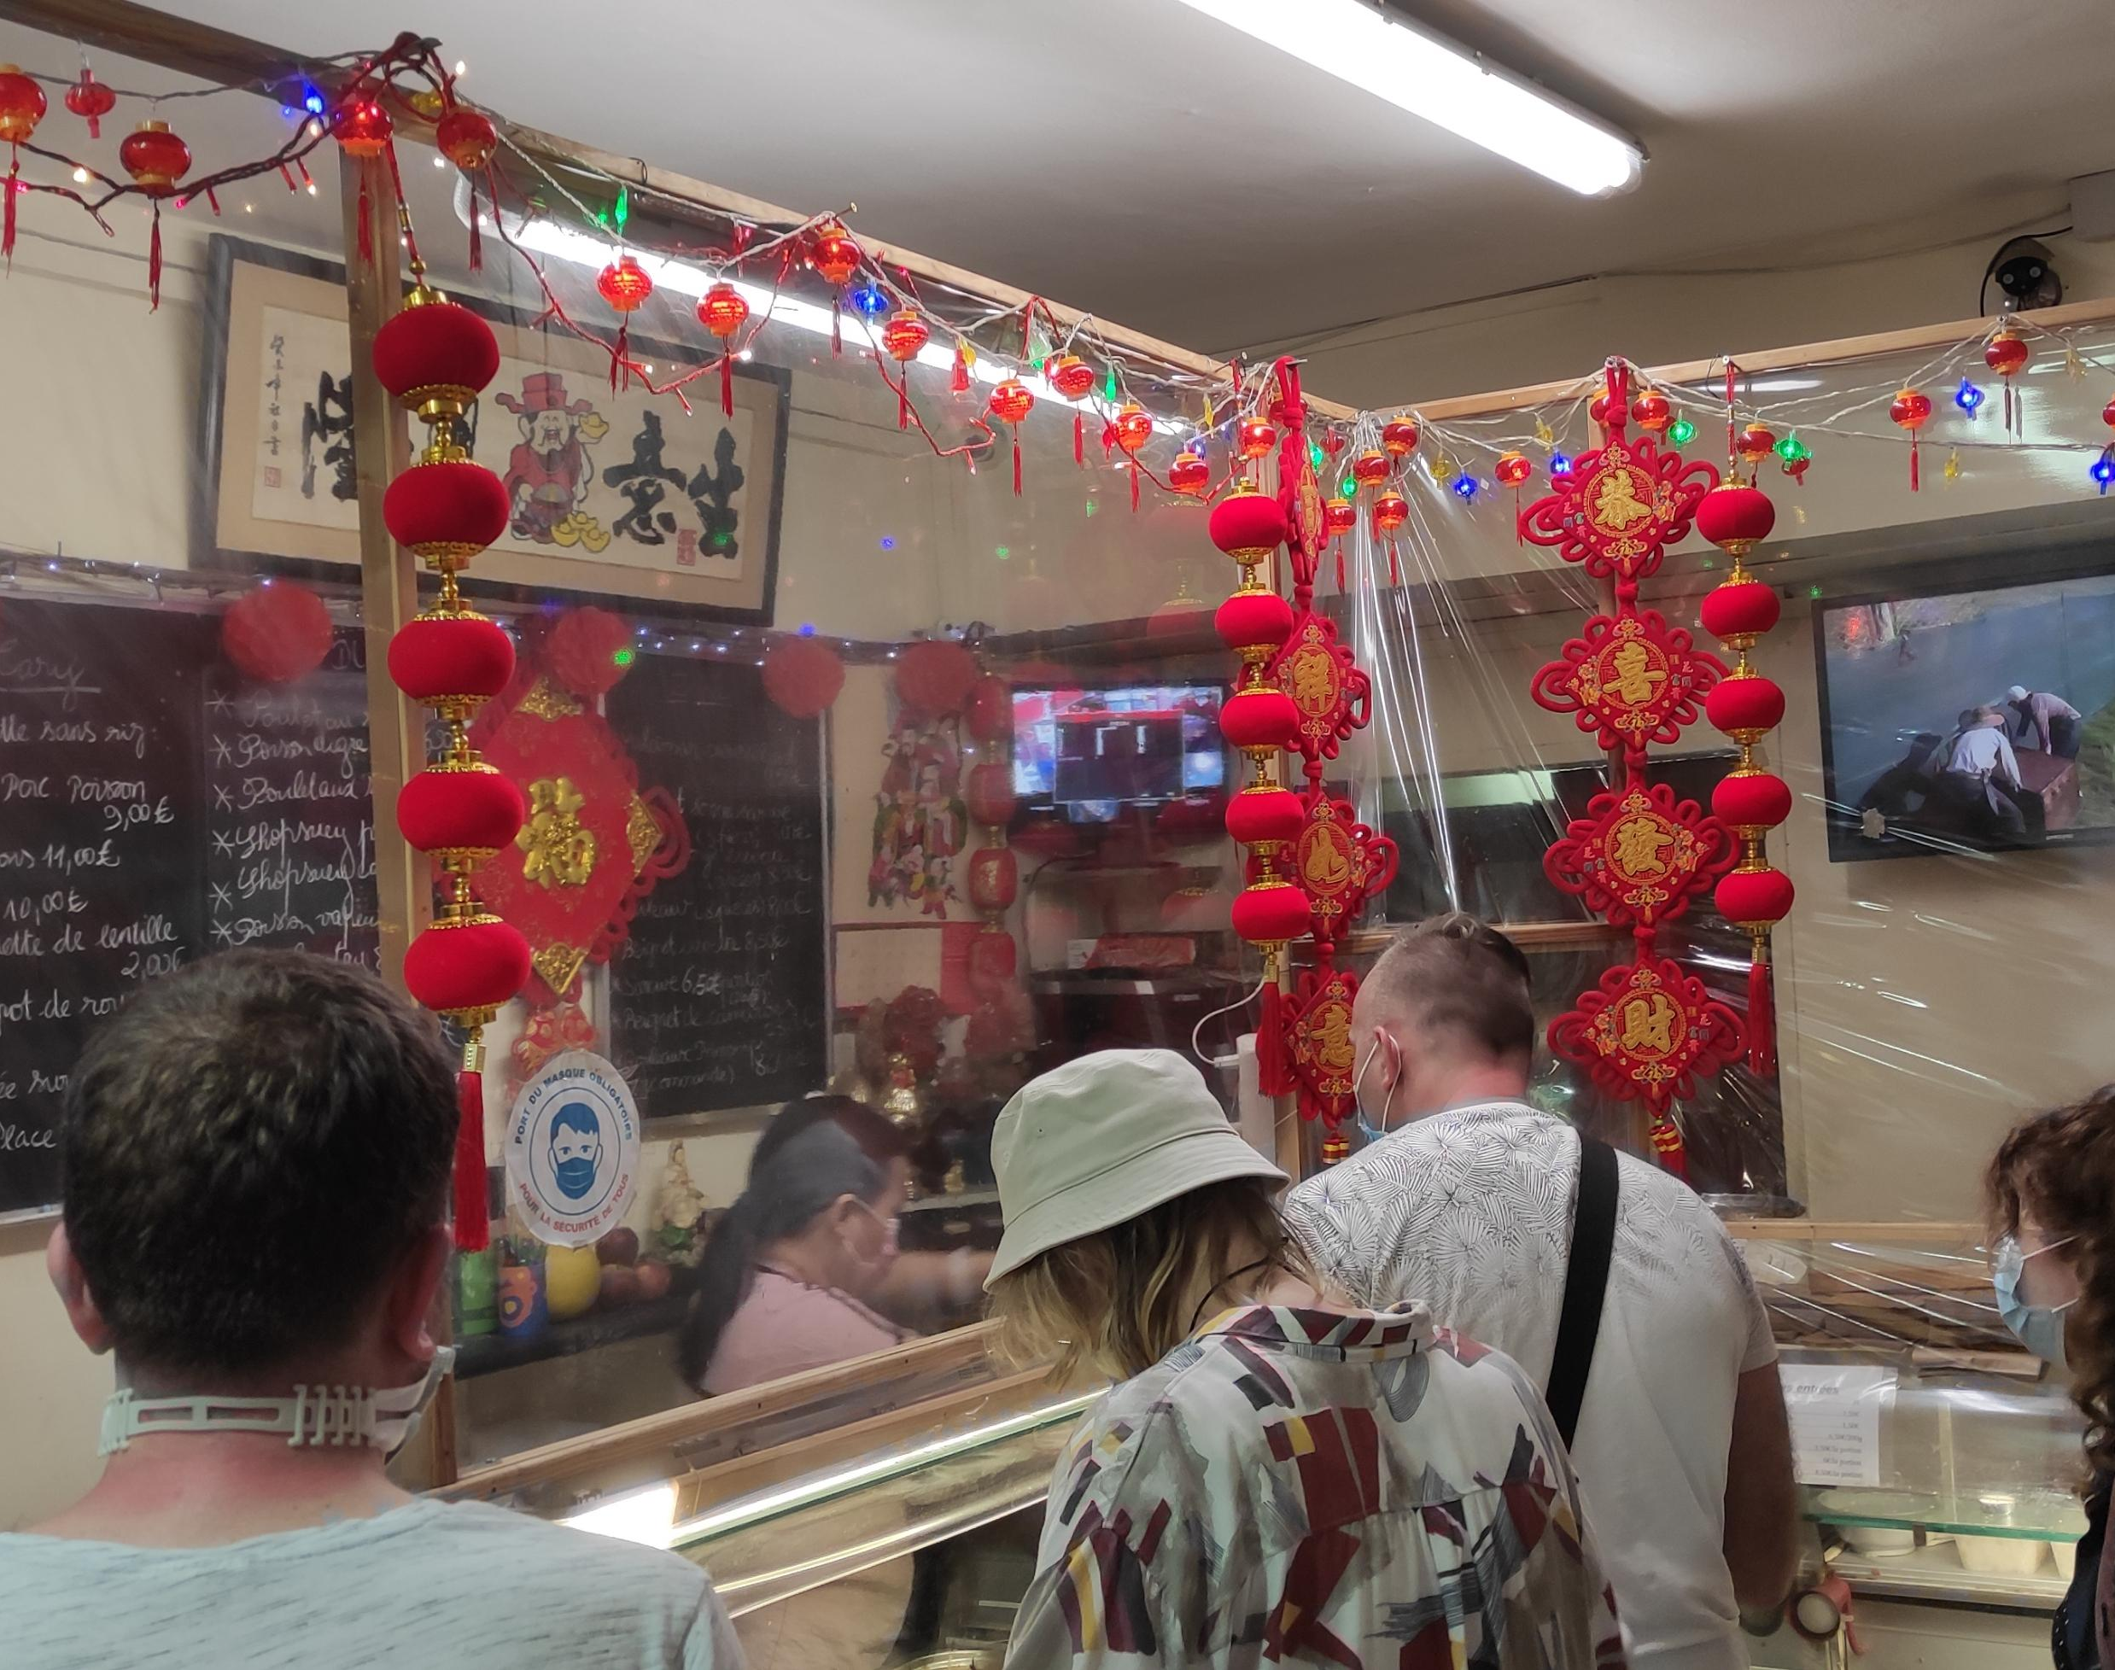
We went around and bought a few items. We left the things we bought at the hotel and went to the chinese restaurant to get food.
We went around and bought a few items. We left the things we bought at the hotel and went to the chinese restaurant to get food.

Slide 12
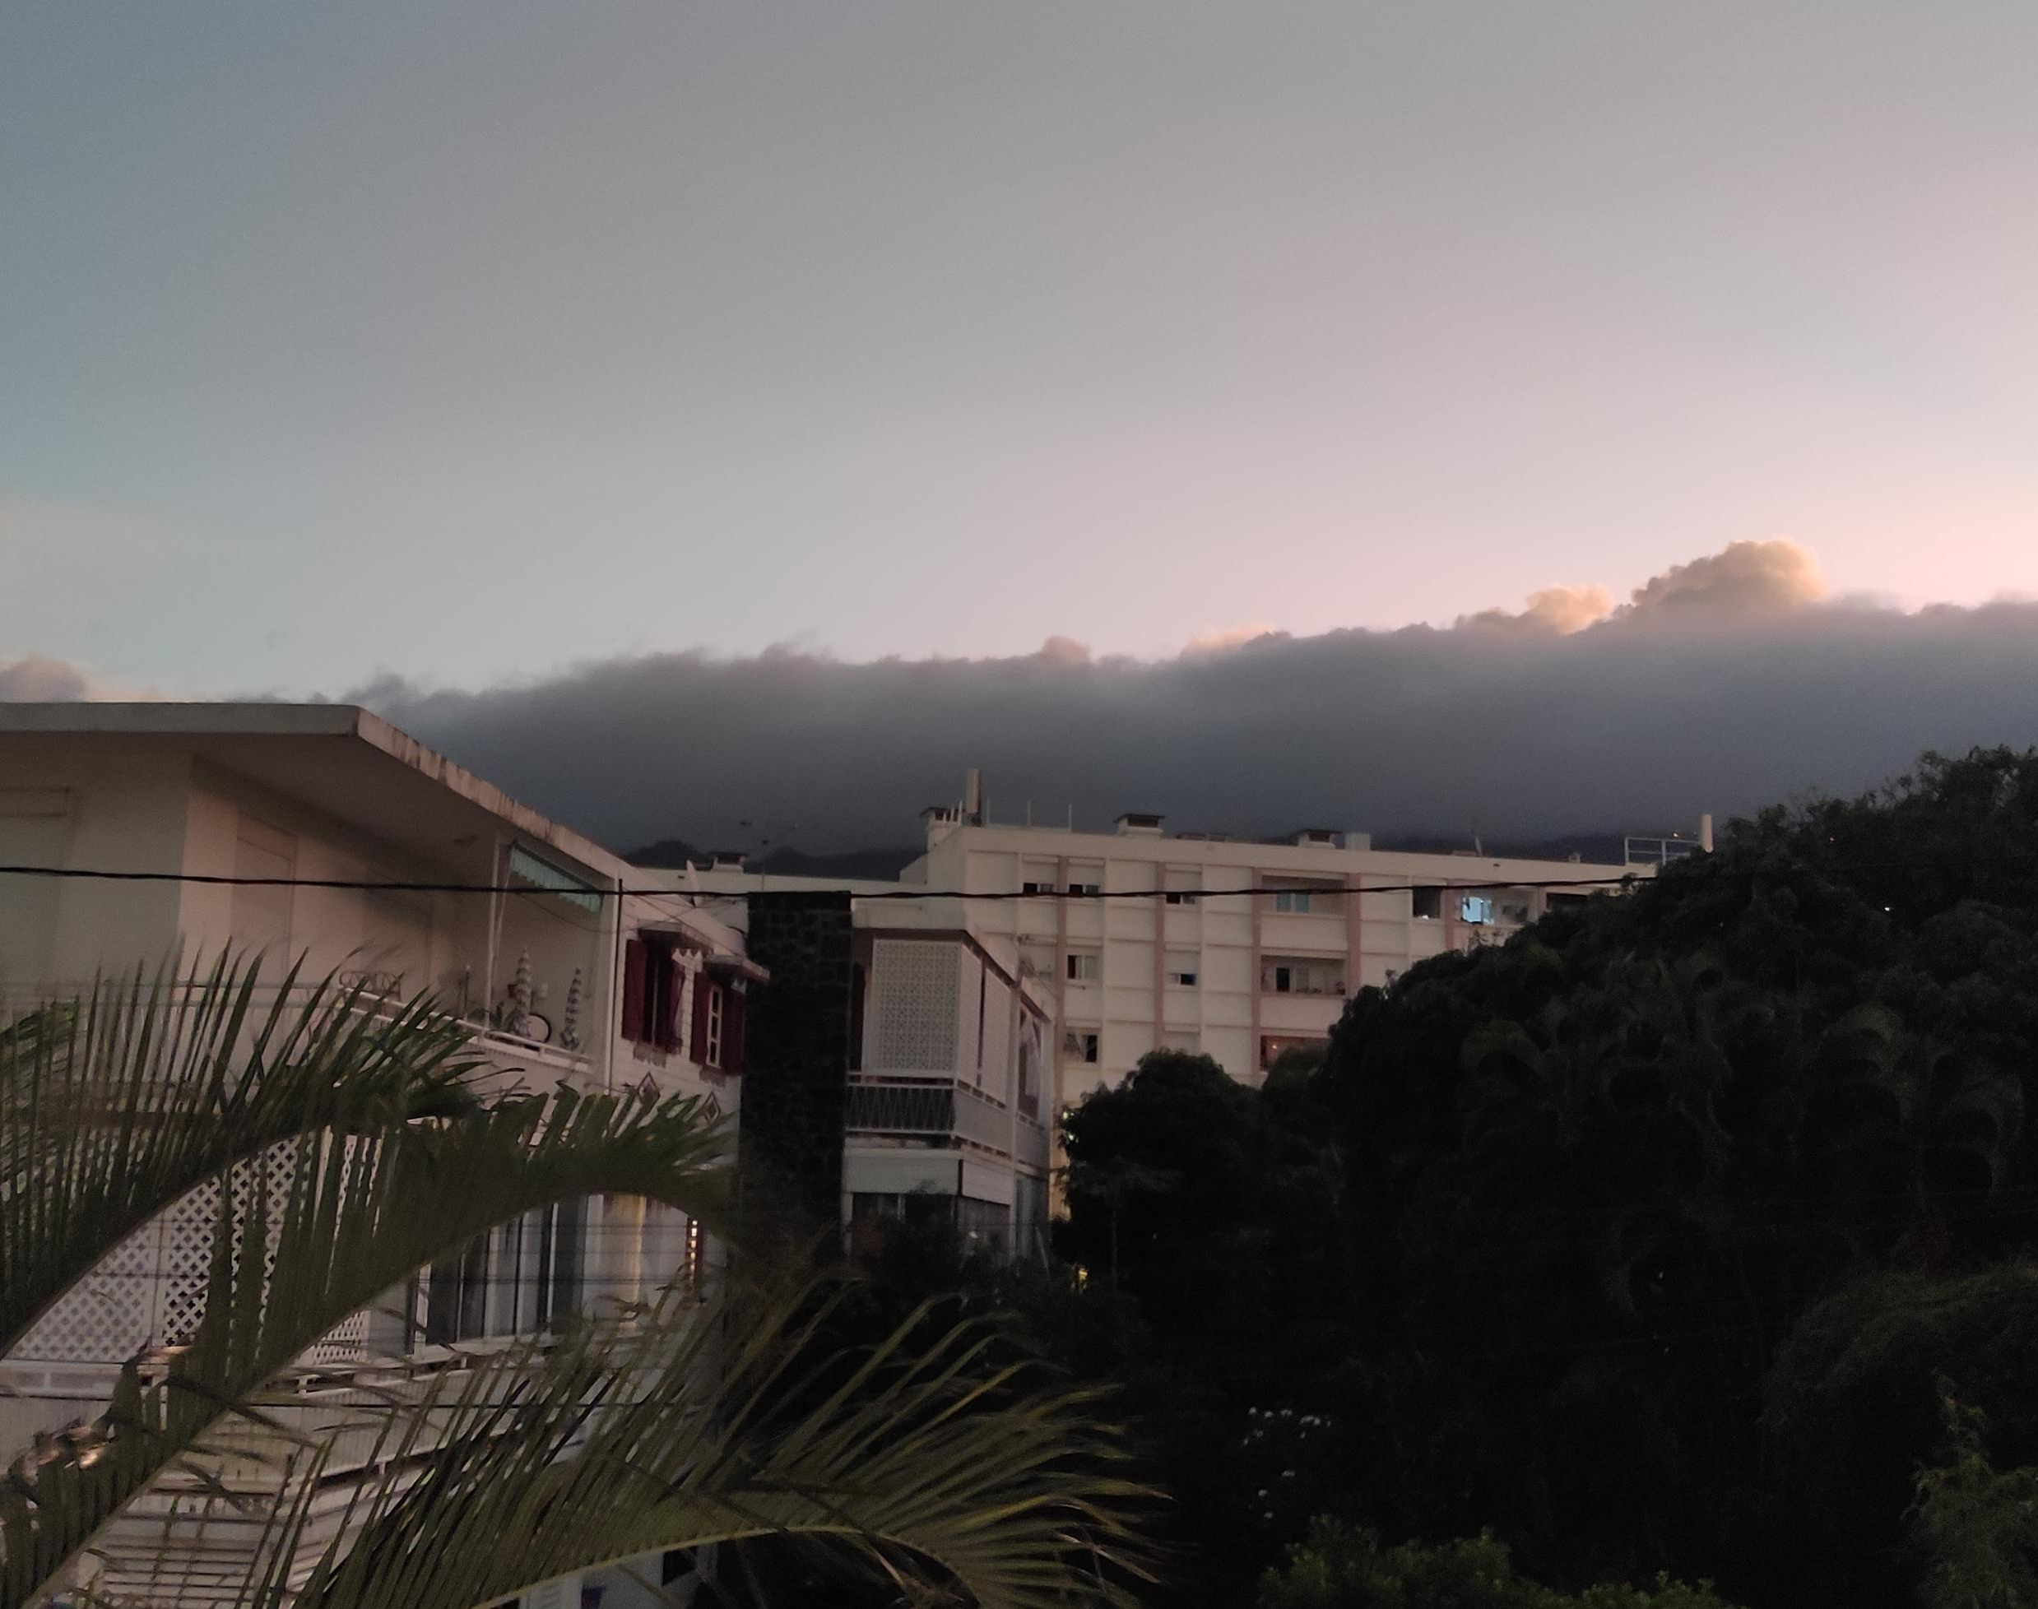
We bought the meal as a package and ate it in the section in front of the hotel. After small talk, everyone went to their room to sleep.

Slide 13
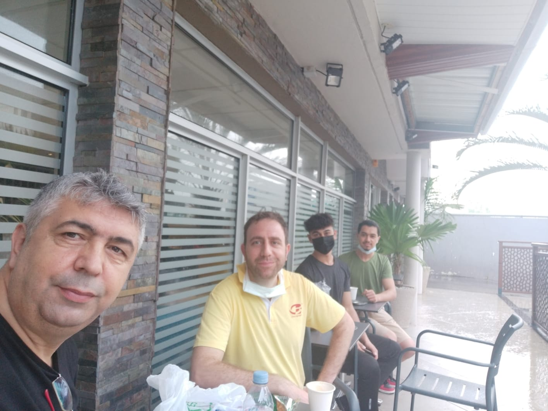
13.02
After waking up in the morning, we went downstairs for small snacks. The weather suddenly changed and it started to rain quickly. It was a very strange, but at the same time beautiful event.

Slide 14
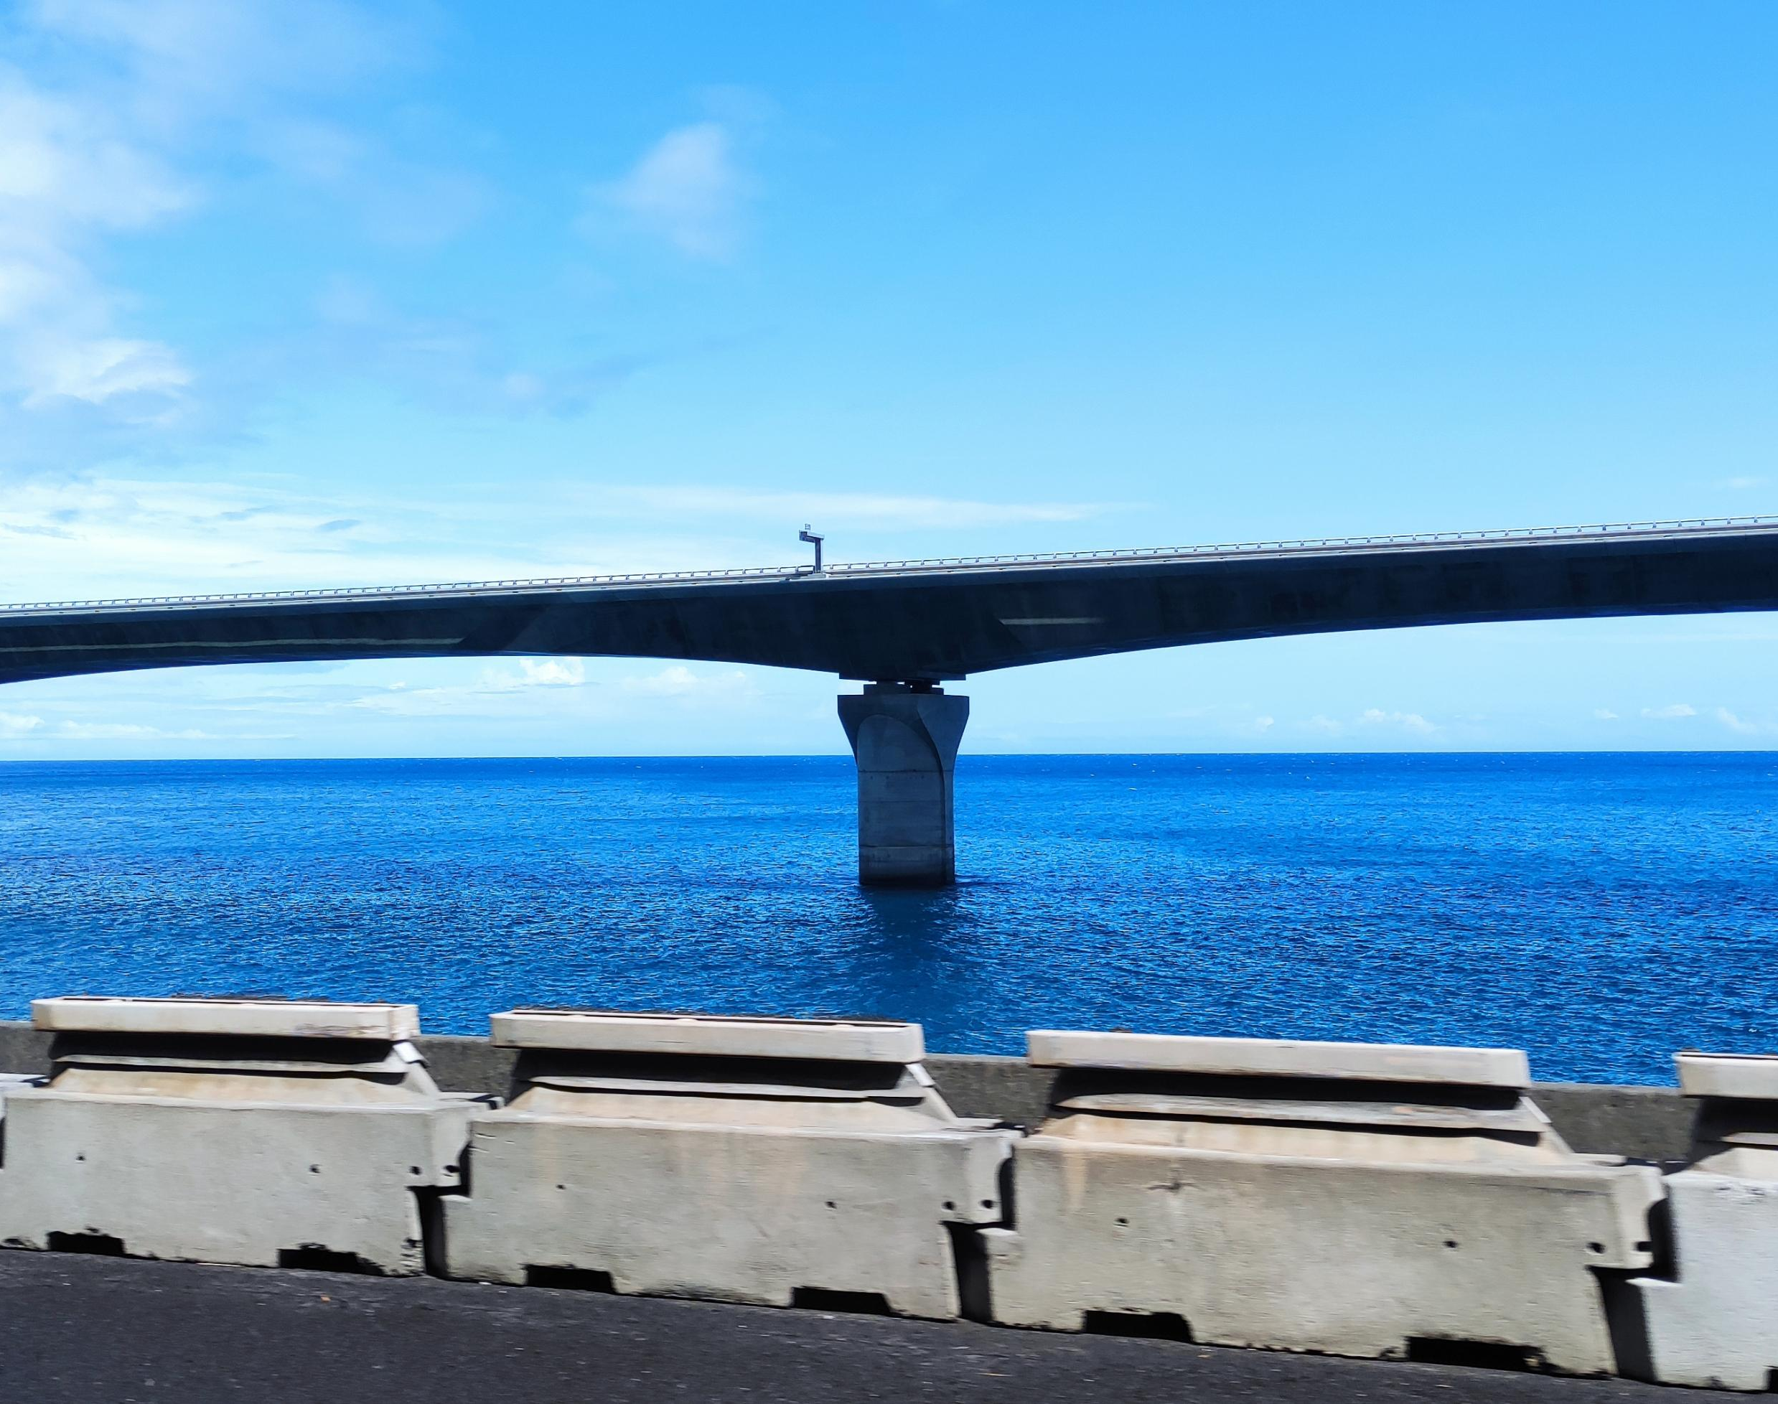
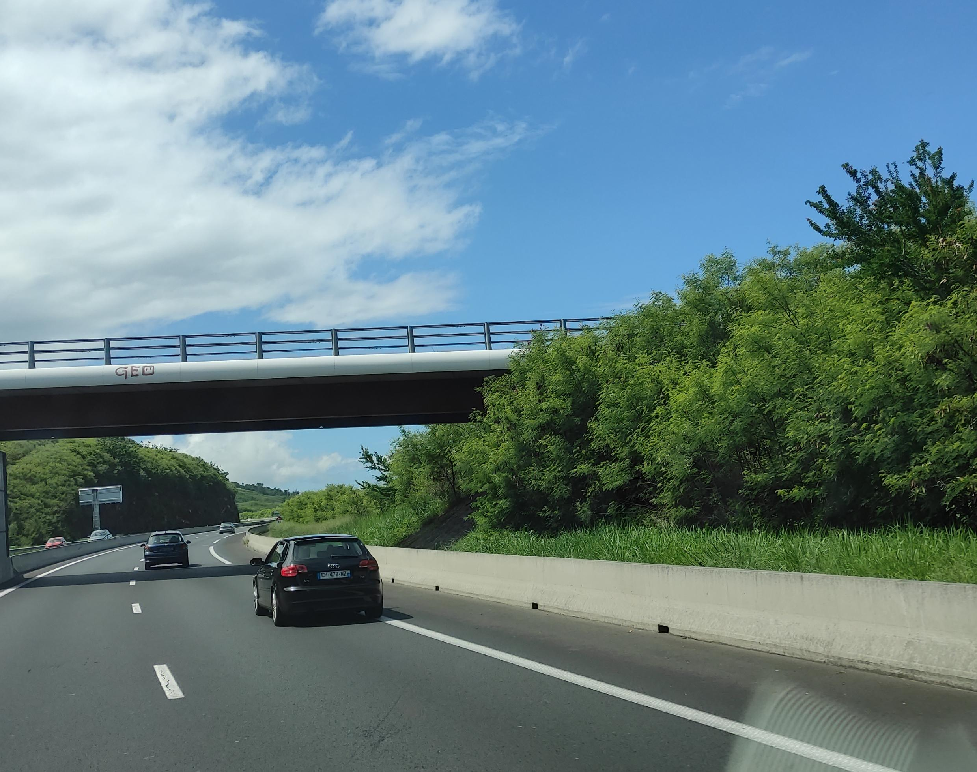
10 minutes later the weather turned sunny and warm again. We had to go to the other end of the island, to the Saint Pierre part, to be given to the families. We packed our bags again and placed them in the car waiting for us downstairs. We stood next to the driver and sat down together. We had a little talk with the driver throughout the trip.

Slide 15
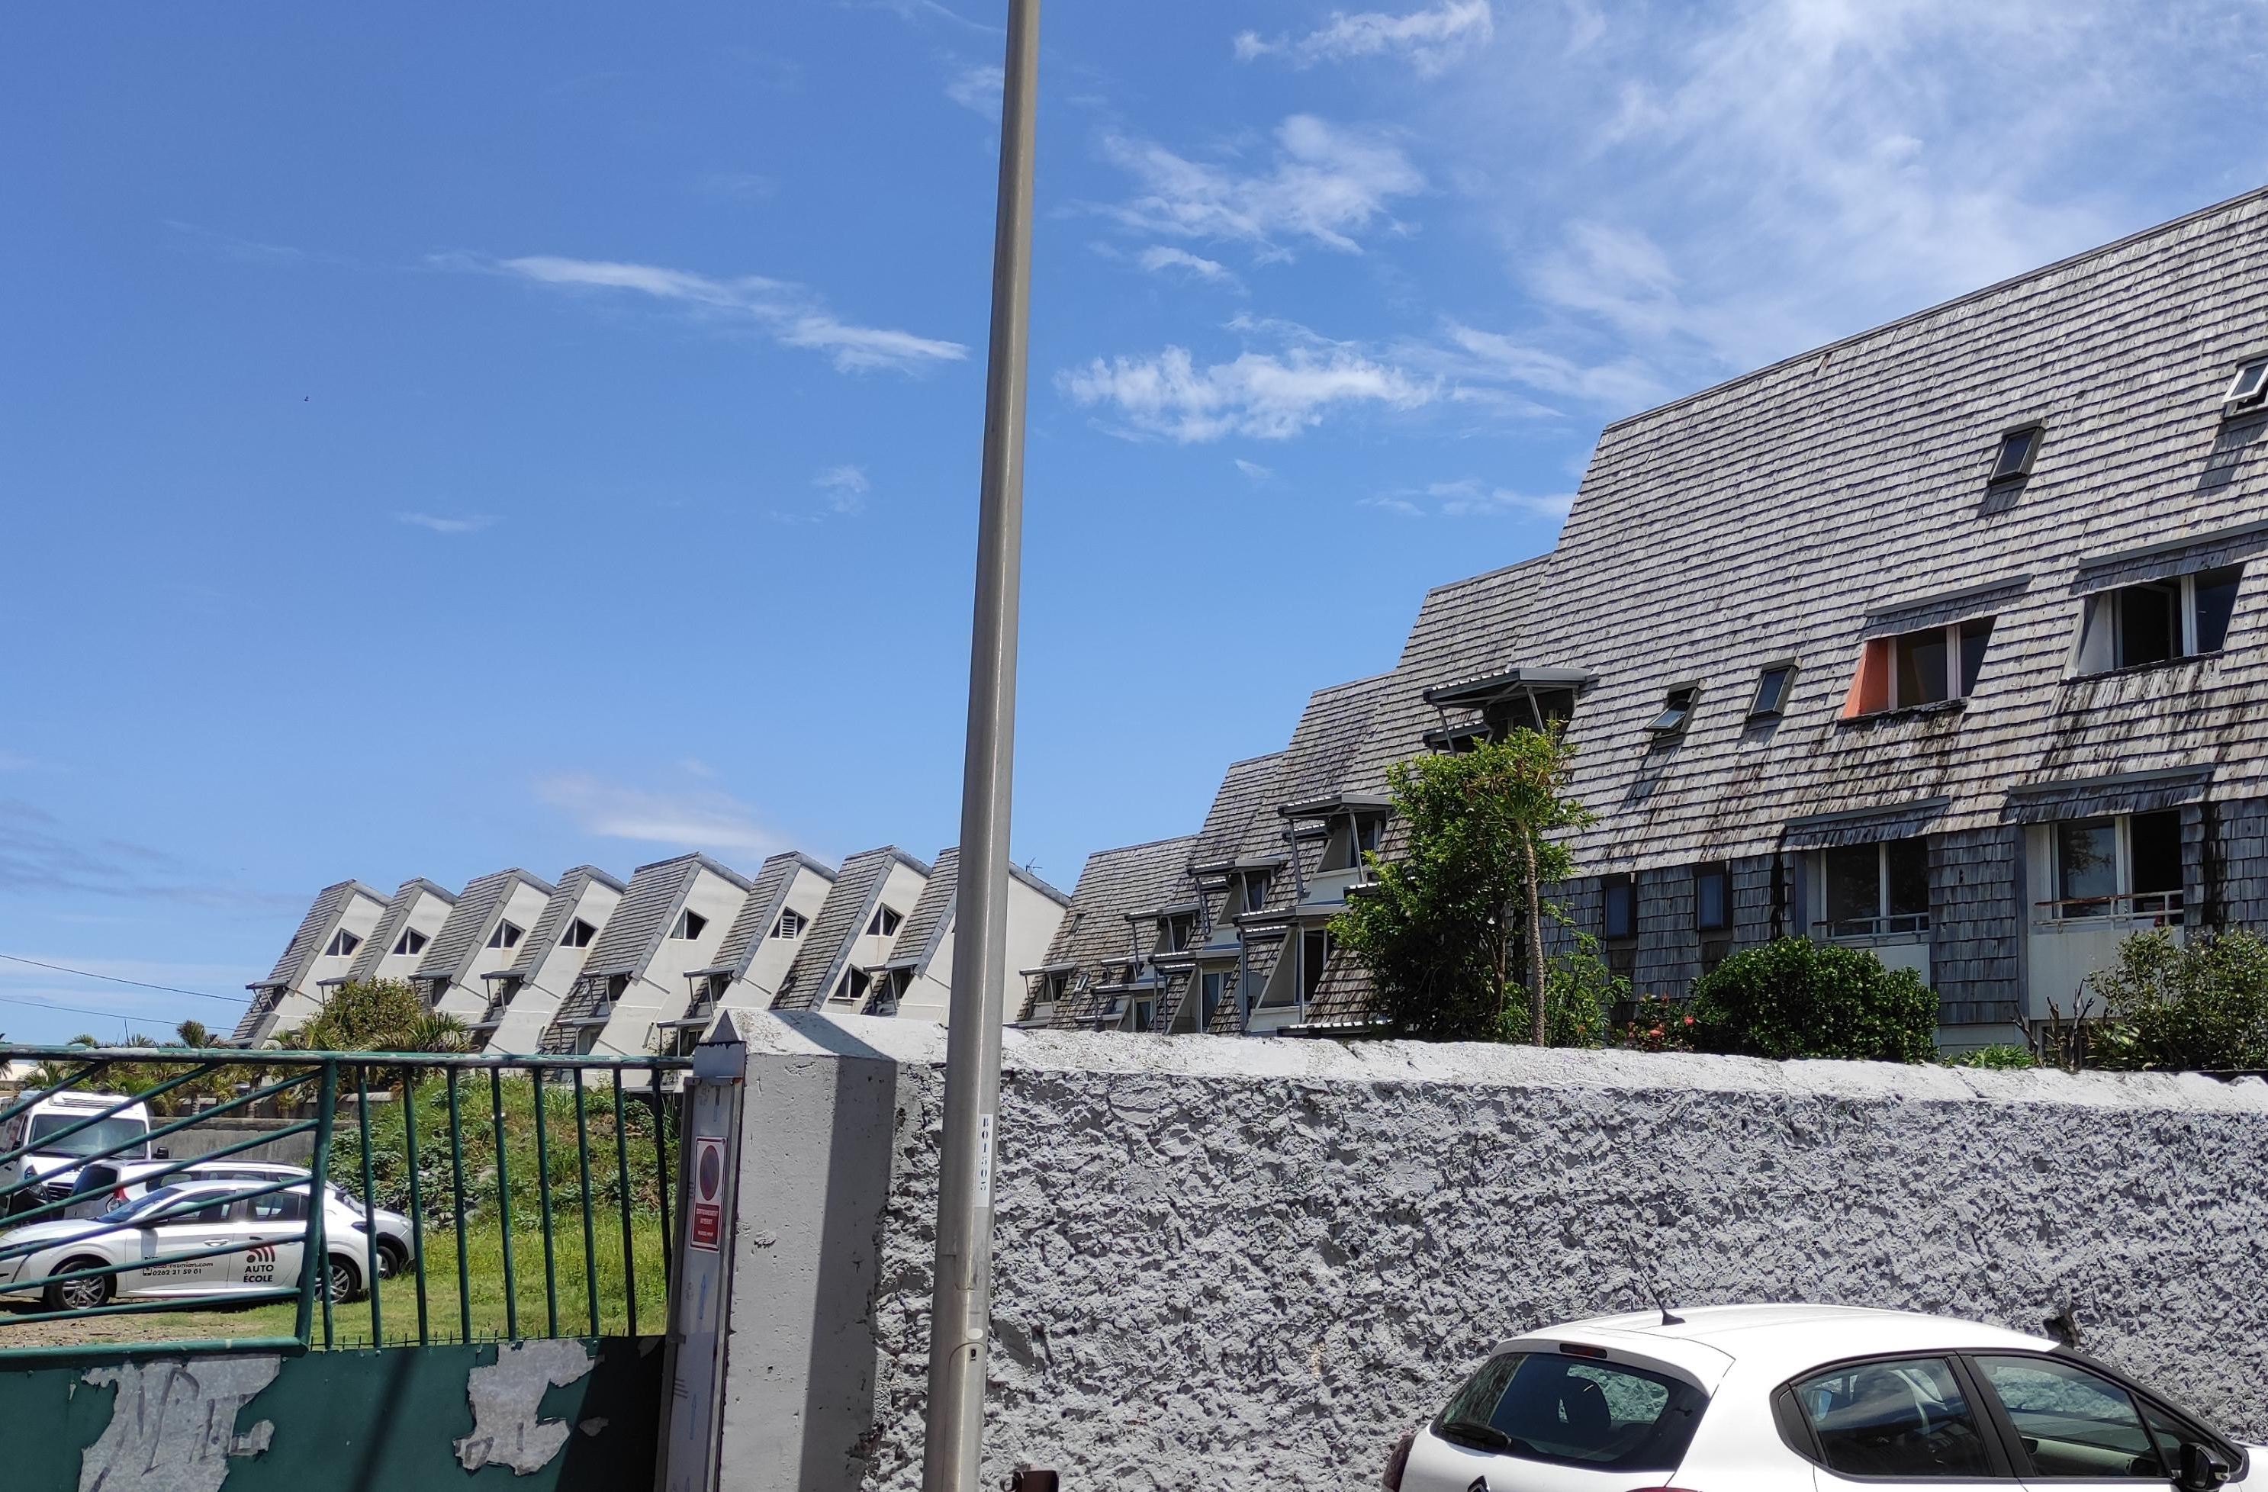
Aline ( teacher coordinator ) was waiting for us when we arrived in the city of Saint Pierre . Our family had not yet arrived. Several families were waiting for their student .

Slide 16
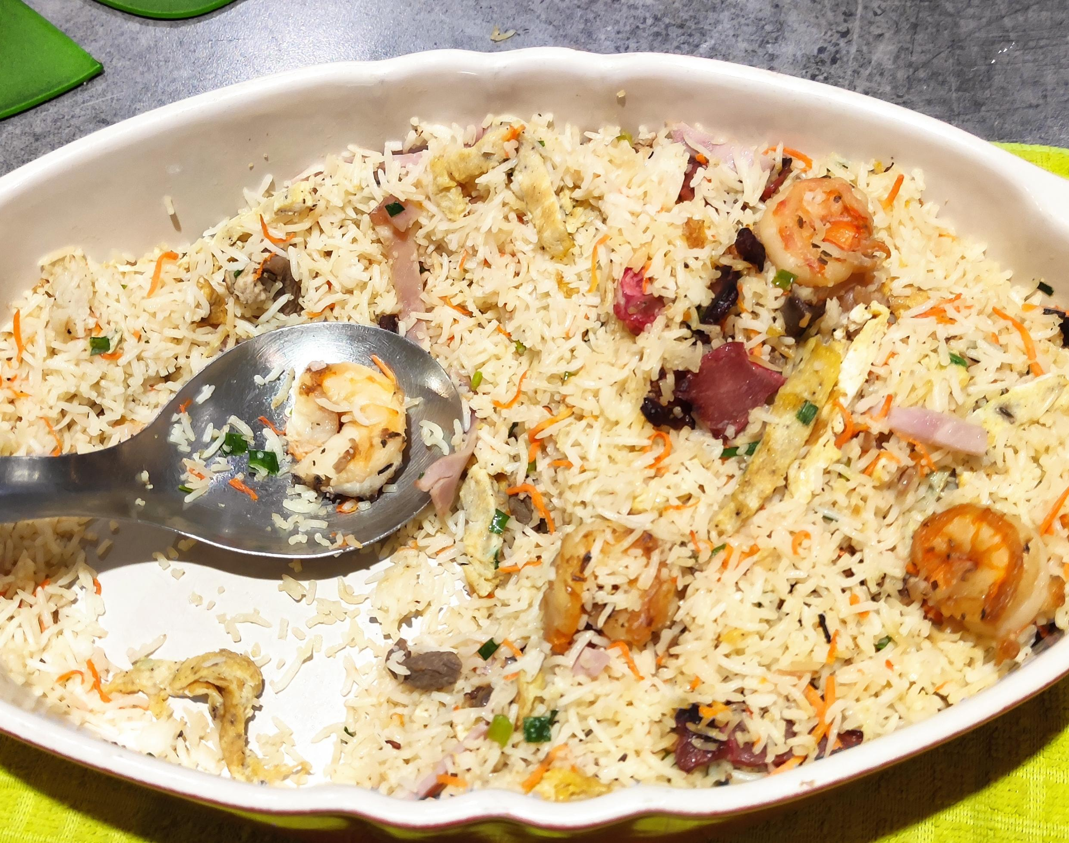
Our family came. Durmuş and I, Reigo, settled in the car. During the journey, small conversations passed between the 3 of us. I was quite surprised when we got home. There was a jacuzzi, sauna, etc. in the house. It had Doubleks and a huge hall. We were staying on the 2nd floor and we had a PS4 in our room. The house had a small garden, 3 of us went downstairs. There was Hannah who came with Erasmus at the house besides us. She was Norwegian, she spoke French and English. We sat under the tree in the garden and started chatting by introducing each other. After chatting until the meal was ready, we set the table together. The food arrived and was placed in the middle of the table. It smelled and looked strange. It looked like rice pilaf and meat. Next to it was chicken. There was a plate of fork and knife in front of us. Everyone was getting their own food. I ate a spoonful of the food and asked what was in it.

Slide 17
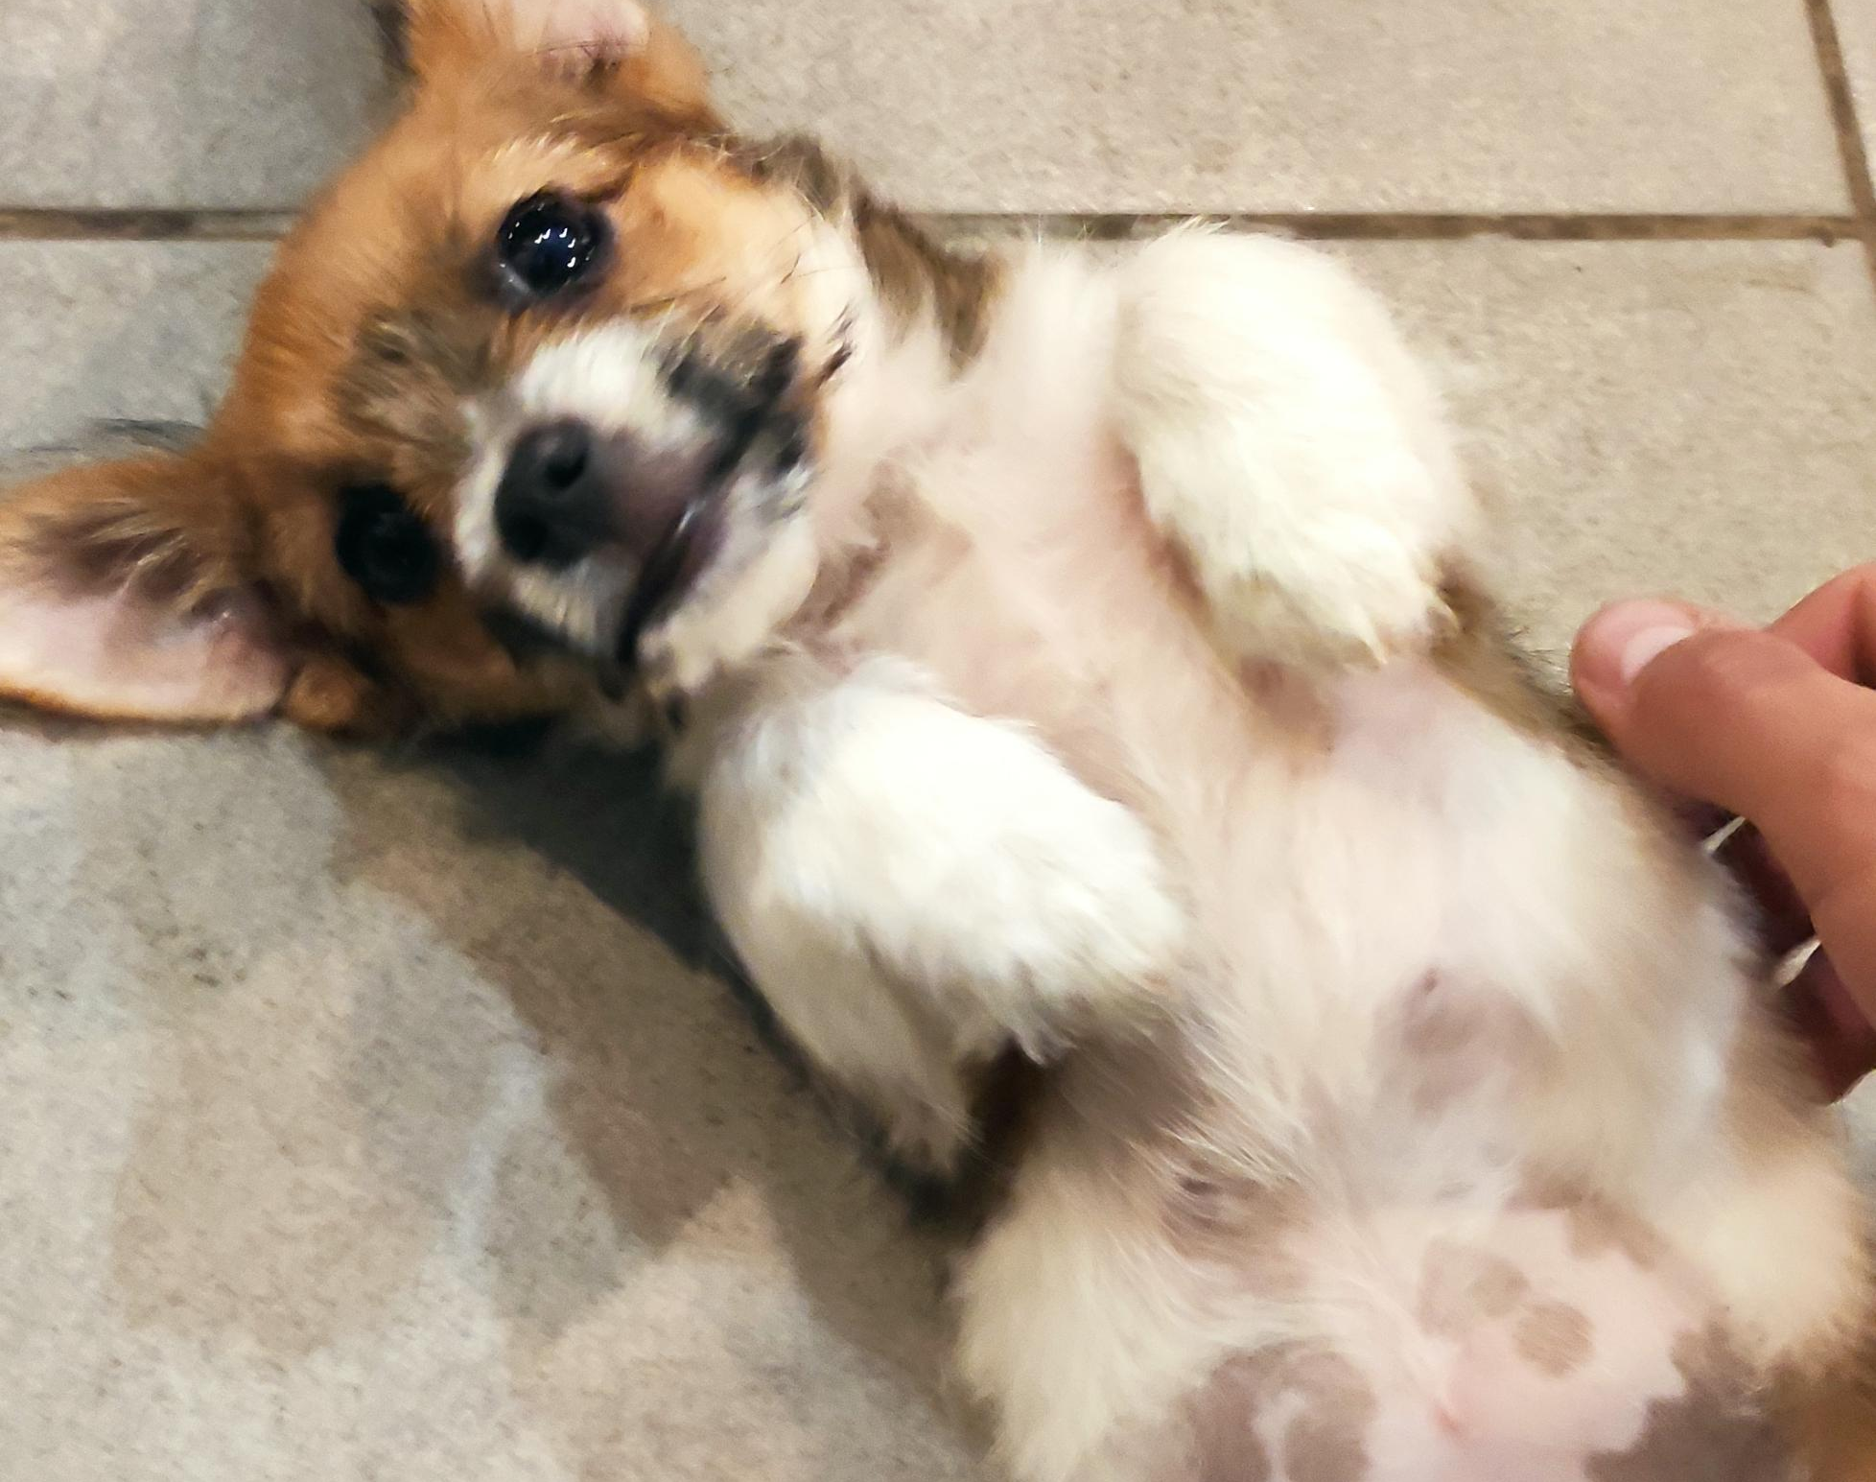
And yes, it has pork in it. We stated the situation and after explaining that we cannot eat pork, we ate chicken. After the meal, everyone would partially clean their dishes and put them on the counter. We did the same.

Slide 18
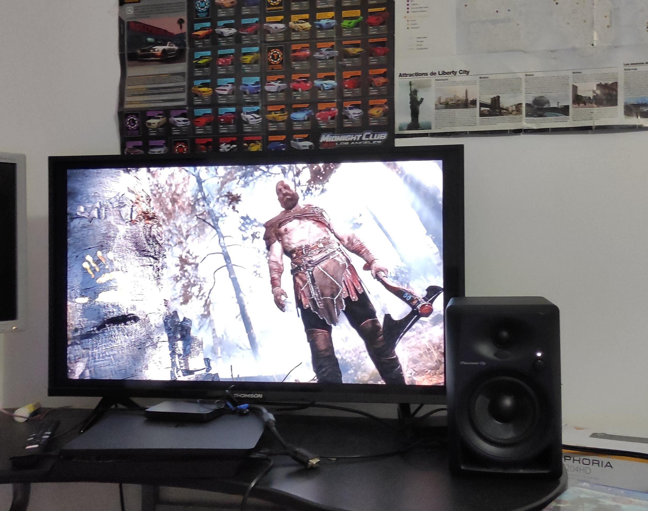
They had a small dog named Taliyah. We played with it a little. We chatted again. Afterwards, everyone gathered around the counter and handed over the gifts they had brought for the family. They were very surprised and happy , I guess they were not expecting it . We went to our room to rest. We played a little PS4 and slept.

Slide 19
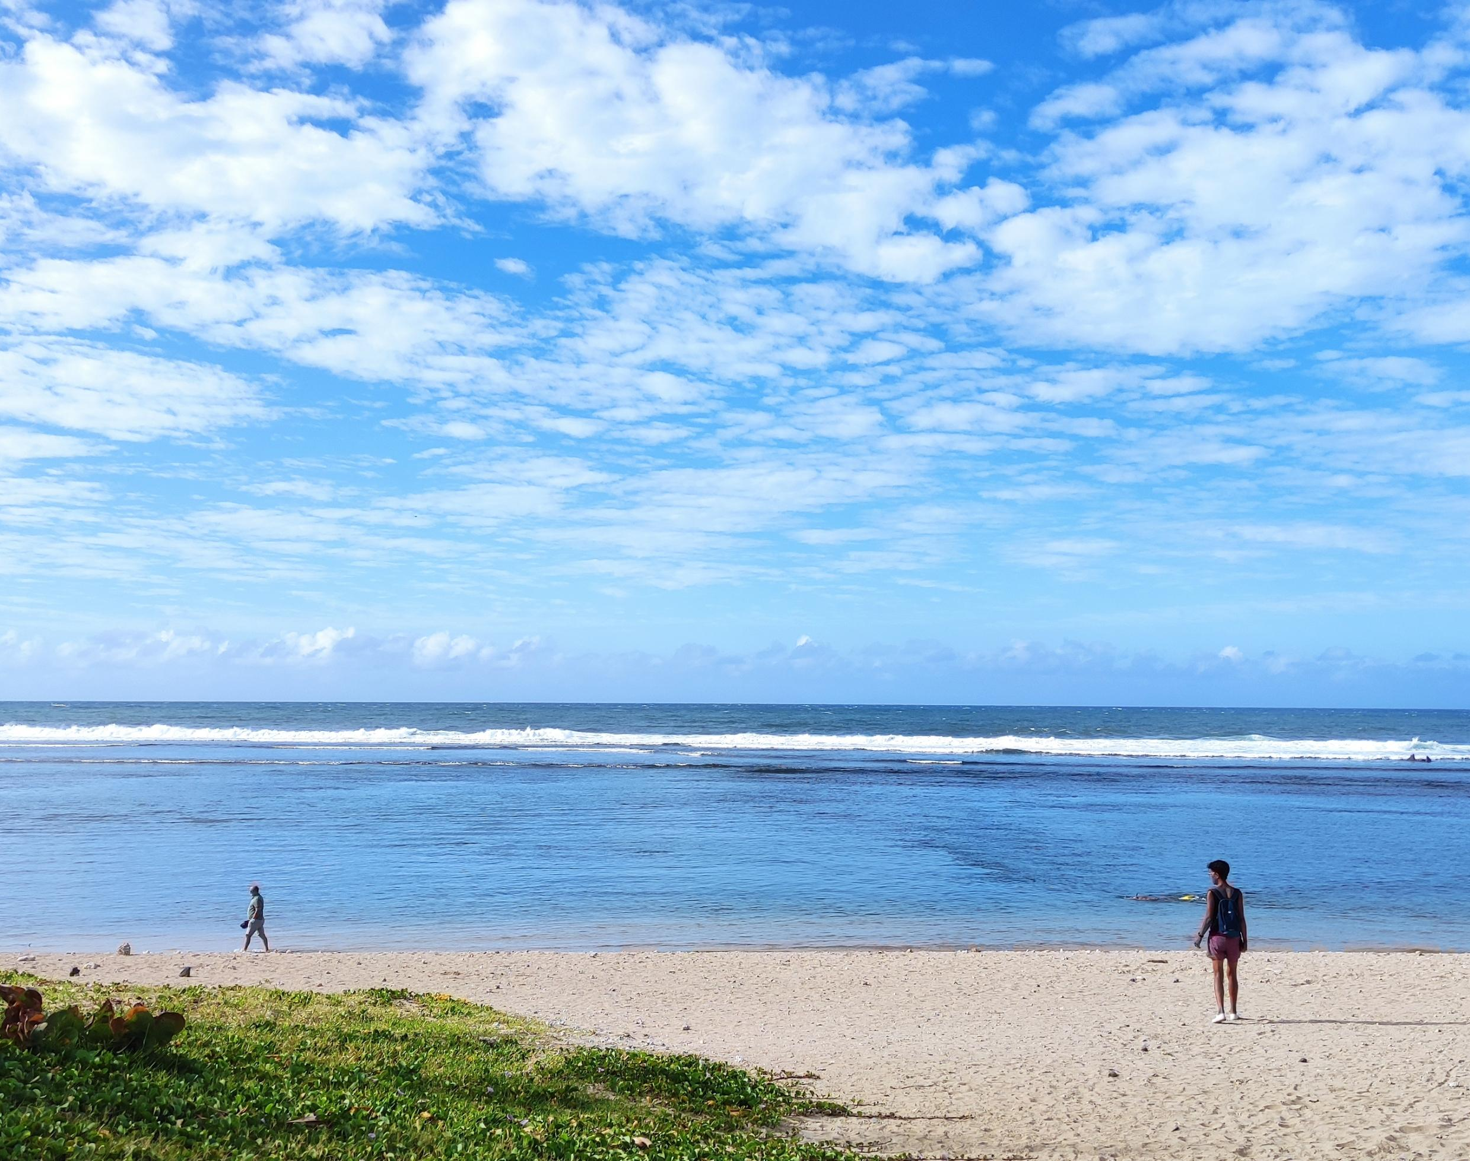
14.02
The program would start at 7:30 at school. We woke up at 6 am, got ready and got into the car that was waiting for us below. We met at school. All the students went shopping to a small local market together . We were given a piece of paper when we went shopping. The paper contained words in English, French, and the island’s local language, clore.

Slide 20
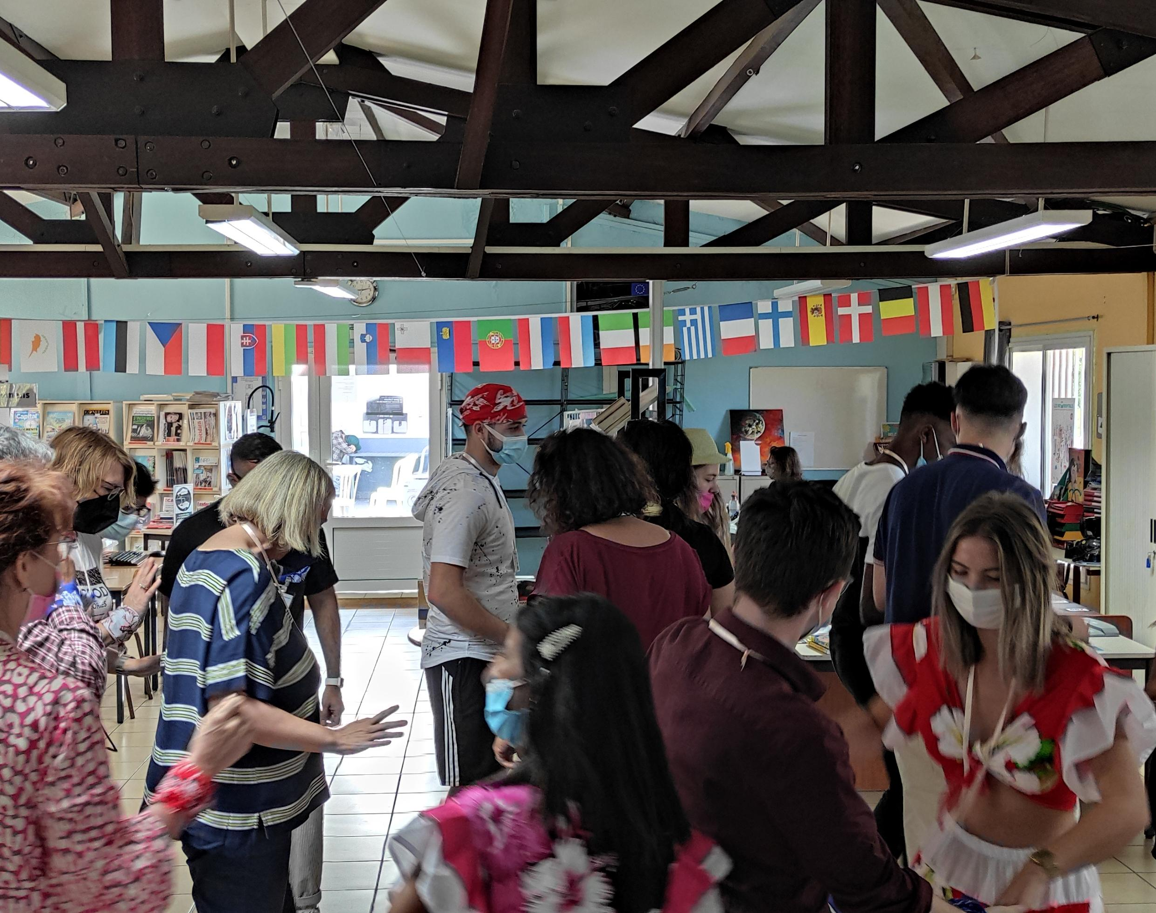
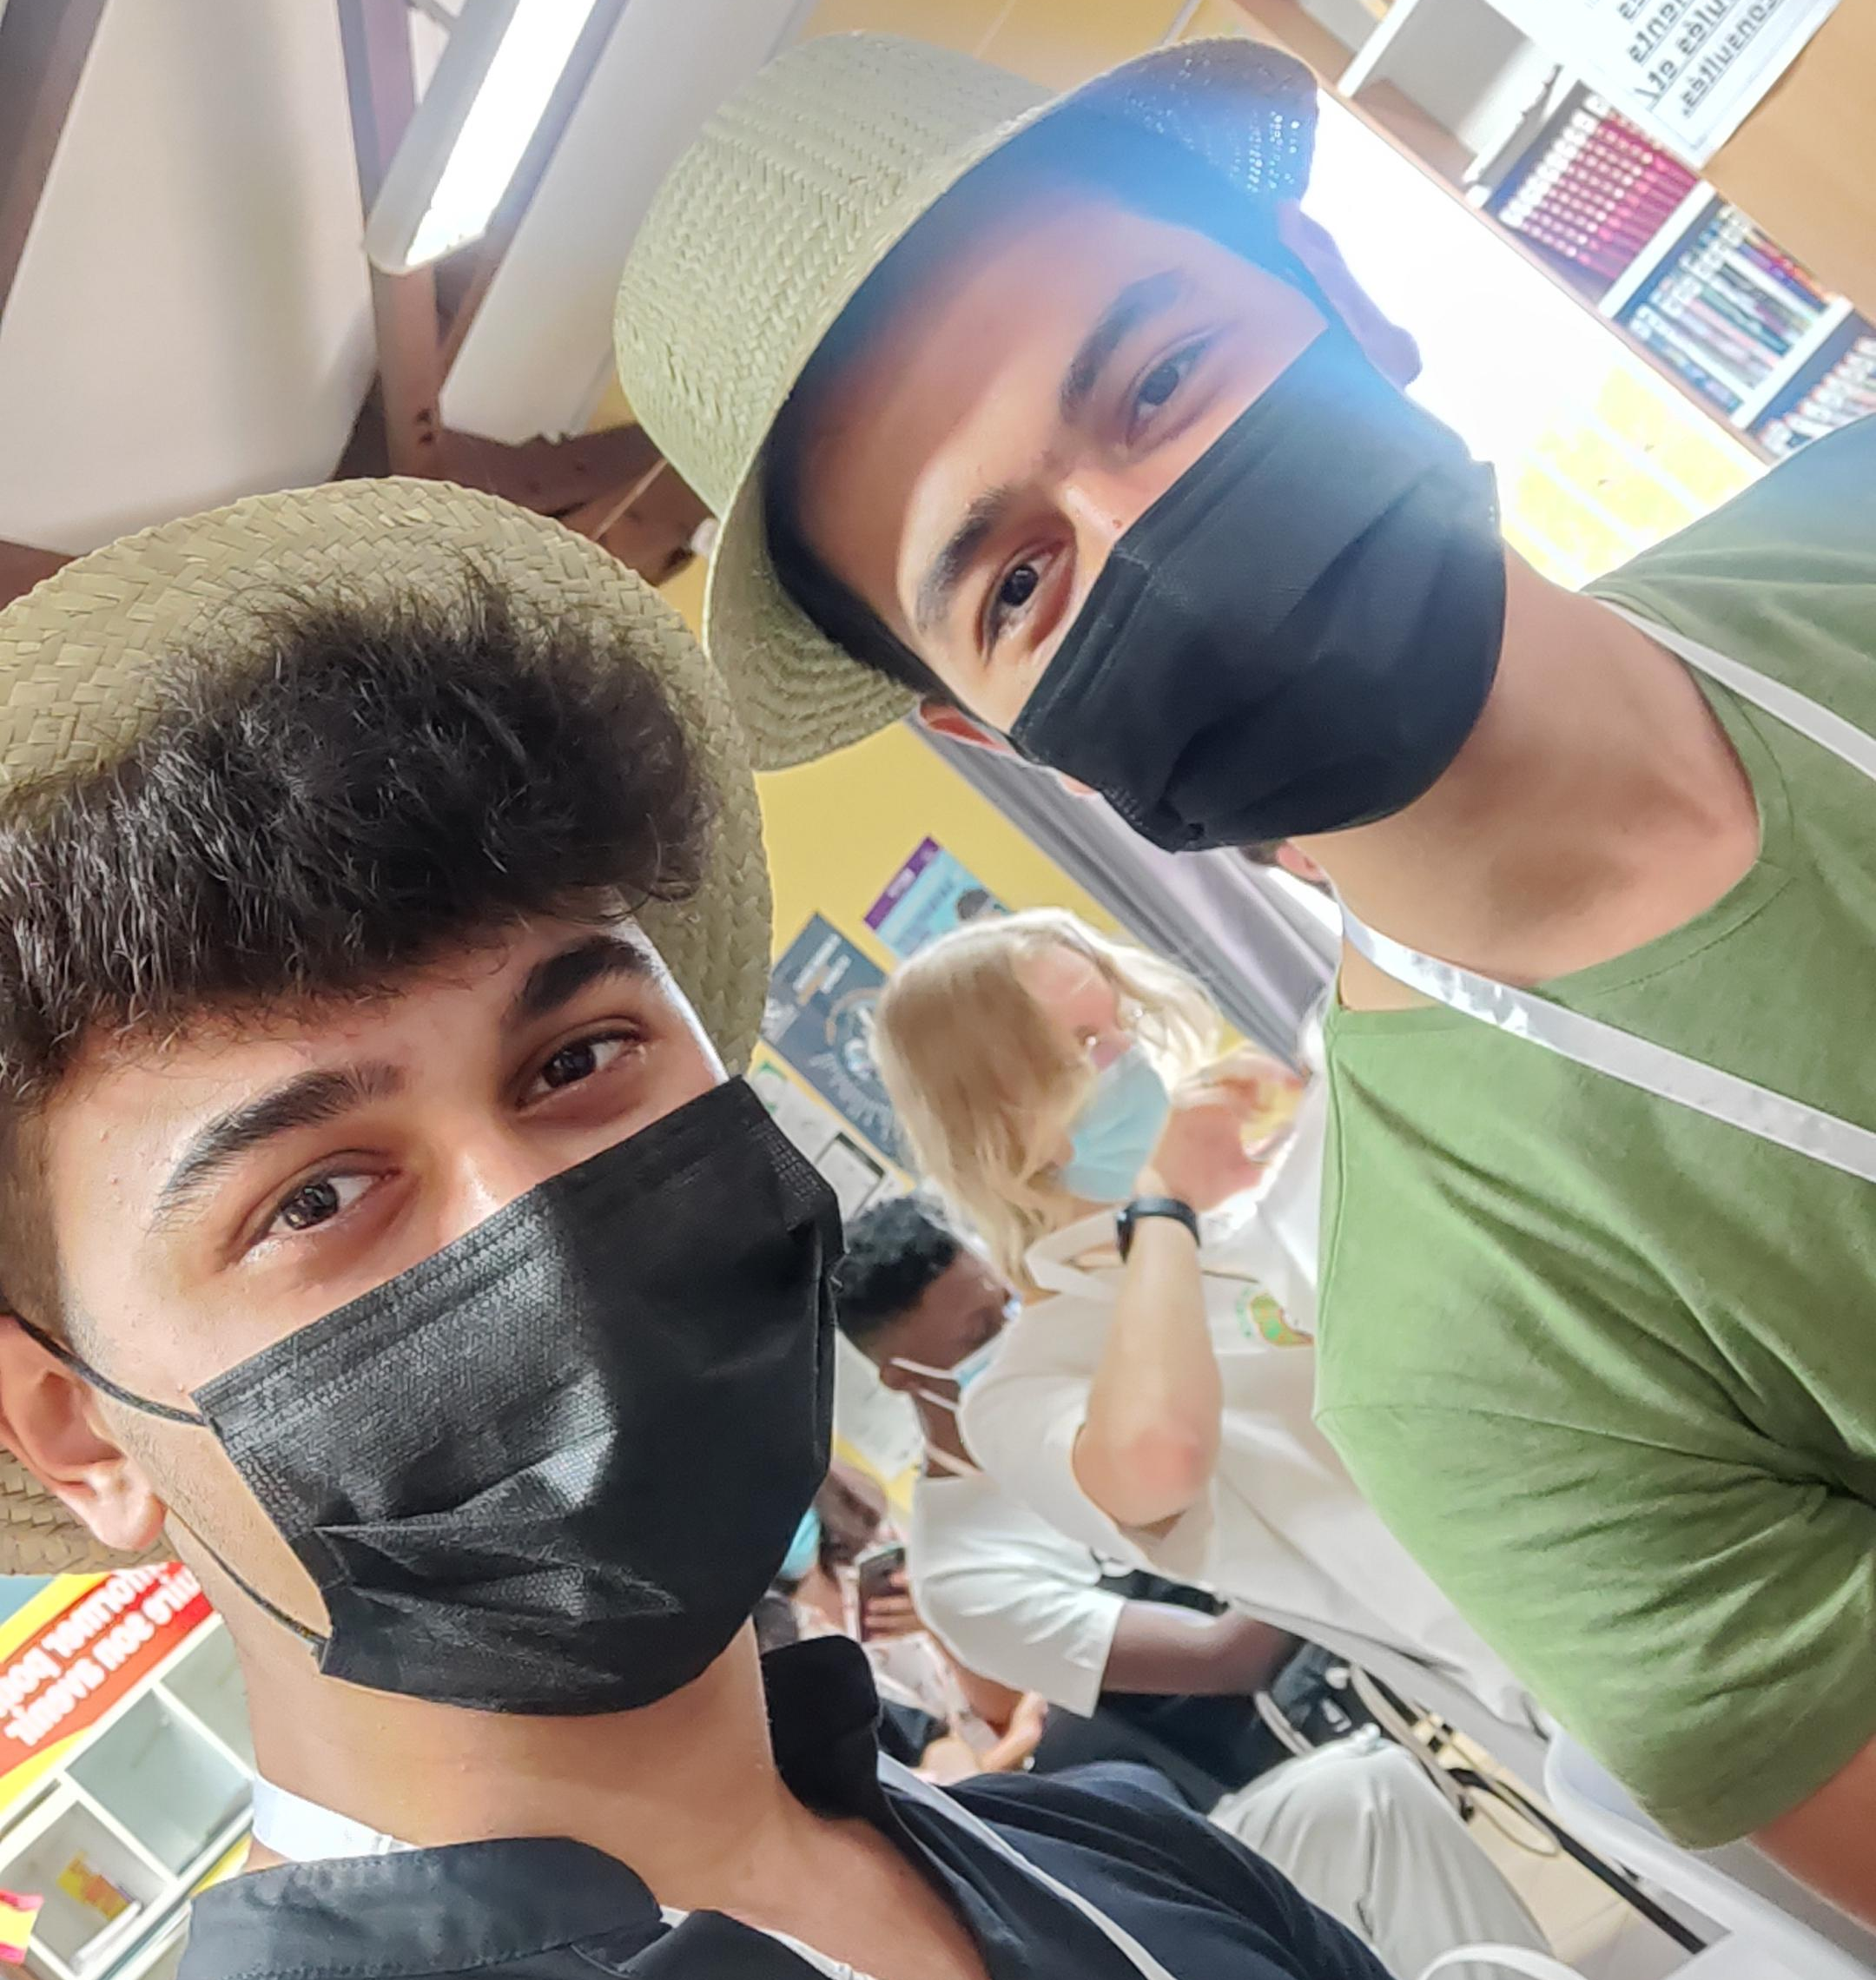
After shopping, we went to the beach. After resting for a while, we went back to school. The weather was extremely hot. We went to the school library. All the teachers and all the students were there. After short speeches , small gifts were given , games were played and danced . They were fun times.

Slide 21
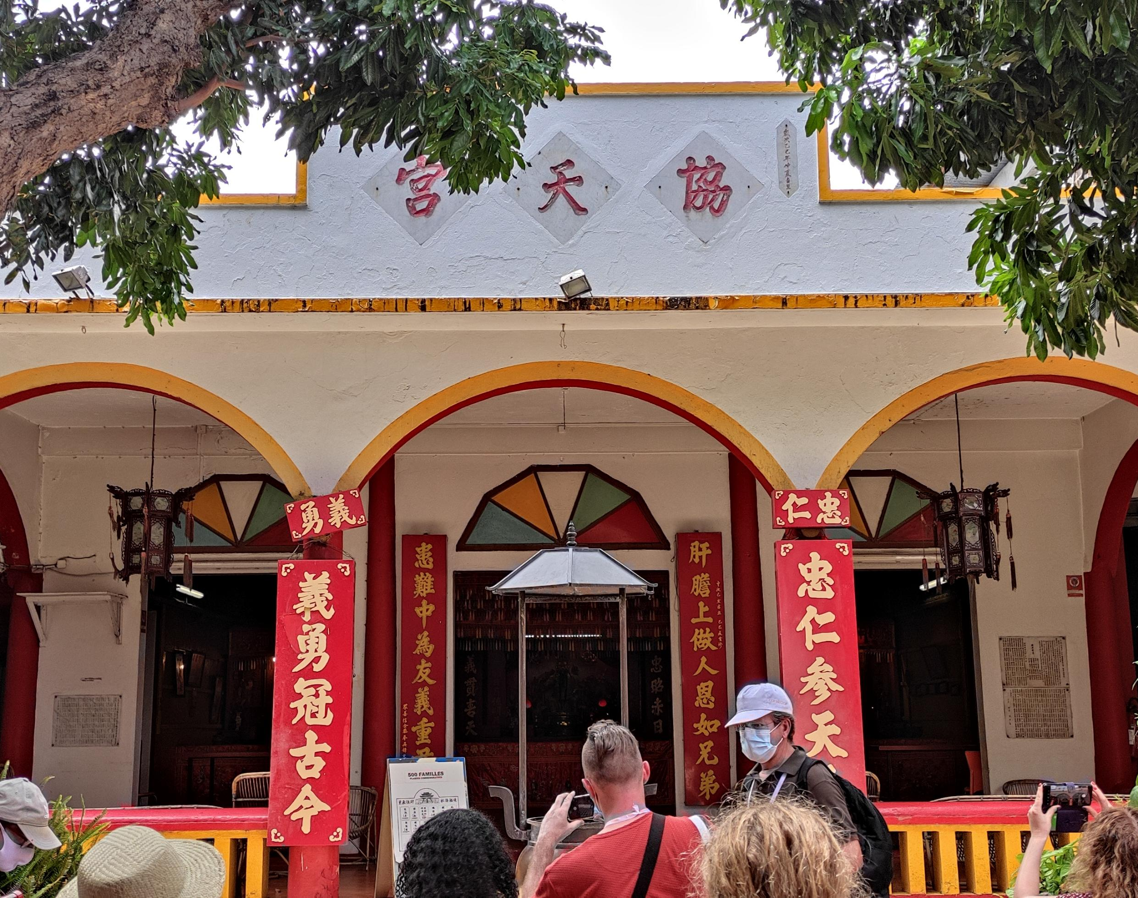
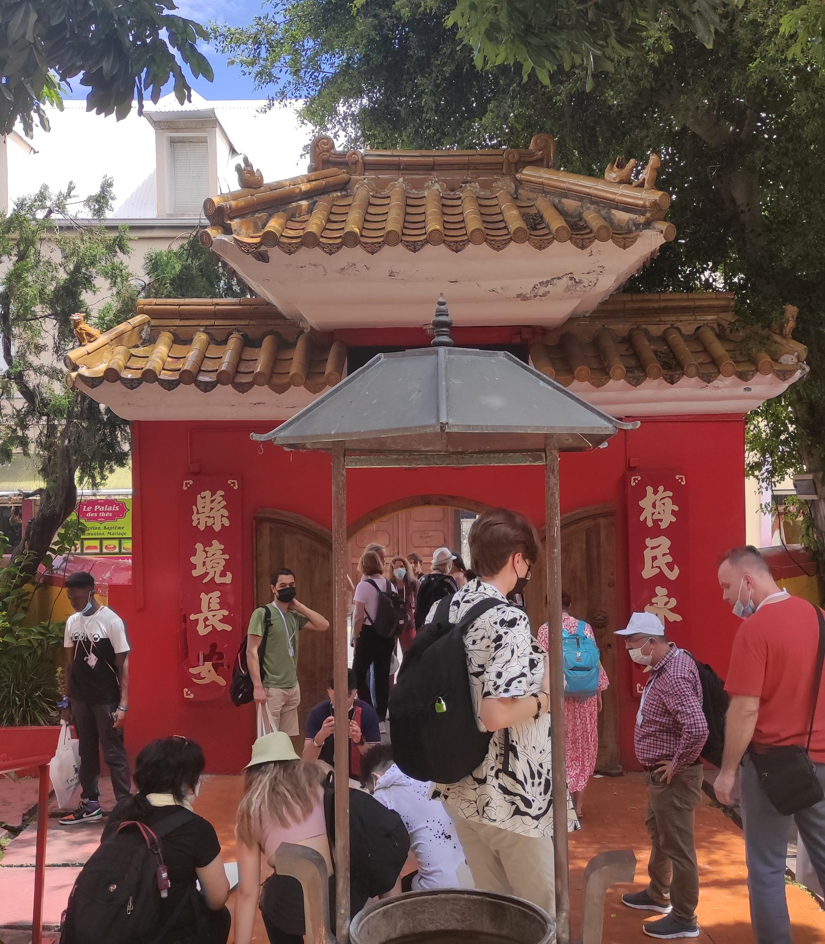
It was time to eat. After we ate our meals in the school canteen, we had free time. At that time, we spoke with the other students in the group. Then we got together again and started to visit the religious sites on the island. First we went to the Chinese temple, then the mosque, and finally to the place that Christians consider sacred.

Slide 22
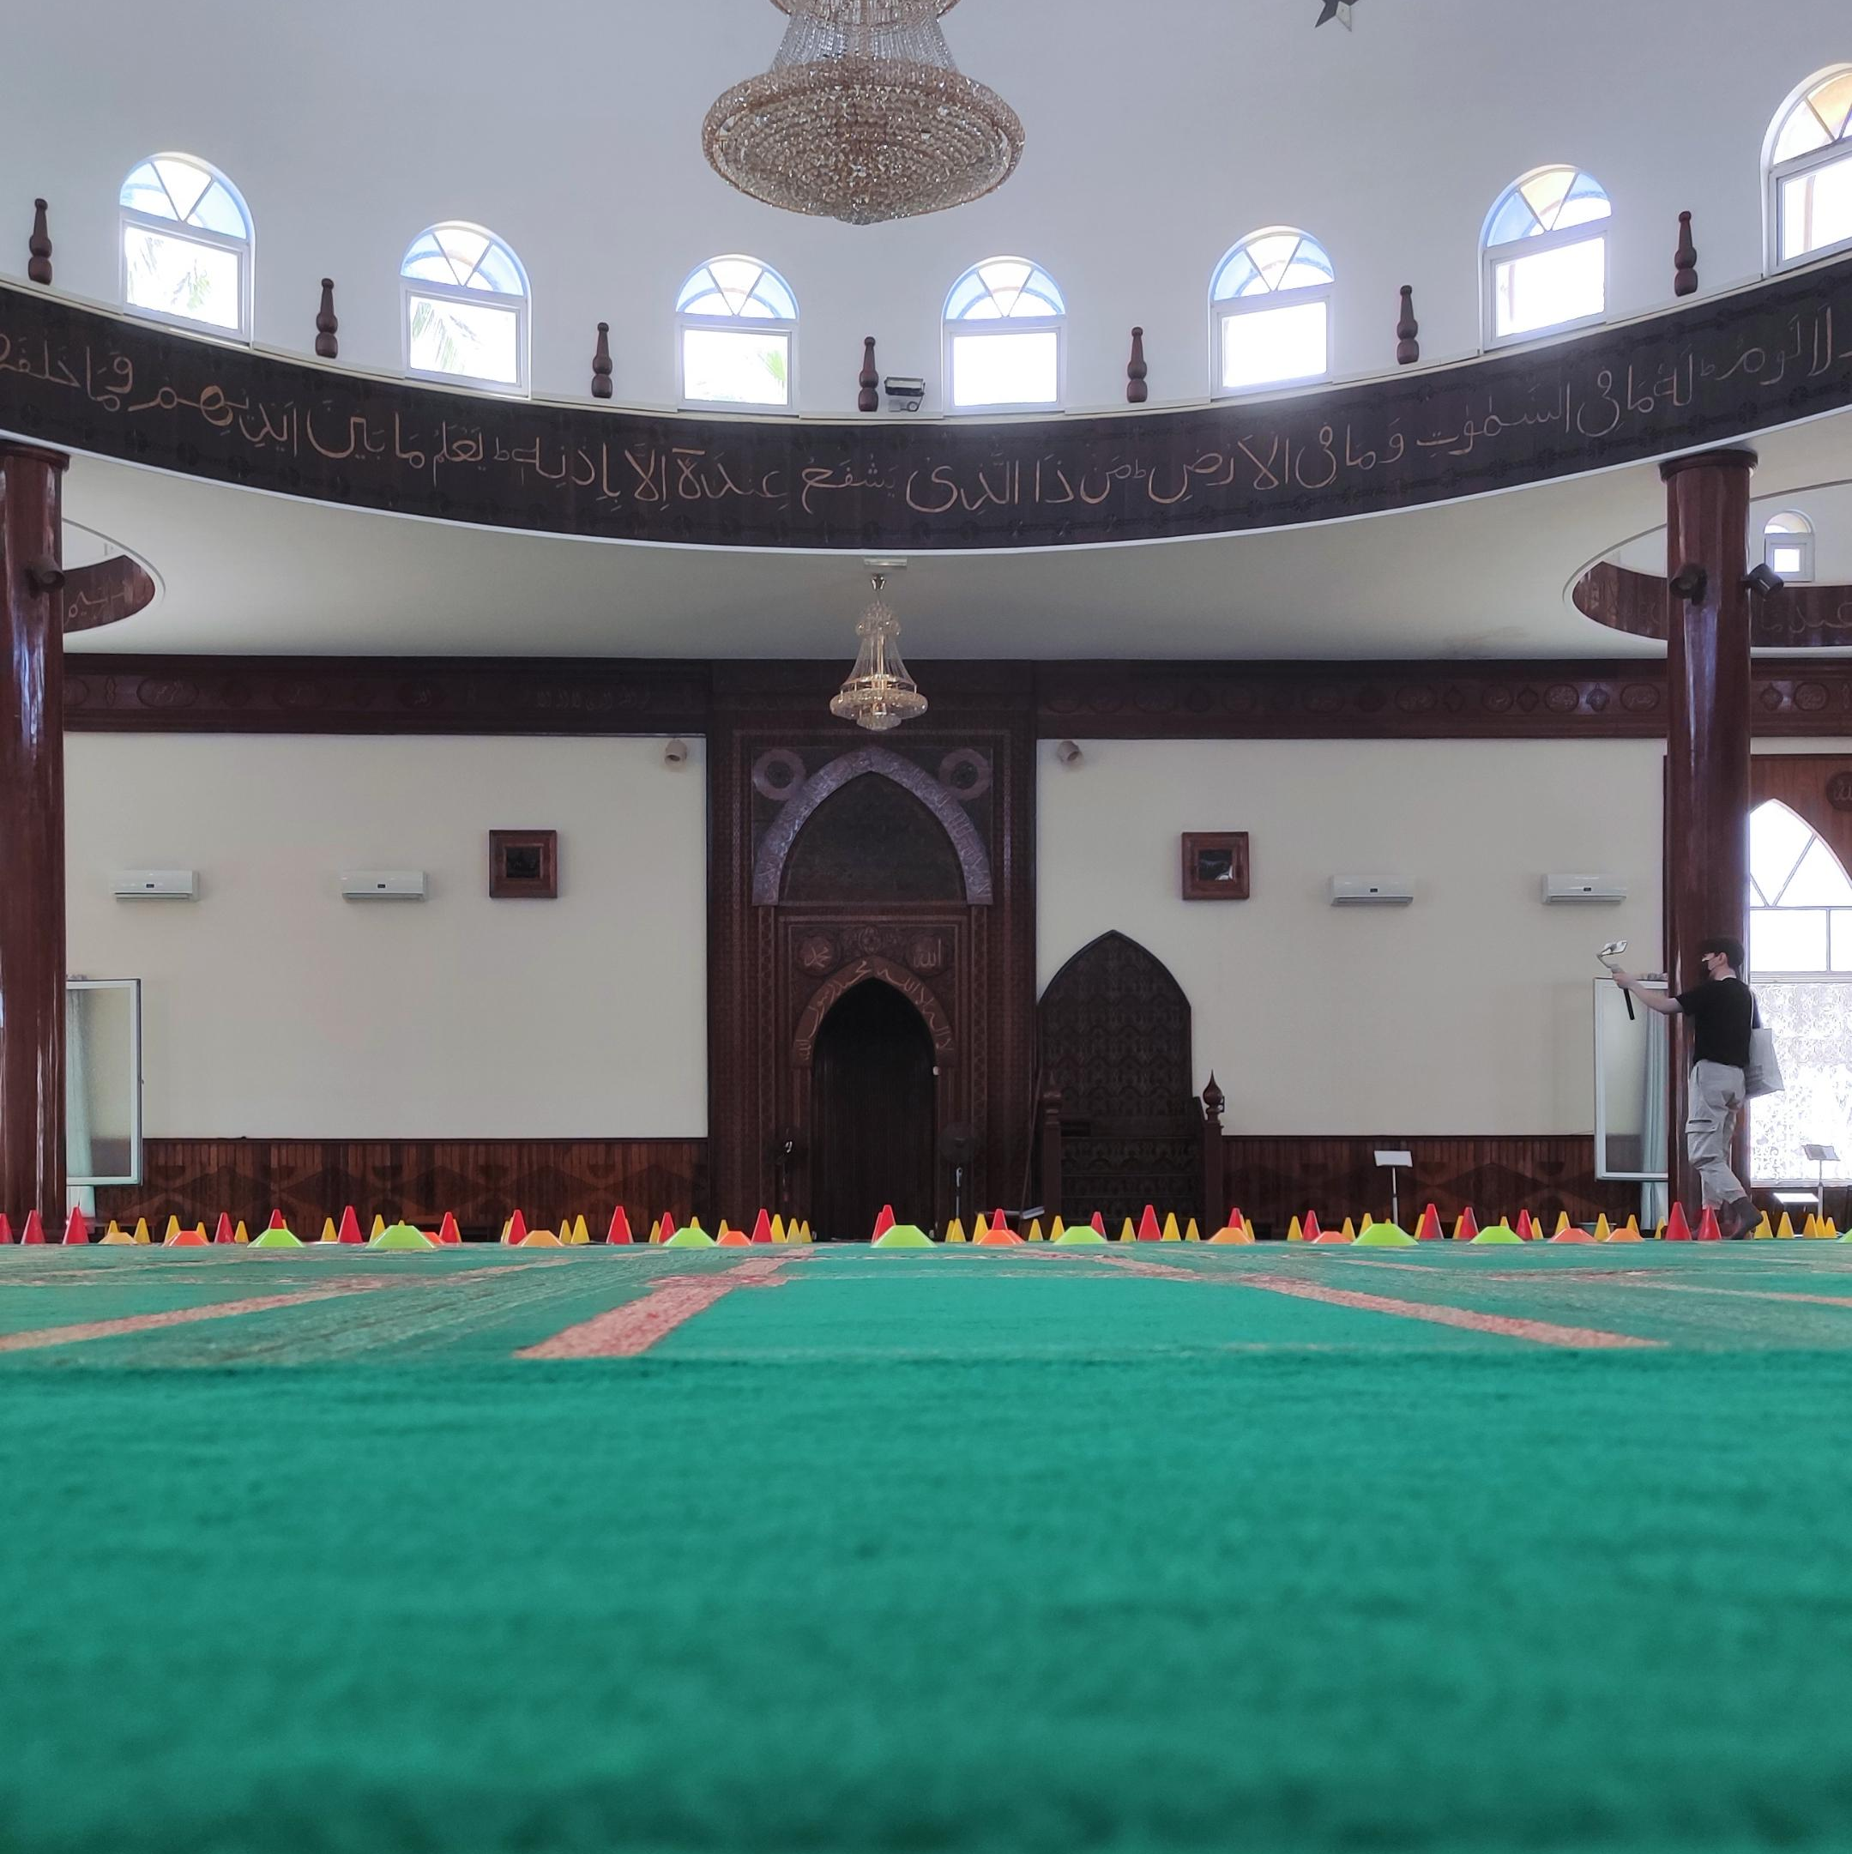
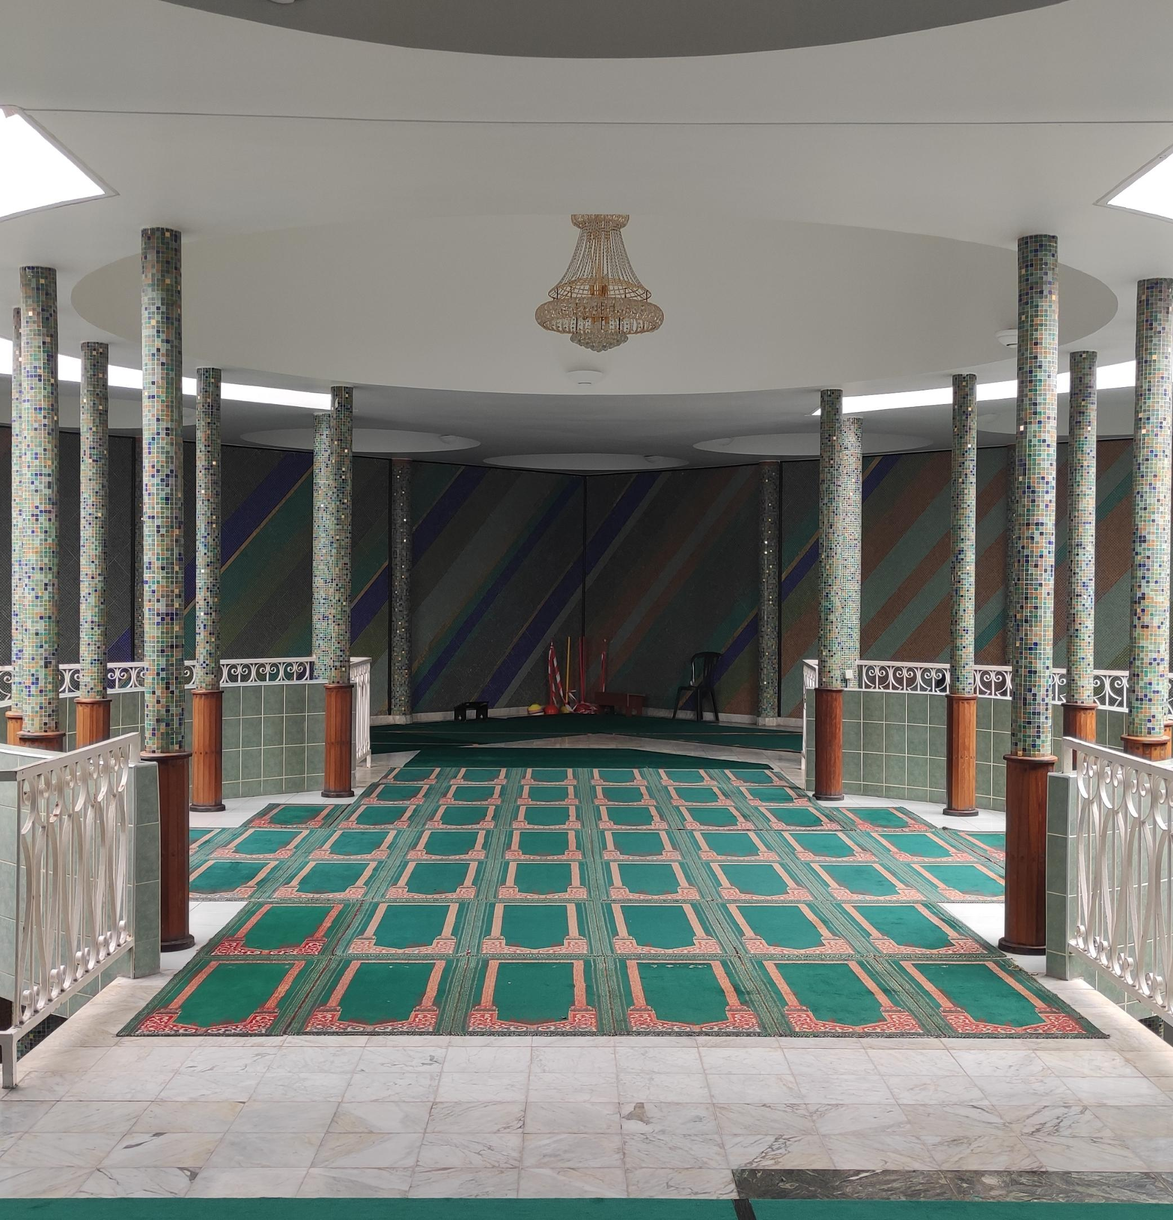

Slide 23
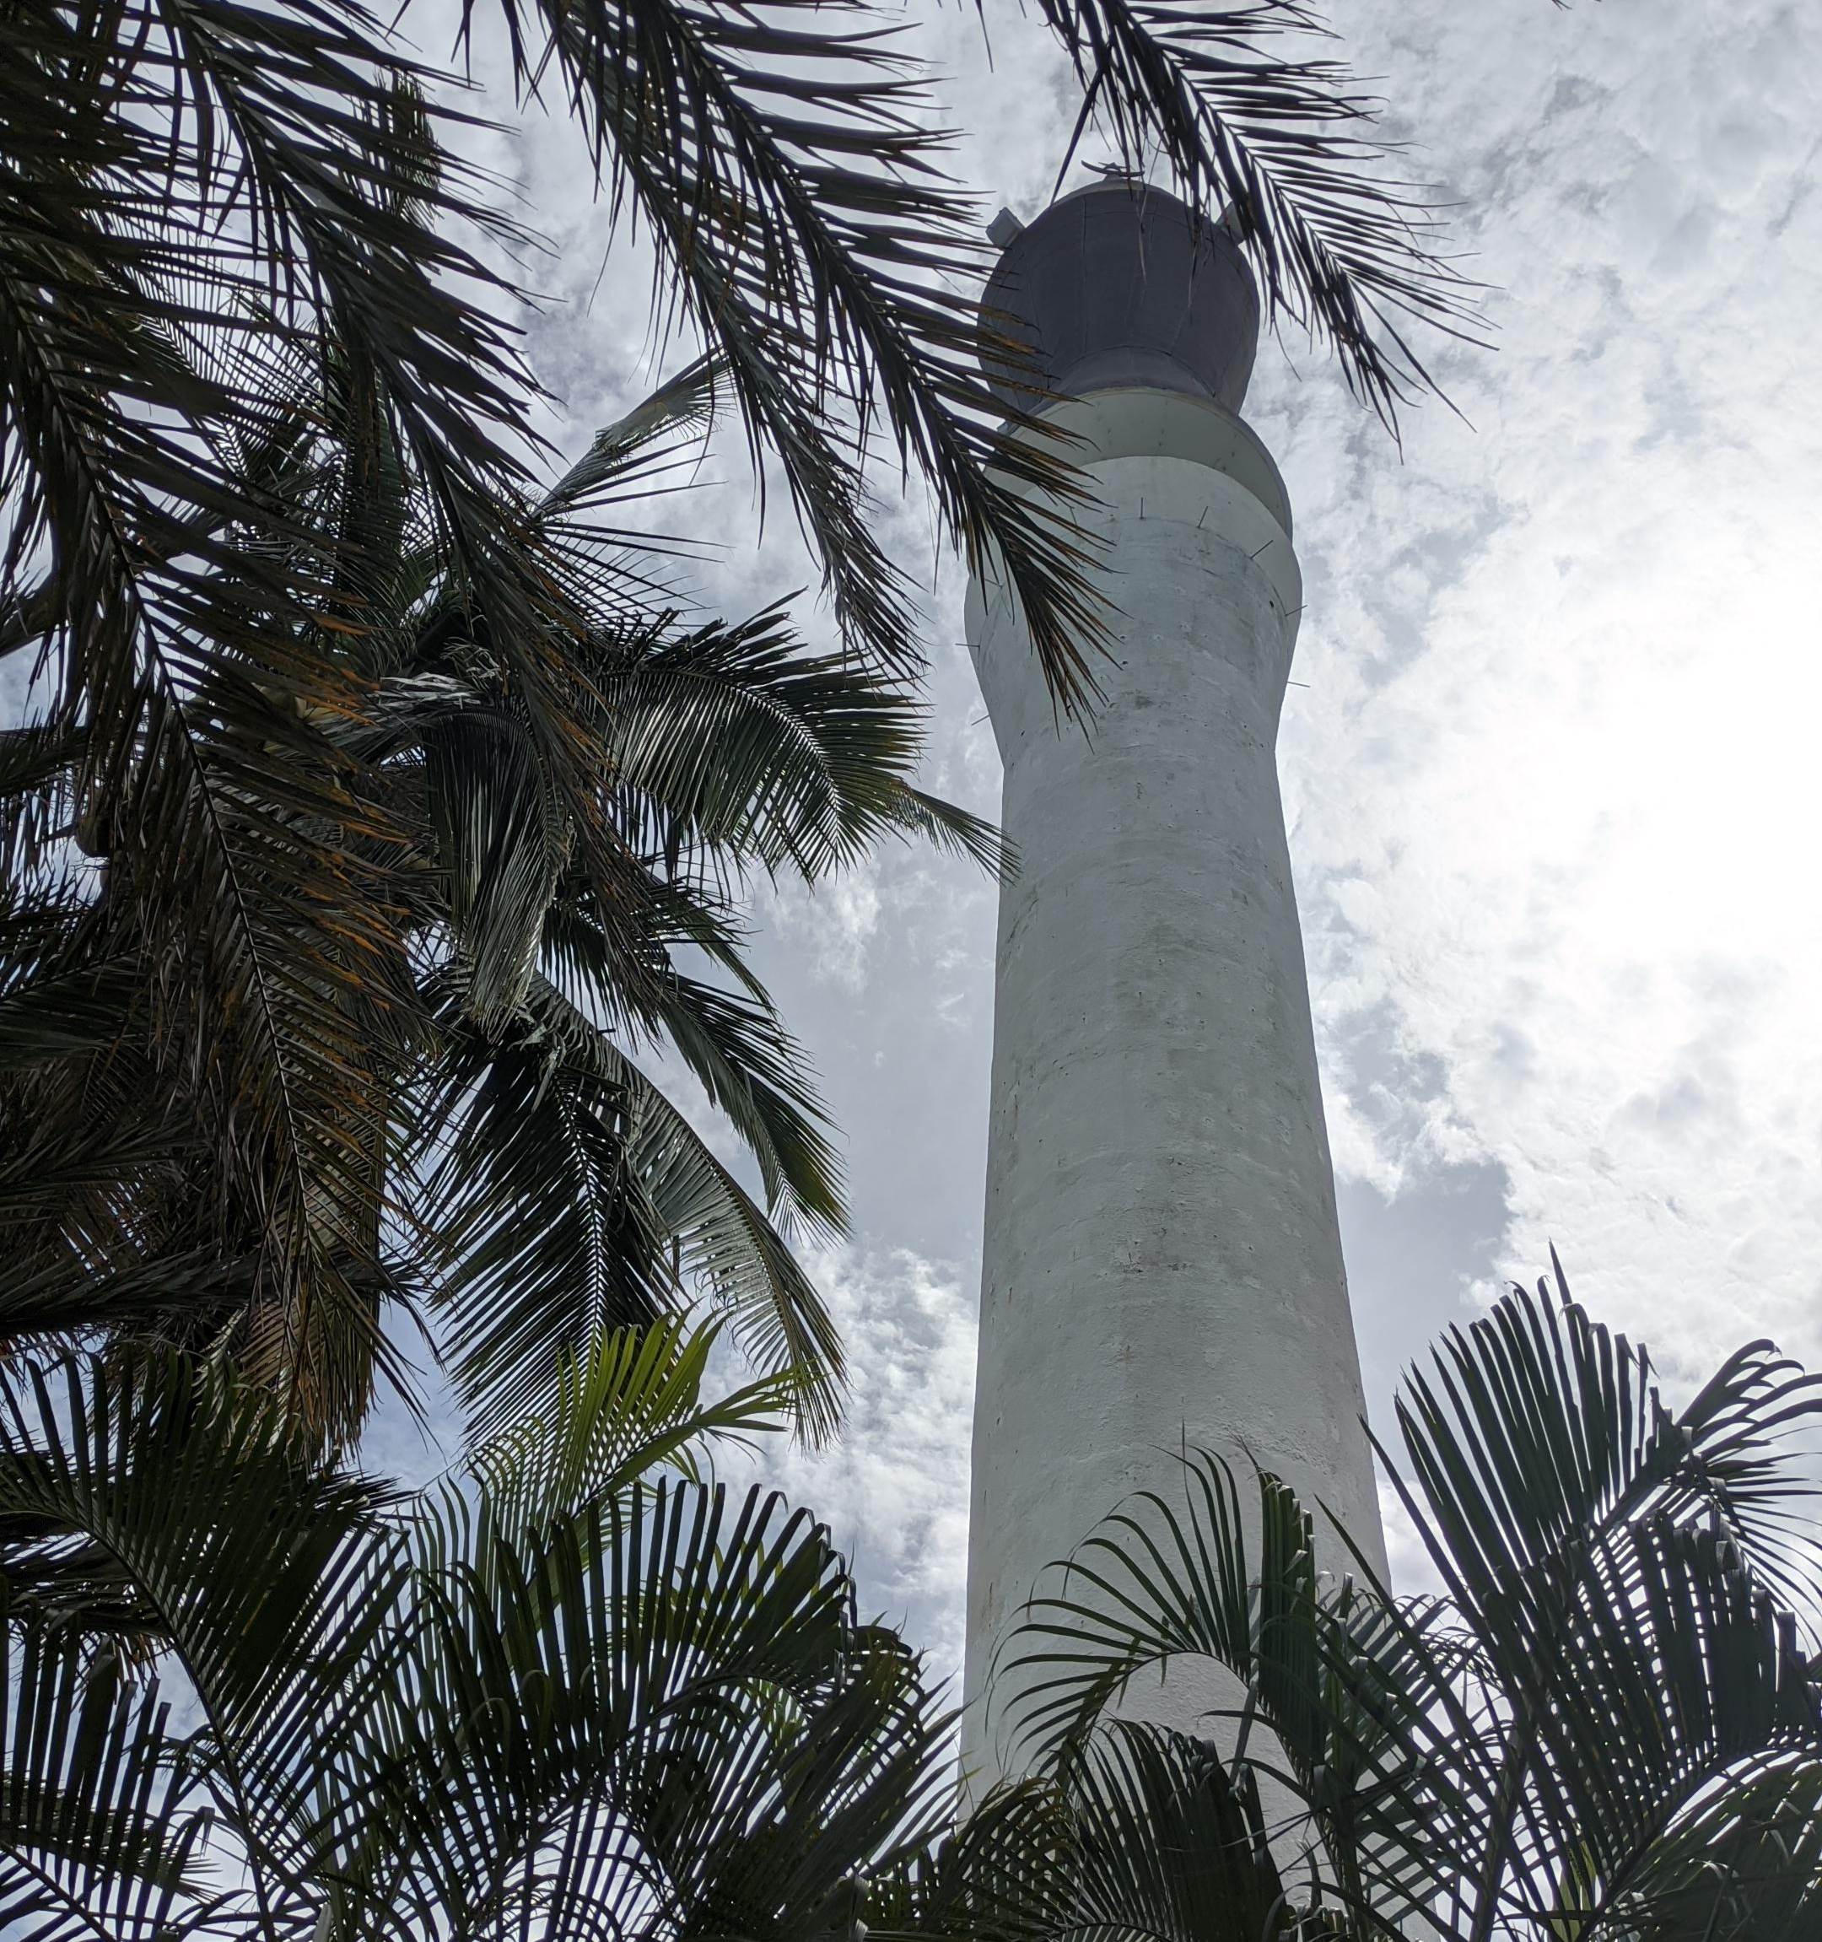
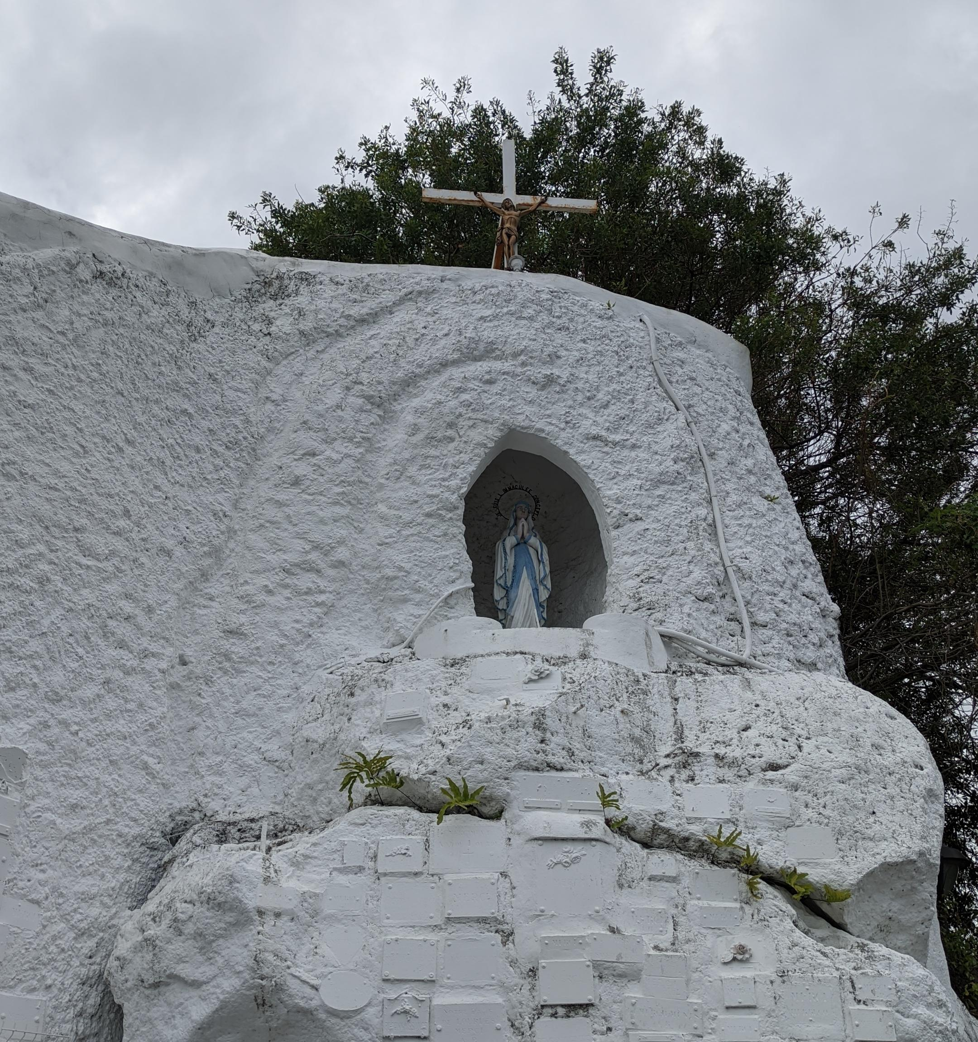

Slide 24
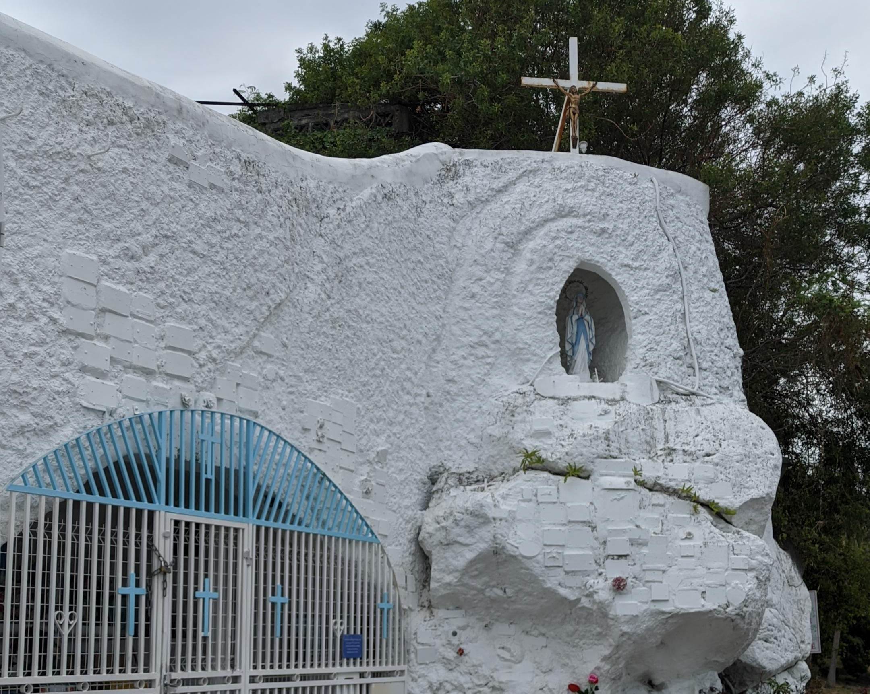
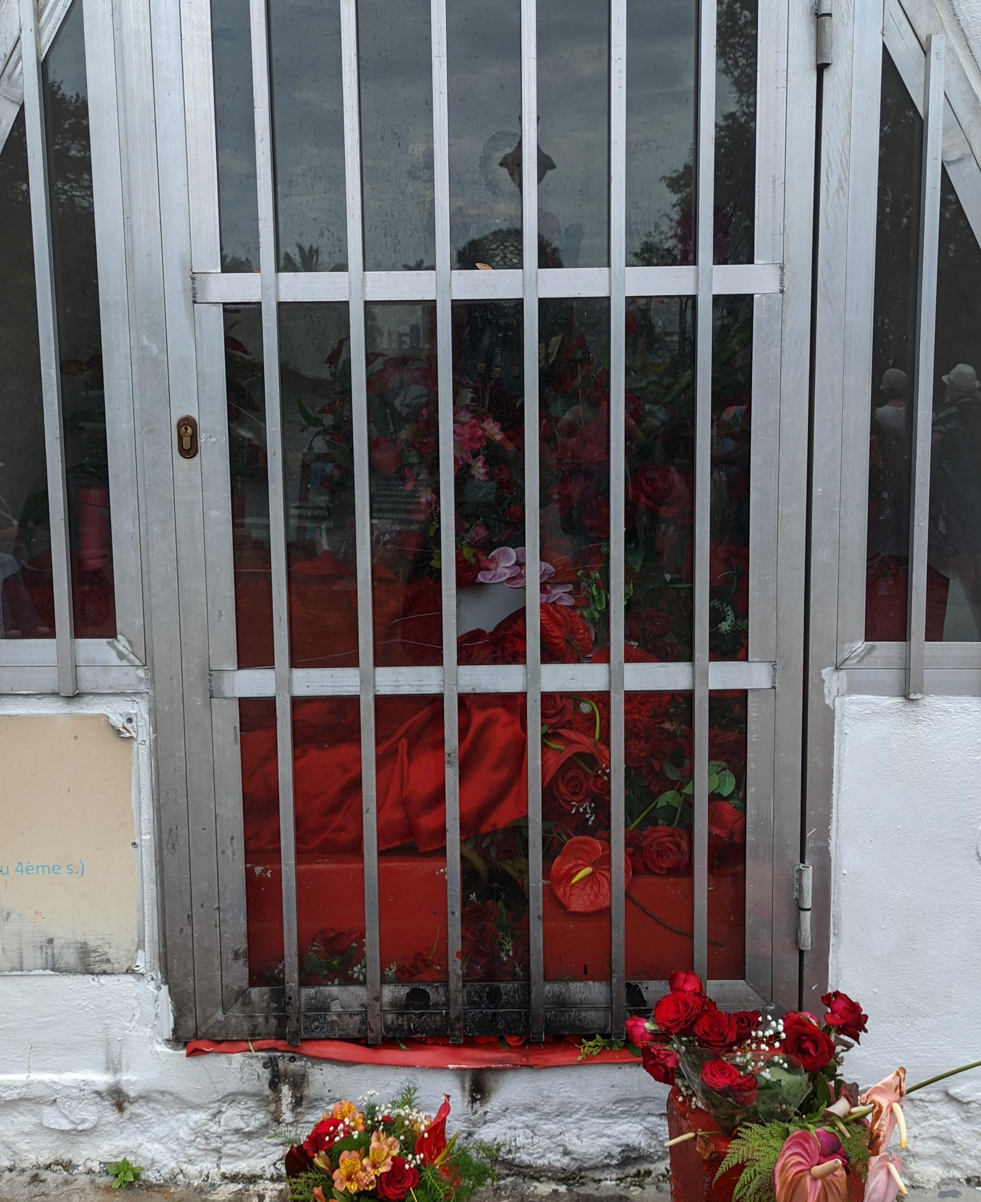
After the tour, the teachers left us. Hannah I Durmuş and Reigo went to school. The family picked us up and we went home. We ate and slept.

Slide 25
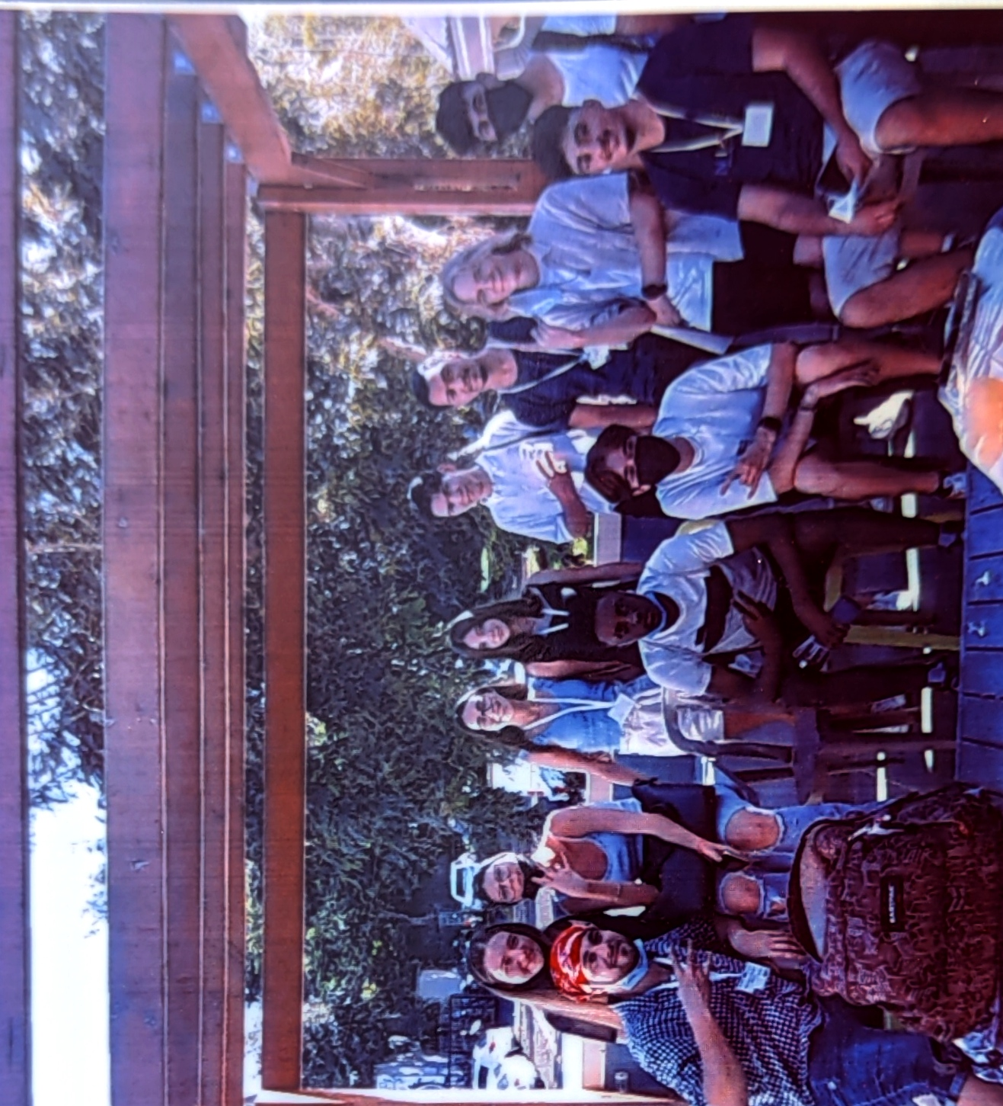
15.02
We woke up at 6 in the morning, got ready, and started the journey at 7 am. We went to the library but it was closed so we waited in front of it.

Slide 26
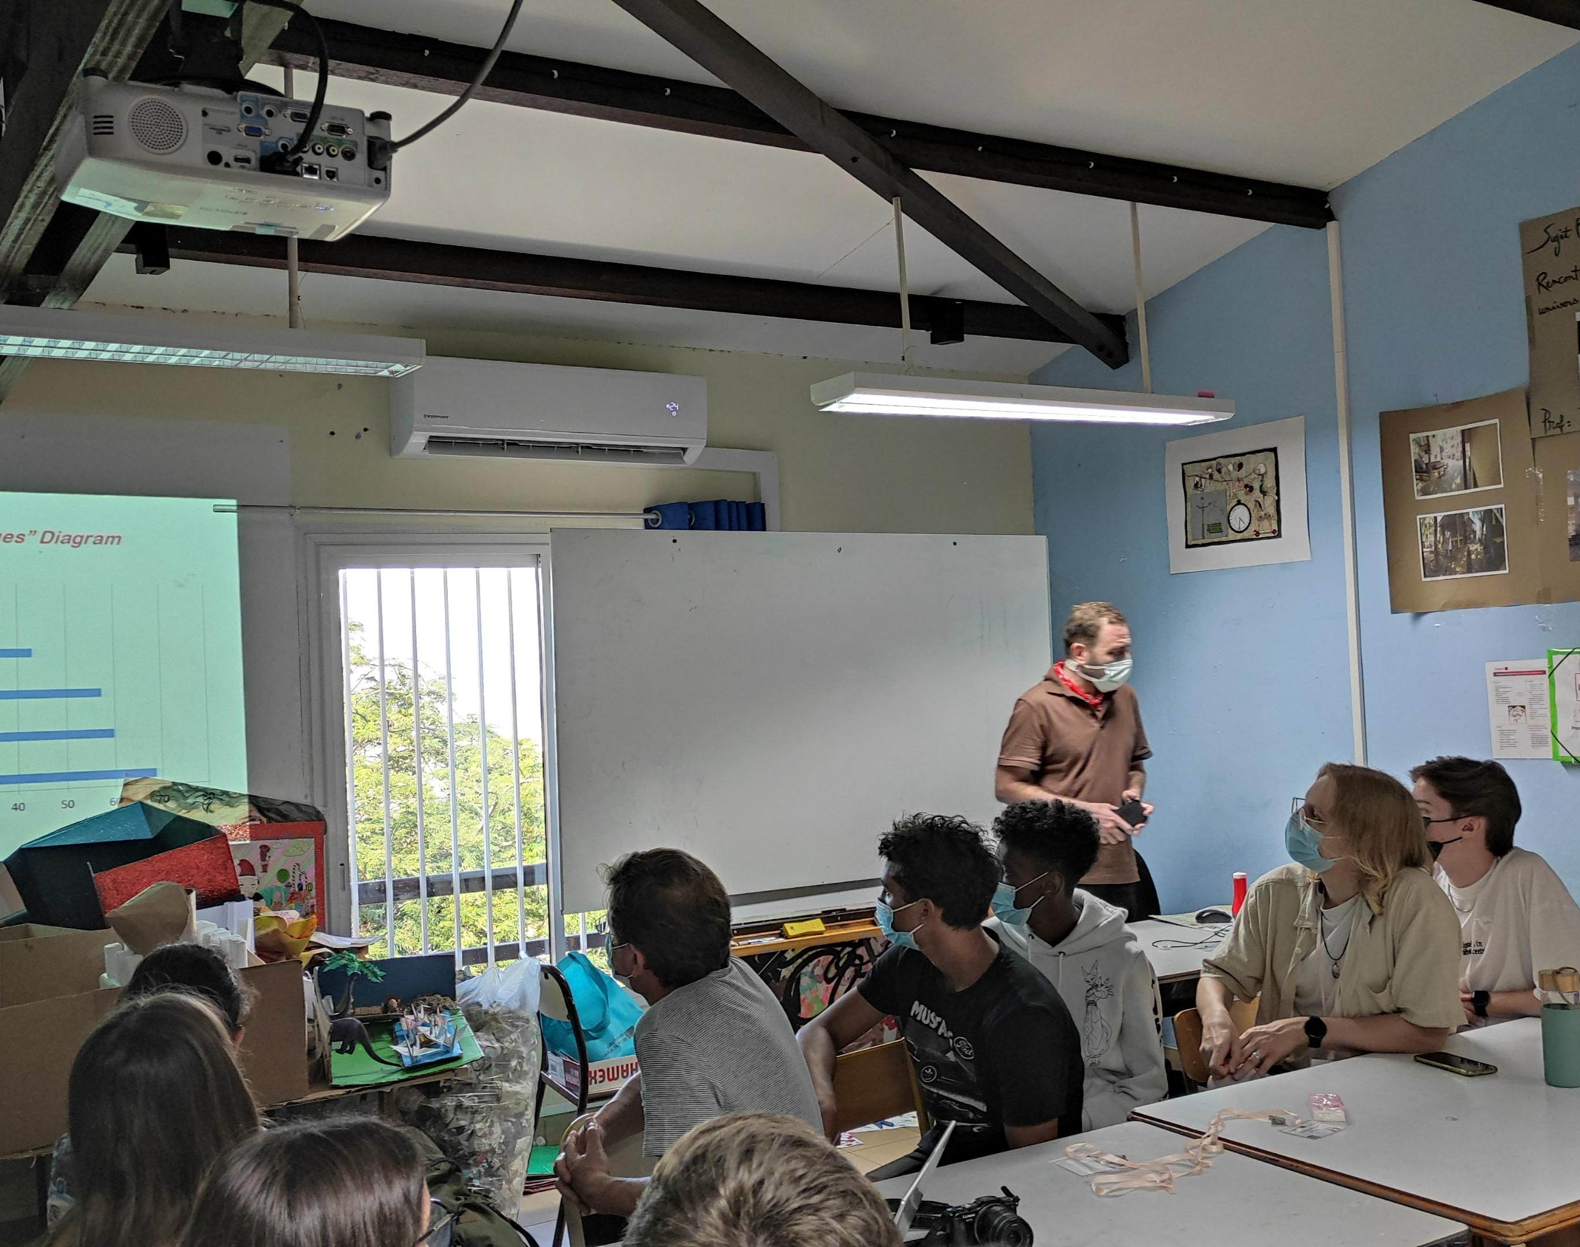
At that time, all the students took pictures together. We waited for the teachers to arrive and the program to start. The teachers came and we went to the room for the presentation. Our topic was values. All groups presented talks, presentations, charts about values.

Slide 27
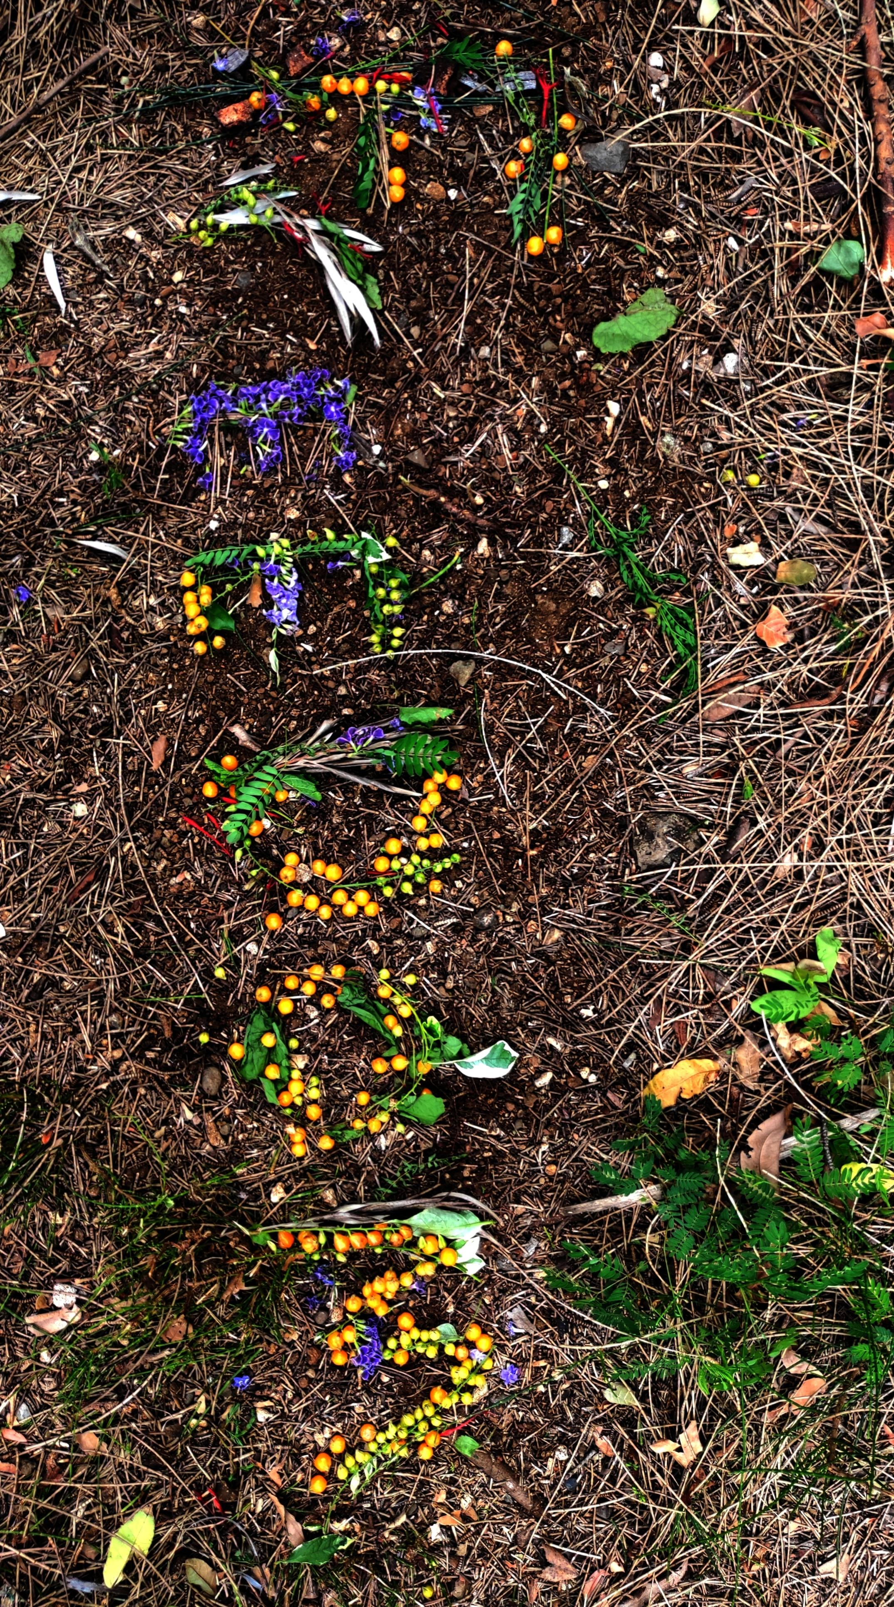
After all the presentations, the students gathered together again. We would choose one of the values ​​and use nature to write anything or write something to reflect that value. We formed a group with the German student yannick and started to think. We made the design and then we wrote "Freedom" by collecting branches, leaves, flowers and stones from the outside. But we were a little late so we couldn't take a picture.
After all the presentations, the students gathered together again. We would choose one of the values ​​and use nature to write anything or write something to reflect that value. We formed a group with the German student yannick and started to think. We made the design and then we wrote "Freedom" by collecting branches, leaves, flowers and stones from the outside. But we were a little late so we couldn't take a picture.

Slide 28
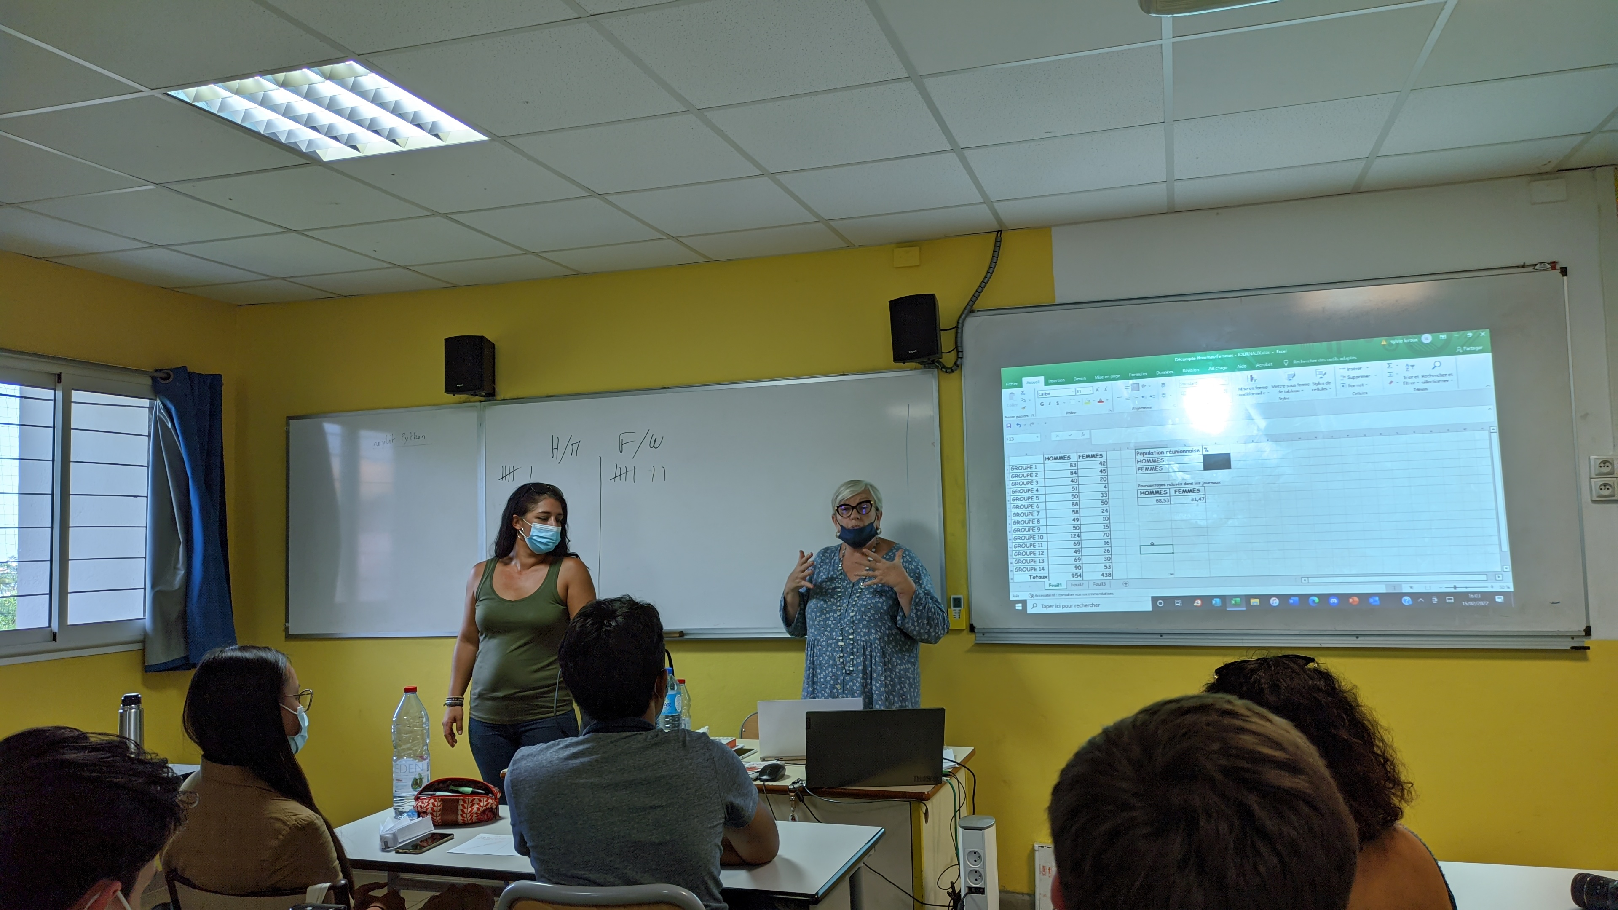
It was time for dinner, we ate our meals, then we went to the room "Room F21" mentioned in the plan given to us. After waiting for a while, we went inside and a conference was held on women's equality. We focused on a few problems, asked and answered questions. We looked at the numbers of men and women on the newspaper. We saw more women in shopping magazines and advertisements.

Slide 29
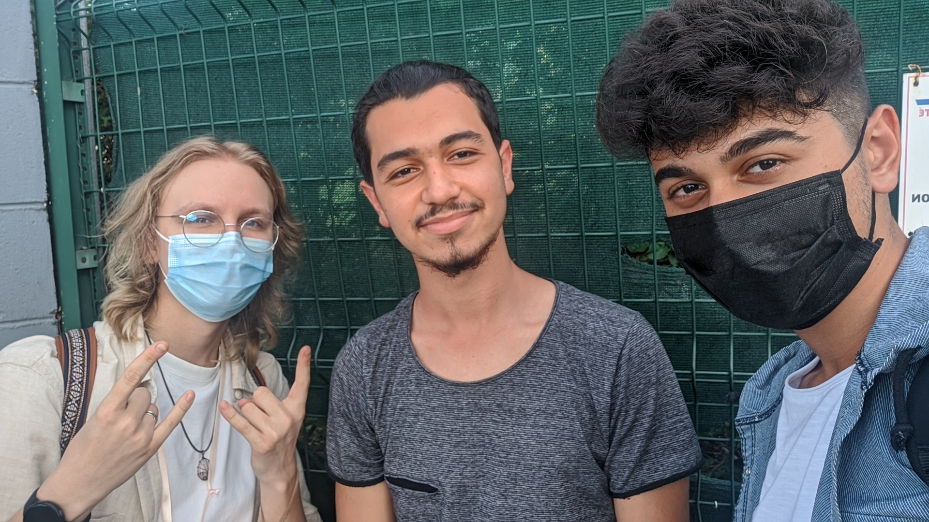
After the conference is over We waited for our family at the exit.

Slide 30
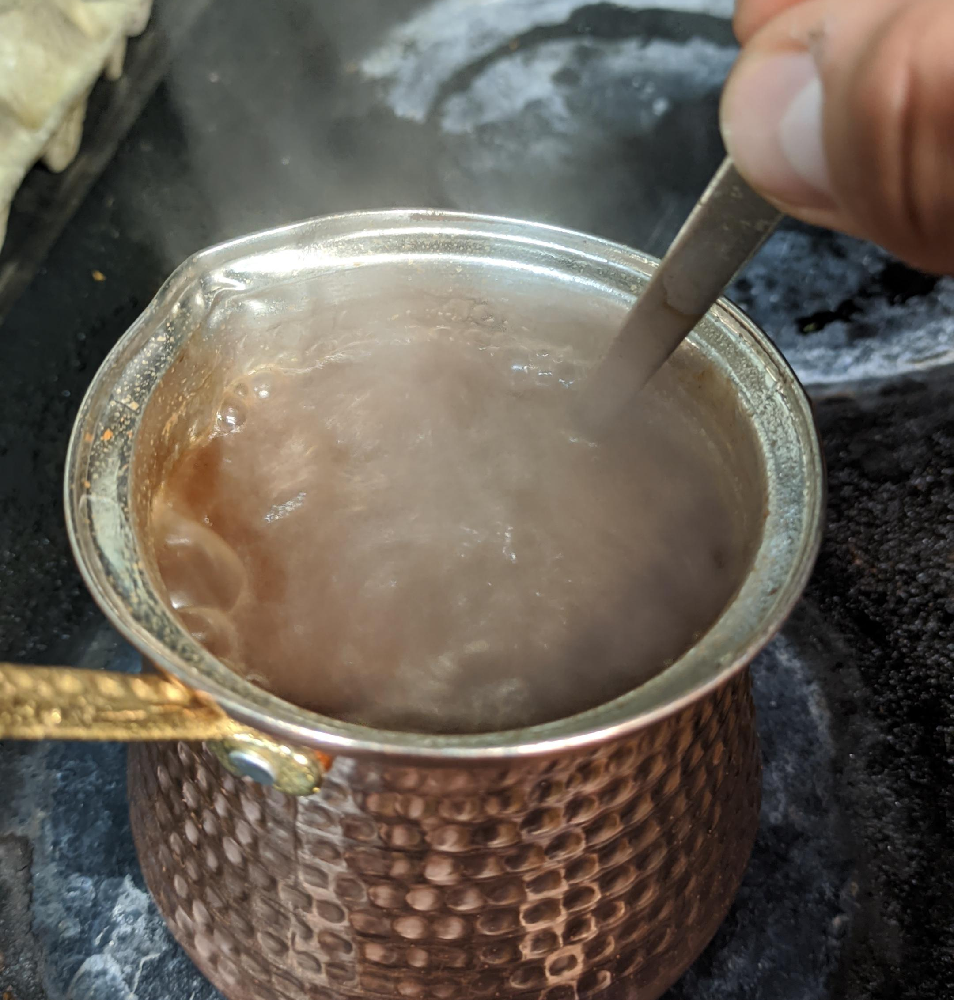
We came home, we rested and after dinner I tried to make Turkish coffee.
It actually seemed like it was going well. They said that because I put Turkish coffee less, it tastes like tea, but it is very good 😂

Slide 31
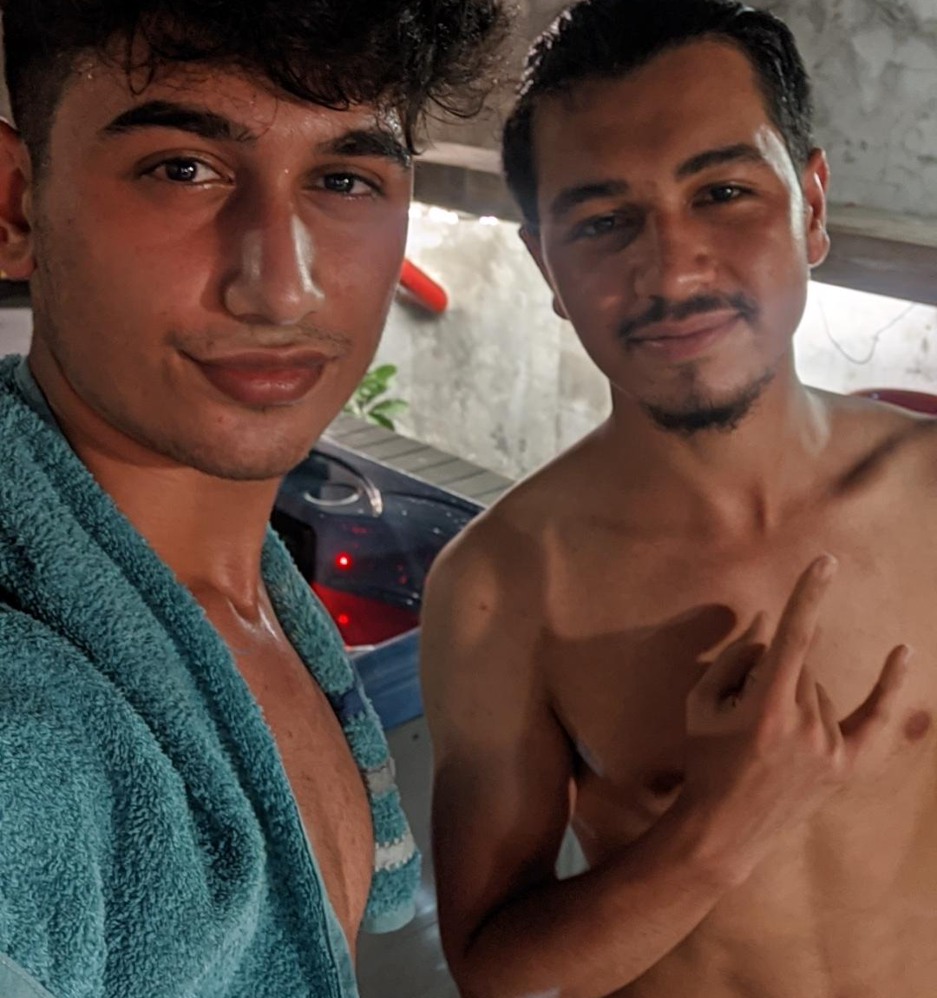
Then we went to the jacuzzi. After spending some time, we went to sleep.

Slide 32
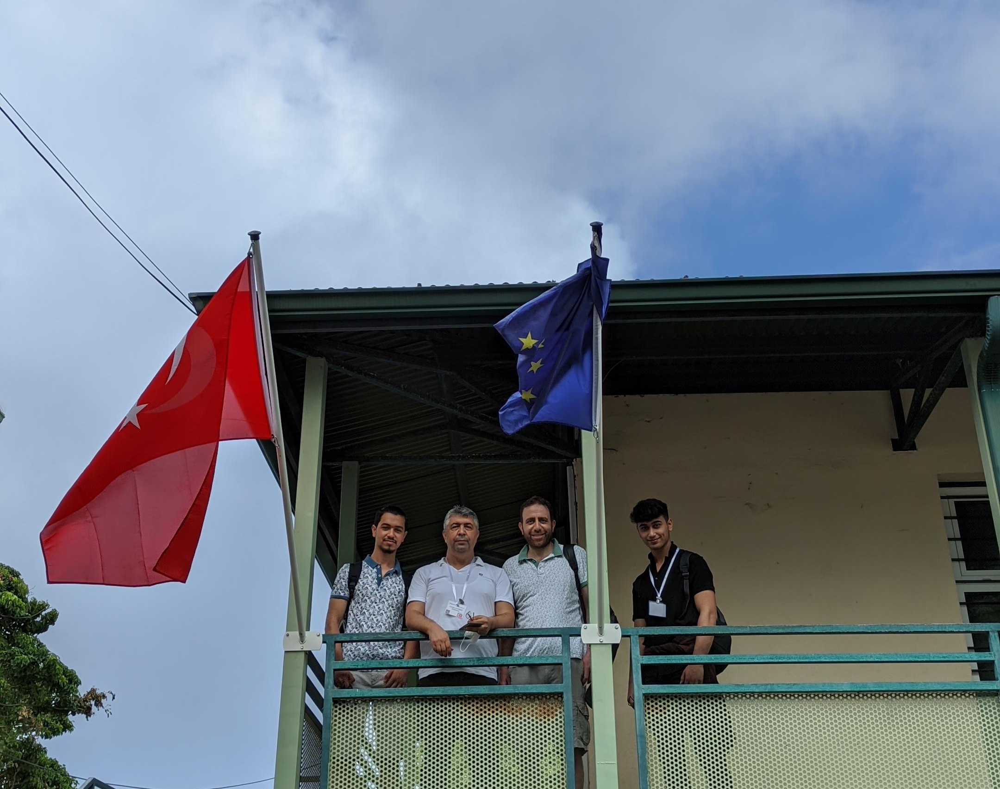
16.02
After doing our routine work again in the morning, we set out for school at 7 am.

Slide 33
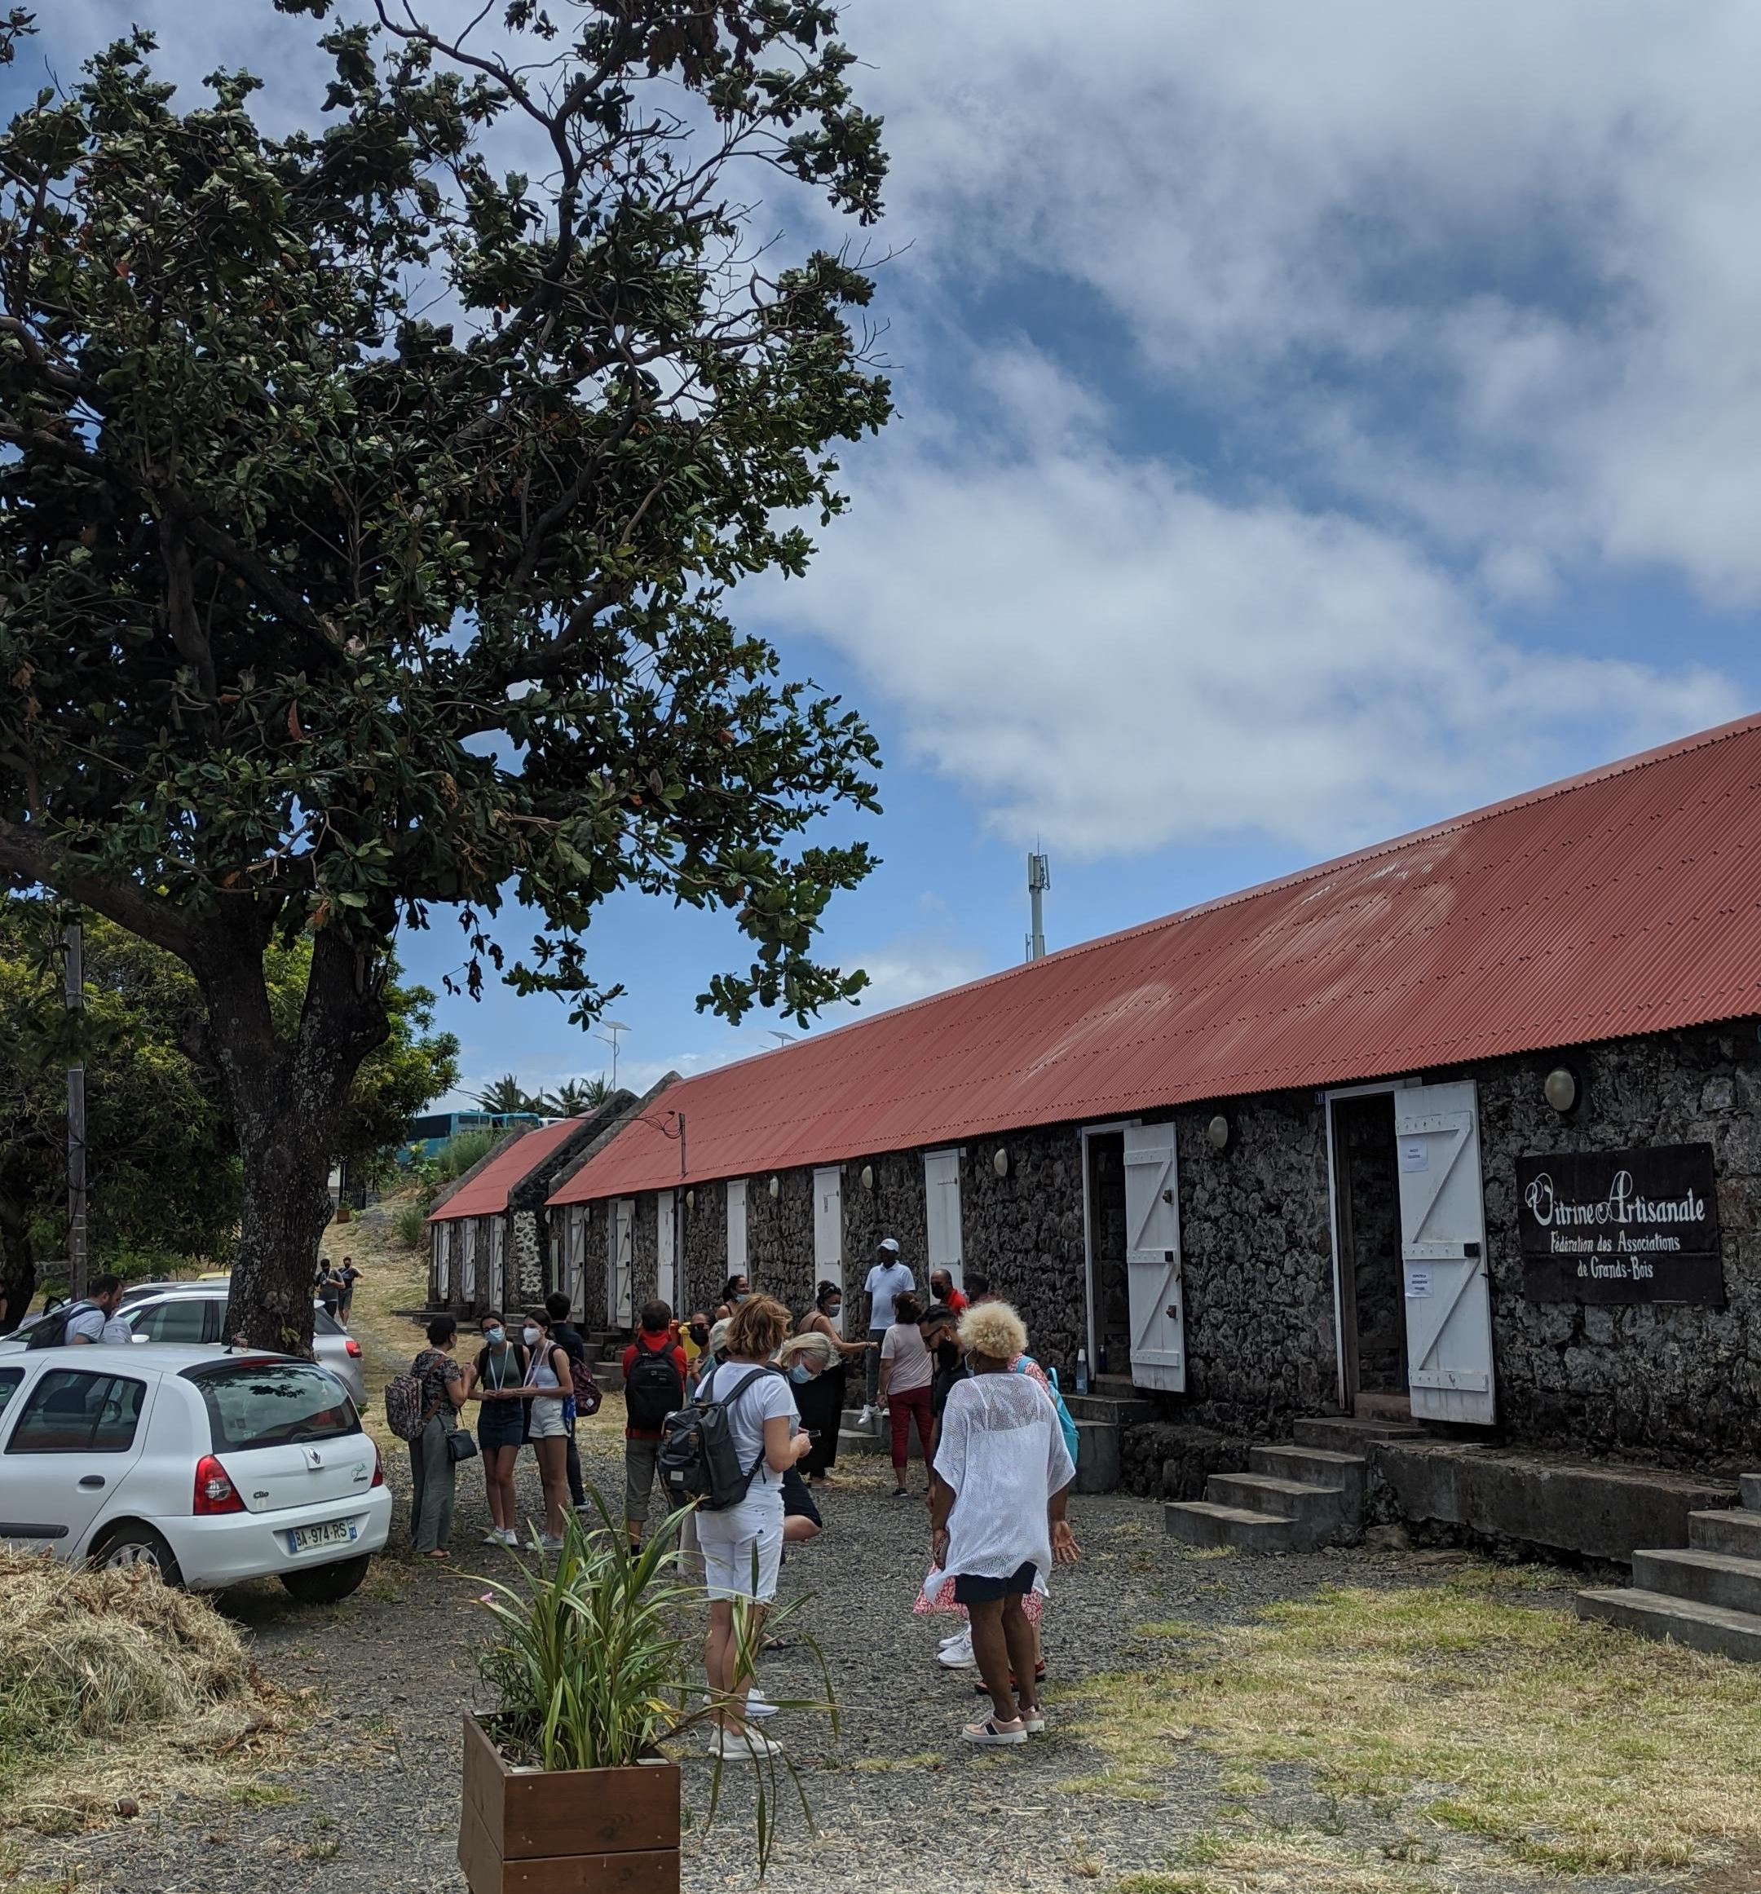
A plaque ceremony was held in front of the private school on this day. We then painted some stones to reflect certain values. It was time for lunch. After dinner, we started to visit the historical places of the island.

Slide 34
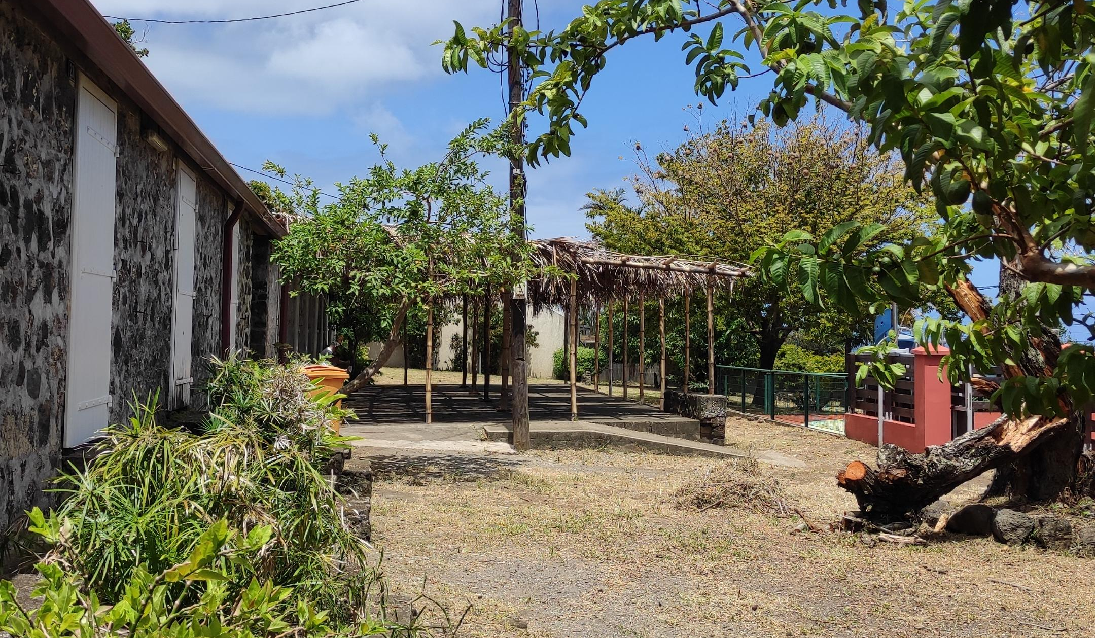
We saw old houses, old settlements.

Slide 35
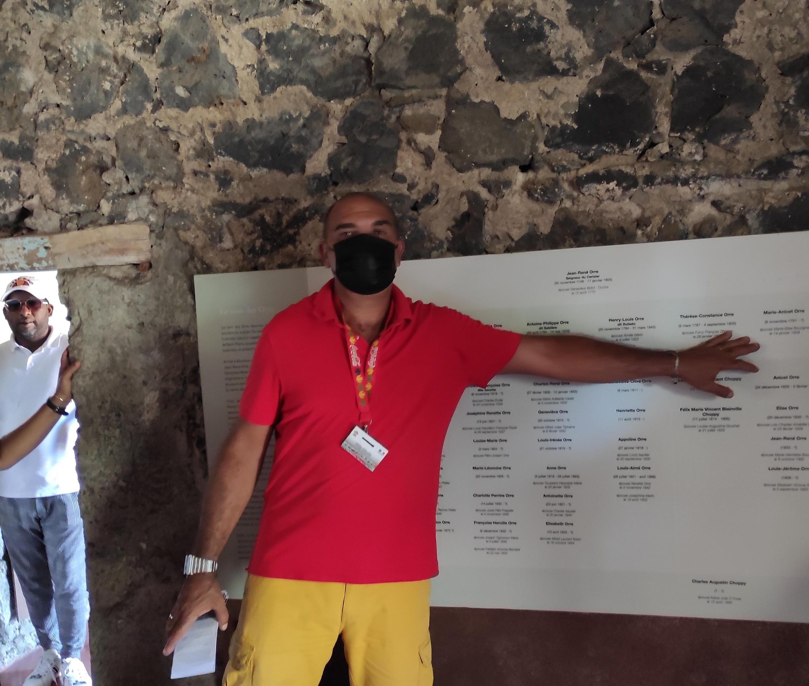
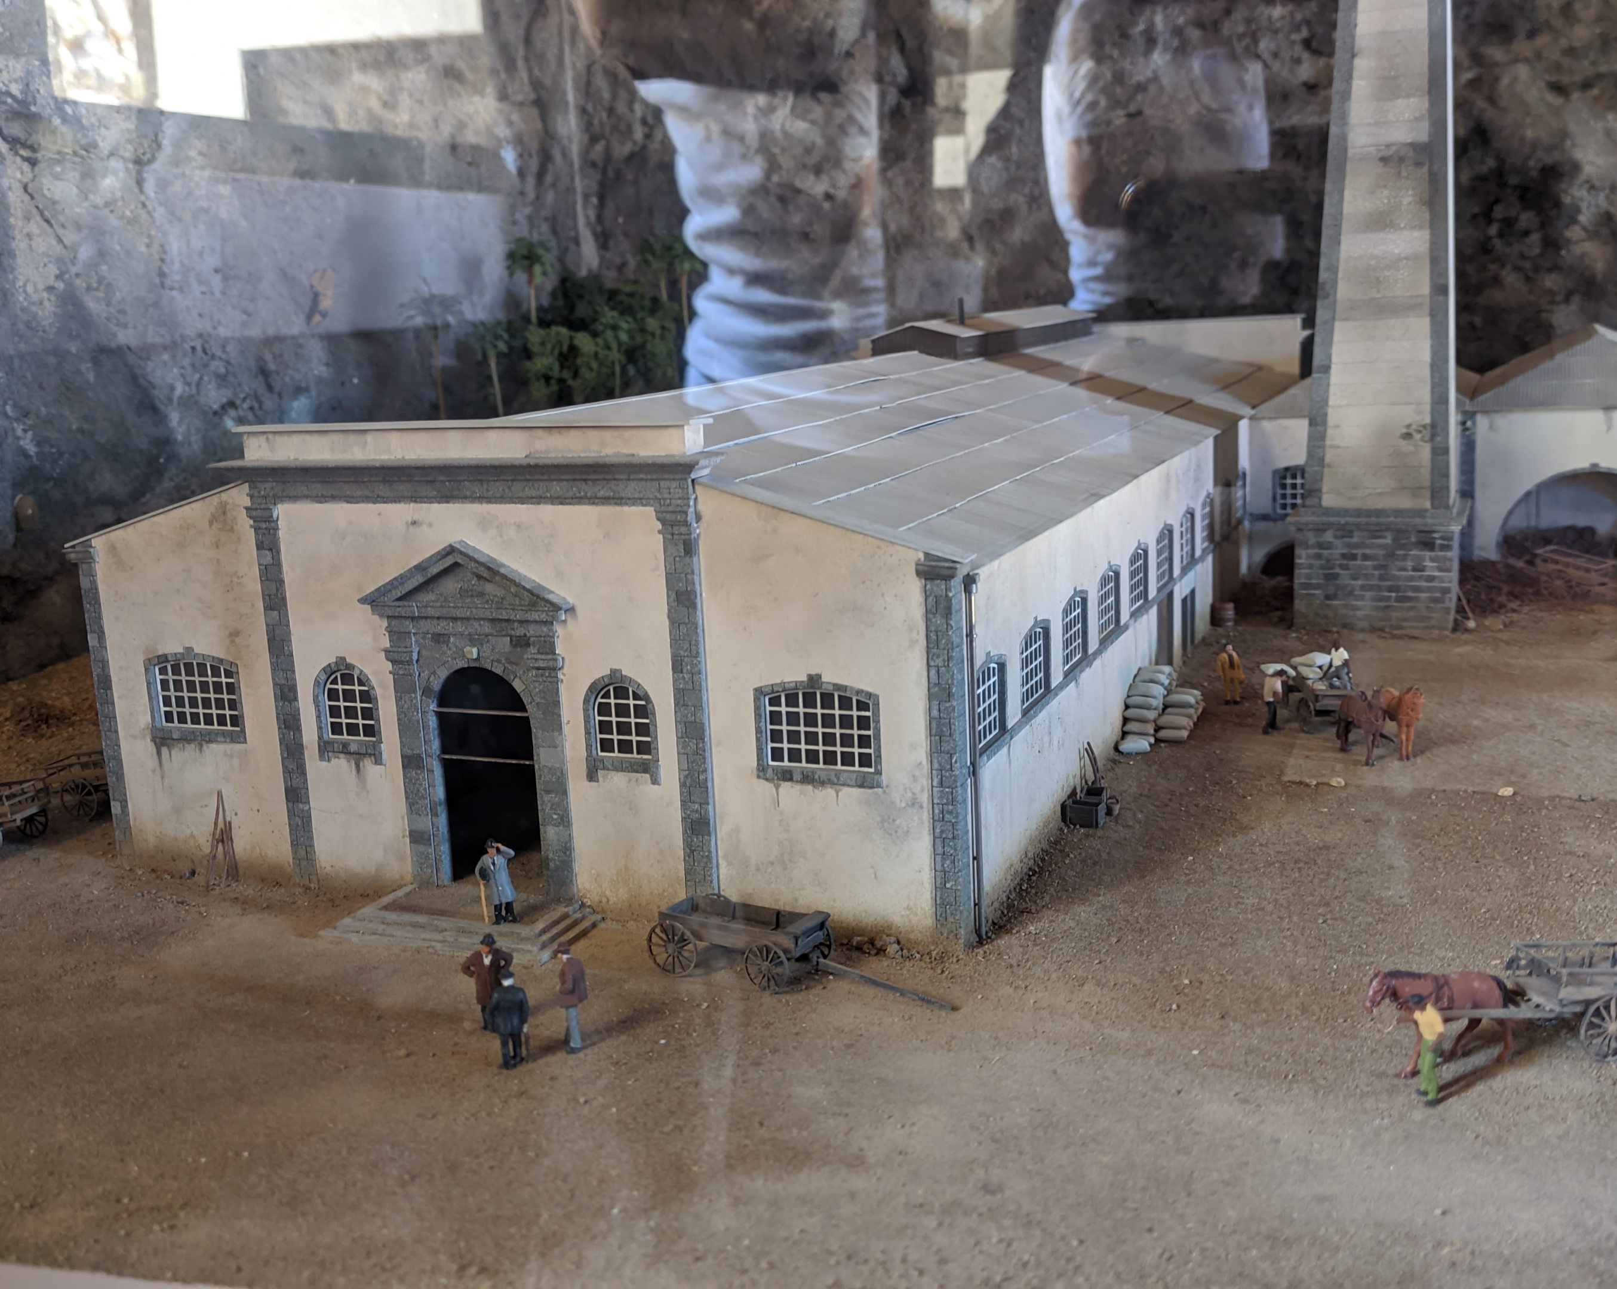
During the tour, the guide told us the history..

Slide 36
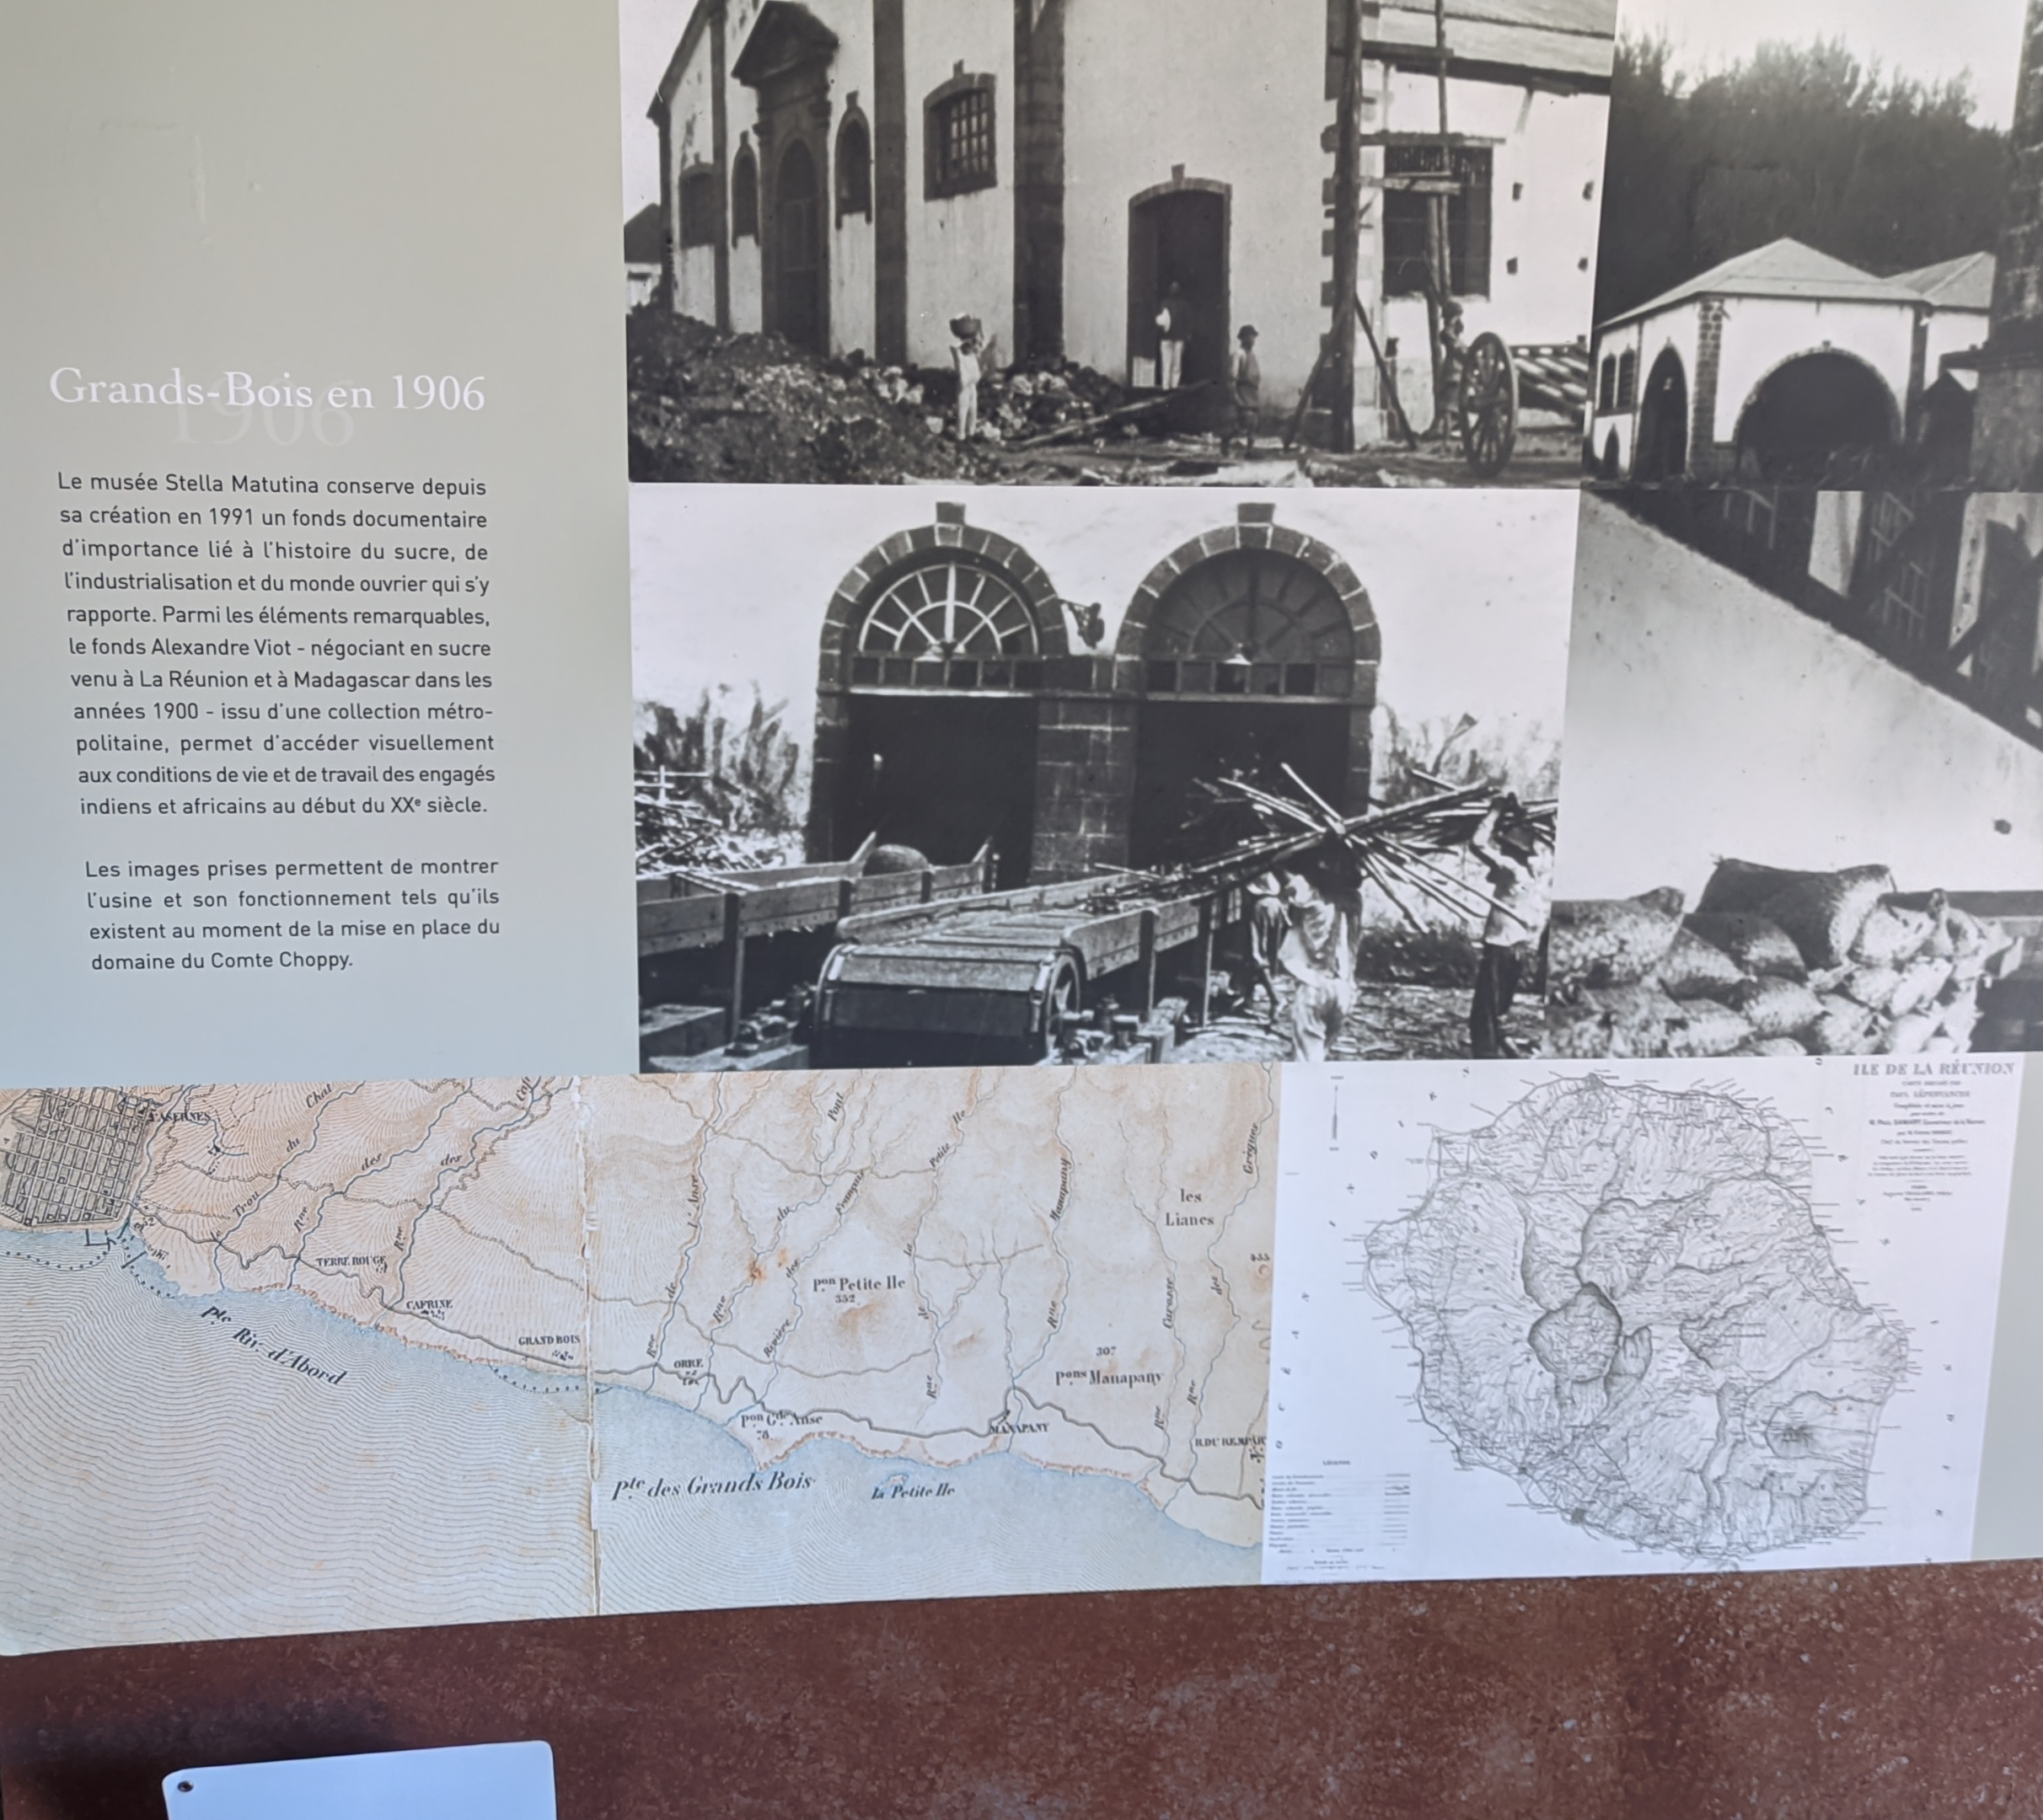
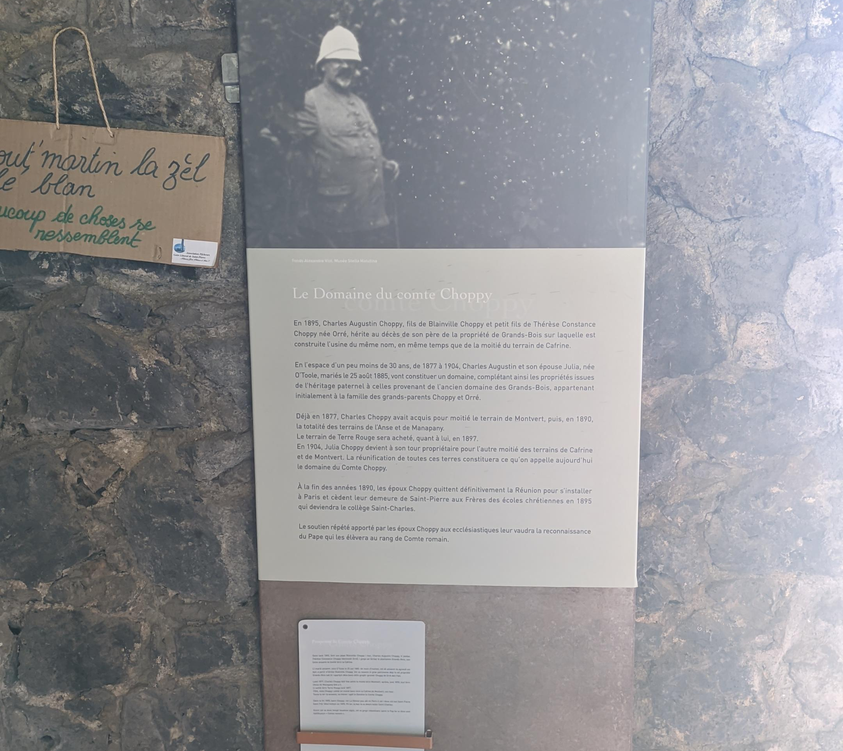

Slide 37
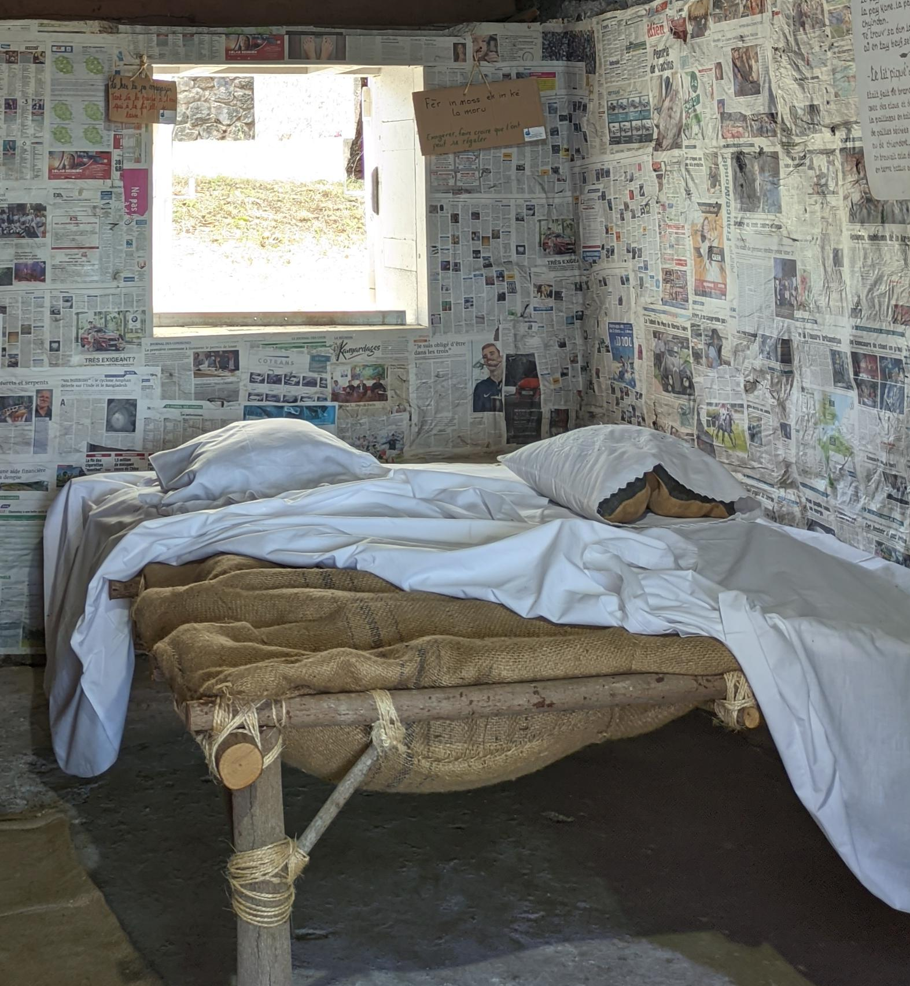
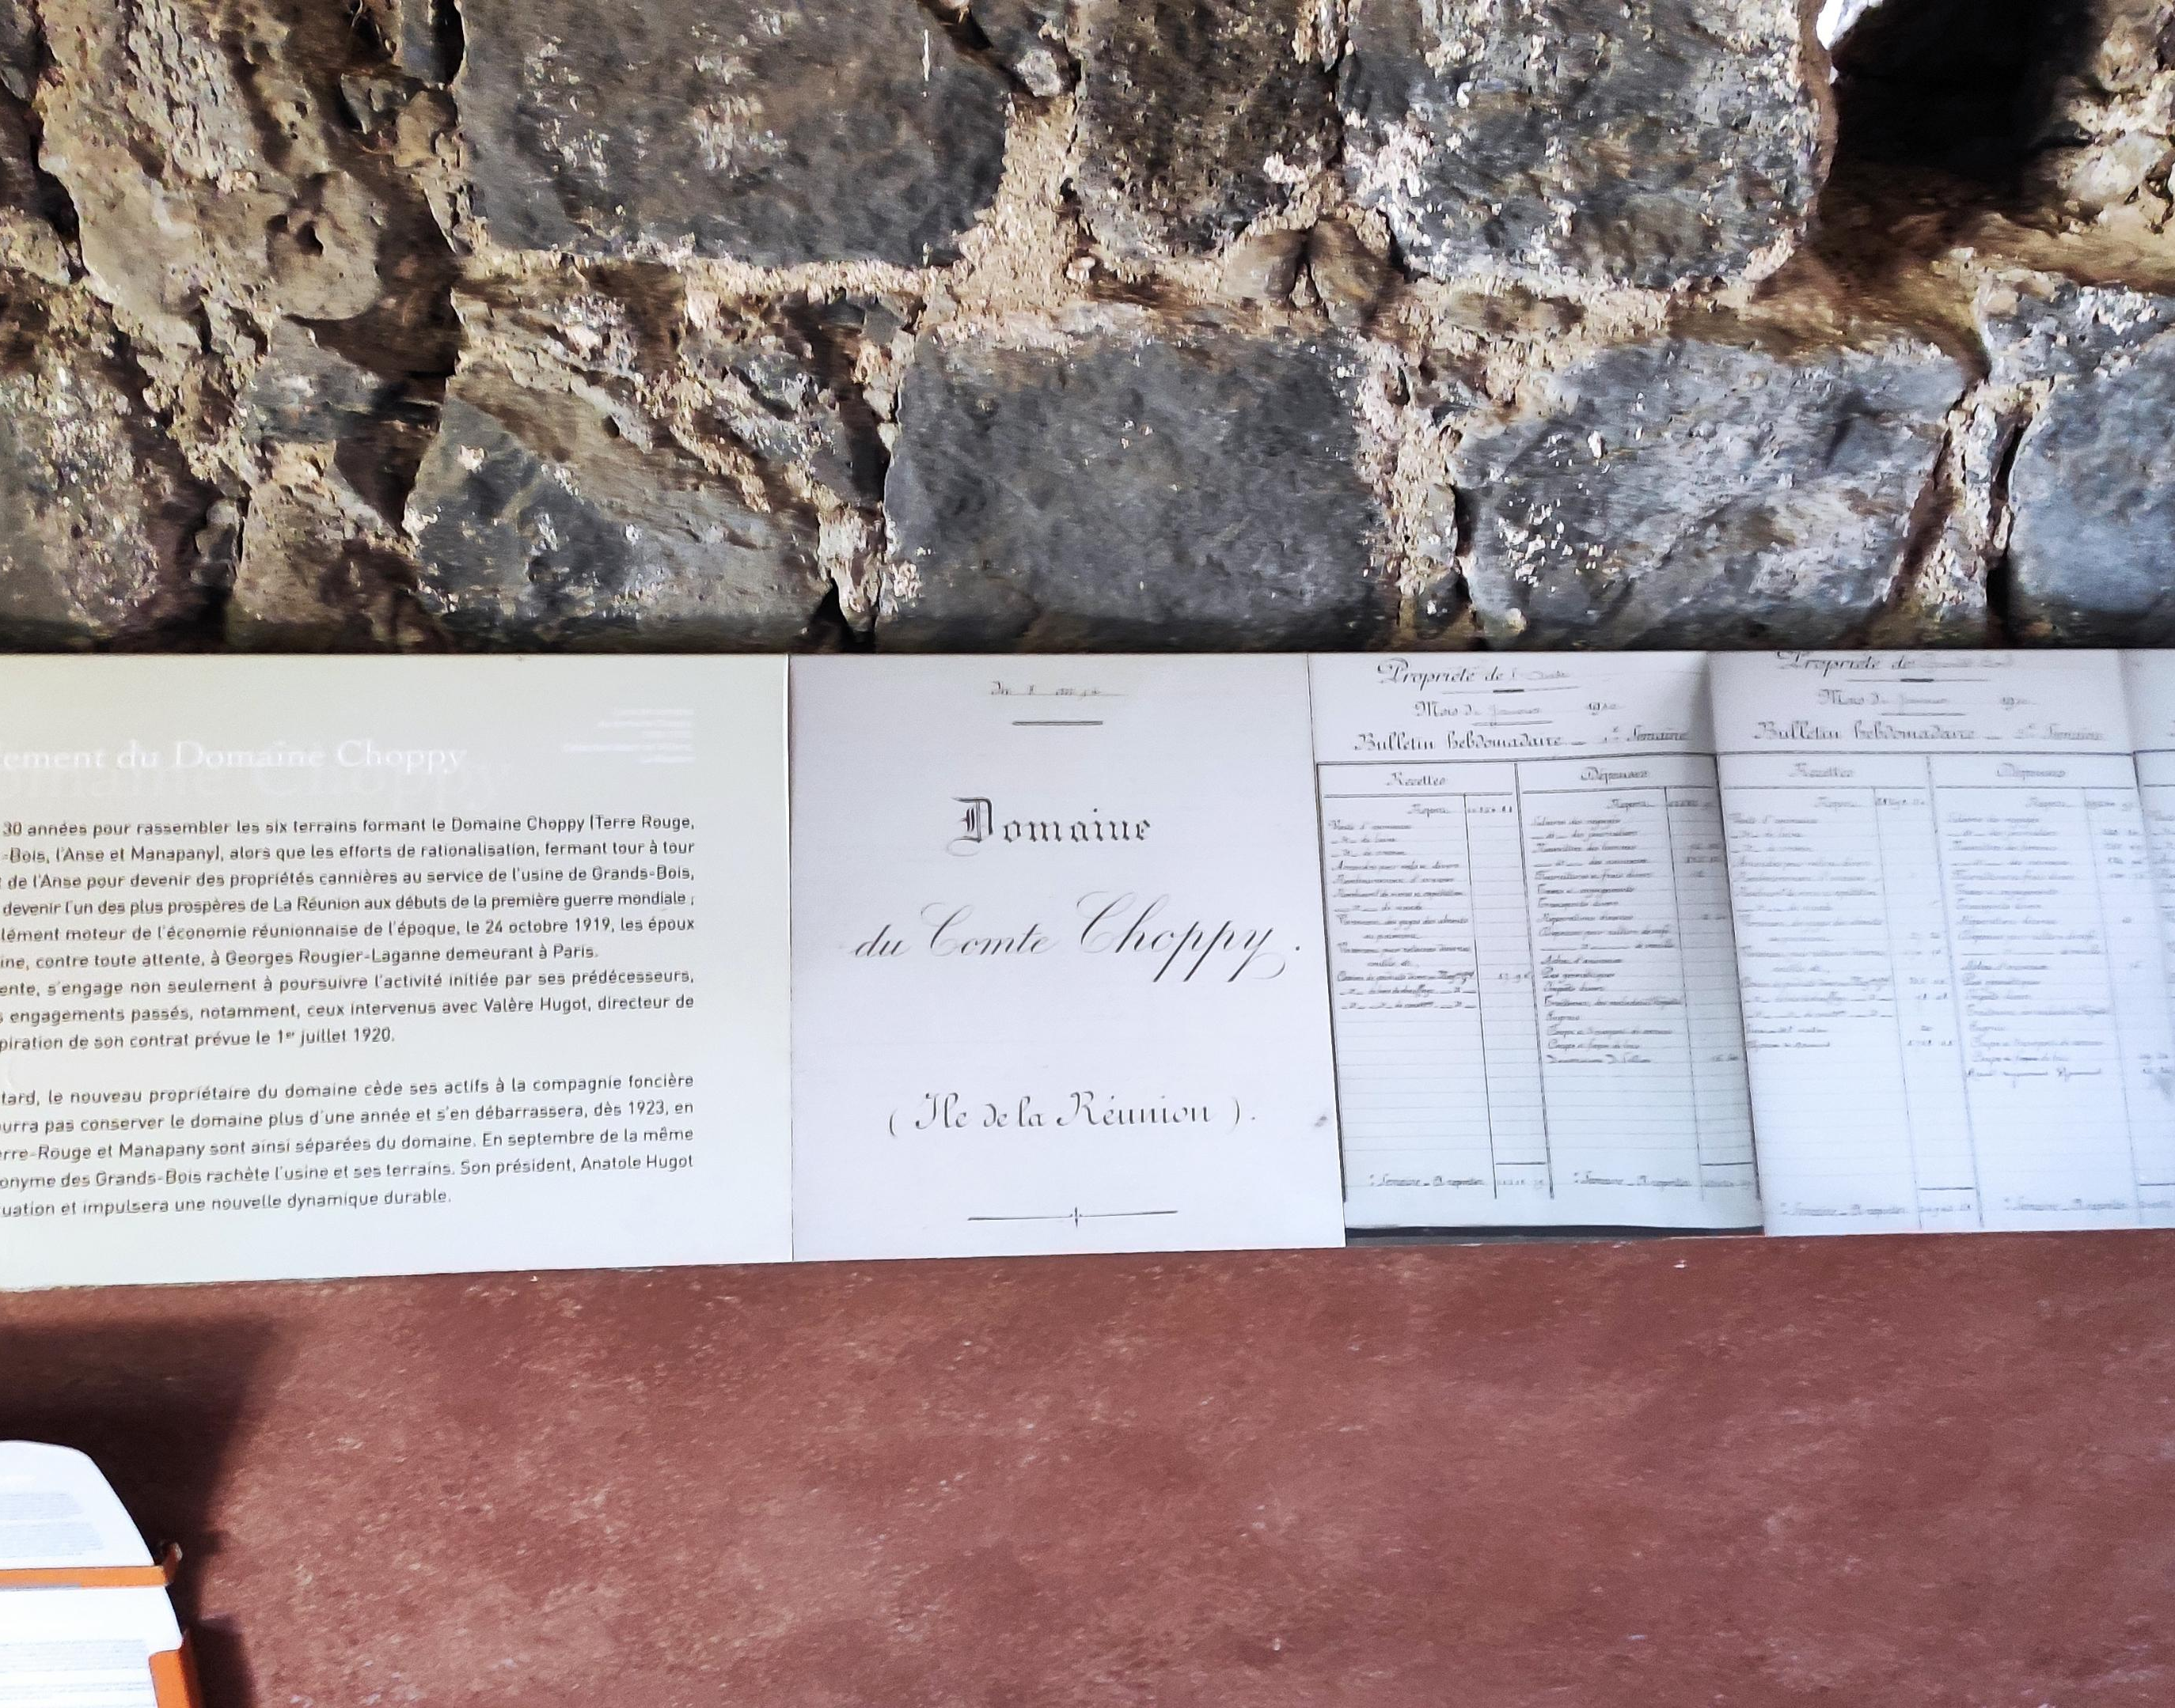

Slide 38
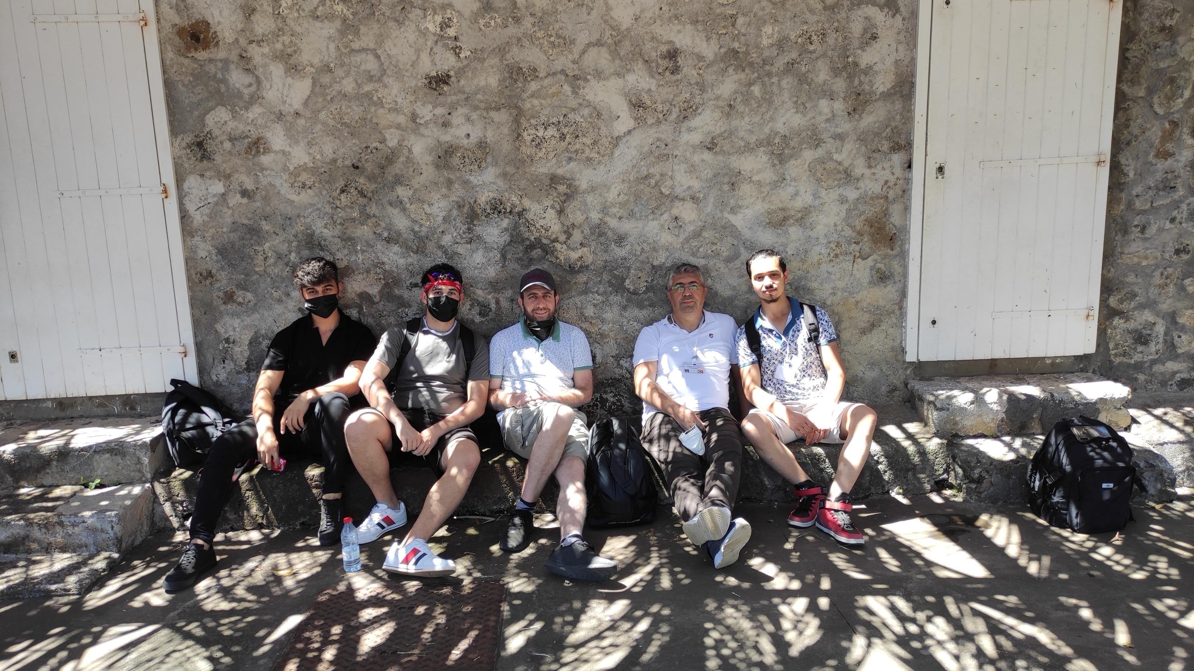
Everyone was tired from the heat at the end of the day.

Slide 39
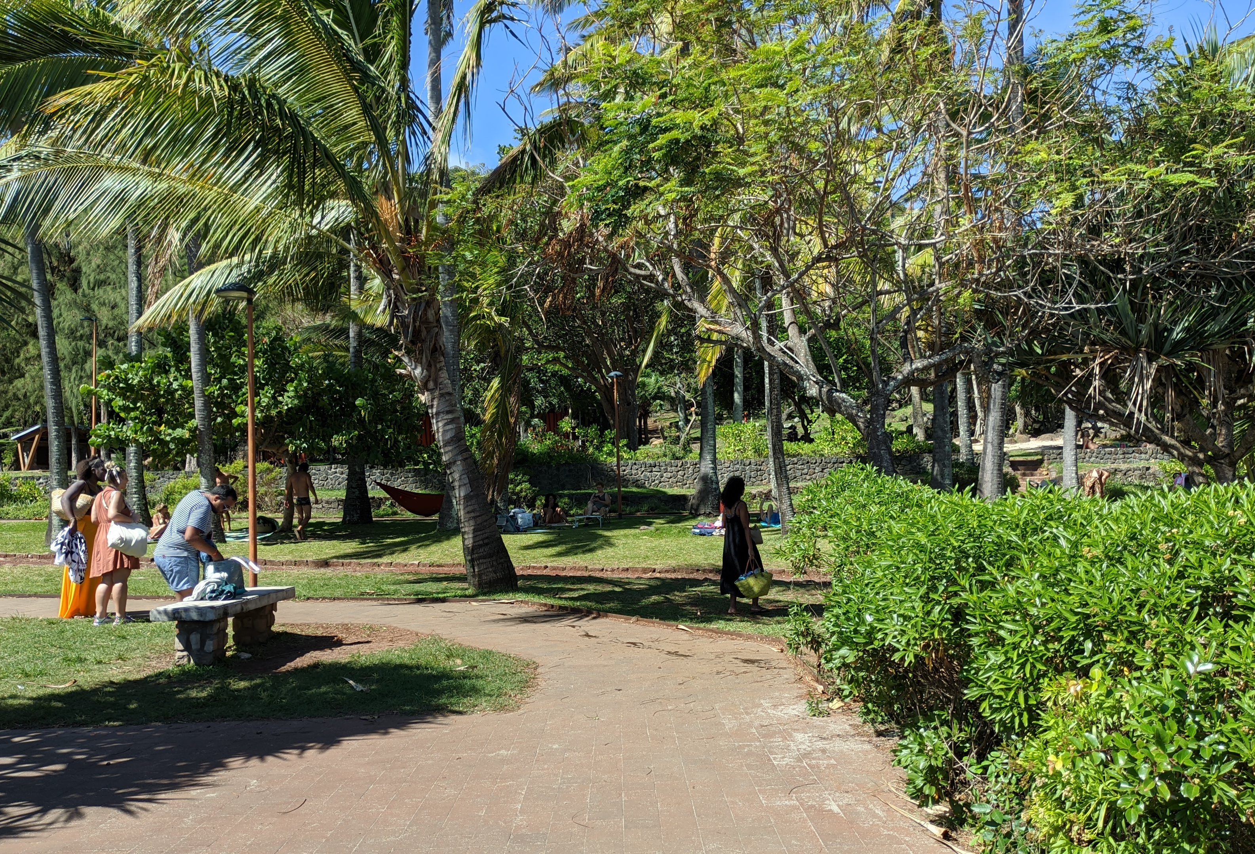
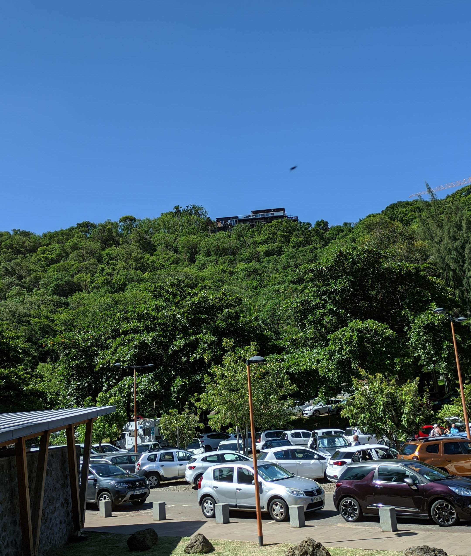
We finally arrived at the beach, the last place of the trip. The beach looked truly magnificent. The weather was relatively cooler. But the sun was burning .

Slide 40




Slide 41

At the end of the trip, we finished the day's plan with a beautiful photo. Students returned to their homes.

Slide 42

Dinner was pasta. It was nice.

Slide 43

17.02
Today was my favorite day. Because we traveled all day long. At the beginning of the trip, we stopped by a gas station and bought snacks.

Slide 44

I didn't have breakfast in the morning so I bought some extra stuff 😅

Slide 45


For the trip, we were first moving to the volcano. As we climbed the mountain, we were officially above the clouds.

Slide 46

The volcano had recently erupted and was inactive.
It was possible to enter the volcano, but we did not go down because it would take a long time.

Slide 47

The position we were in was really high.

Slide 48

A little moment.

Slide 49

We started descending again.

Slide 50

On the way down, we stopped by a building. We took a needed break.

Slide 51

We then visited the church, which burned down after the volcano eruption.

Slide 52



Slide 53

We passed through a small forest.

Slide 54

It was an area where you can swim with boats.

Slide 55

The view was magnificent.

Slide 56

The waterfall continued along the mountain. People could go under the waterfall.

Slide 57

After a nice meal at the restaurant, we took a tour of the waterfall and the surroundings, and set off for school. I gathered again in front of the school and waited for our family.

Slide 58

At the end of the day we ate rice and chicken.

Slide 59

18.02
In the morning, after routine work, we went to the computer for e twinning training. We were already involved in a project. We wrote a little article about the island.

Slide 60

After the training, we messed up the plan and went down to the canteen for an early meal. There was slave dance training and we missed the start.

Slide 61

We returned immediately and continued the training from where we left off. We had a good time. Then it was time for the real meal.

Slide 62

After free time we went to court for a presentation on women's rights.

Slide 63

Each country had prepared its own presentation. Our country wanted to make the presentation Durmuş , so he did it .

Slide 64

a little moment.

Slide 65

After the presentation we went back to the library and the certificates were handed out. The Bulgarian team would go. So we said goodbye.

Slide 66

We went home after the plans. We were going to the beach with the family. There was swimming, but there was an approaching tornado. So it was extremely windy. Swimming seemed impossible. We went to the beach and took pictures and then we ate on the shore. Then we returned home.

Slide 67

19.02
Again in the morning, after doing the routine work, we met in the big market place to meet with other students. After the other students arrived, we went to the Indian temple with the guide. We took off our shoes when entering the temple. While we were slowly visiting the temple, we went to the place where we made vows to their gods. The guide told us about religion there. After the lecture was over, we went to the big market.

Slide 68


Slide 69

The market was 3 ways and it was huge. In general, there were fruits and vegetables to eat, but in some parts, clothing, jewelry and souvenirs were found. I bought 2 small sauces and 4 magnets for my family. Then everyone met. The trip plan has officially come to an end . The Estonians were going to stay another day so we said goodbye to them. We pulled the flight back one day because of the tornado. The family we stayed with picked us up again and we returned home. We gathered our things and completed the final preparations. It was nice to eat chicken doner kebab as the last dinner. The family took us back to the front of the hotel and we said goodbye . Together with the Germans we set out for the other part of the island . I slept in the car. We came to the airport and saw that it was very crowded. There was a problem about the passports while giving the items, but we soon solved the problem. We had the necessary procedures done and when the time came, we went to the plane. With this flight, our island trip came to an end.

