Slide 1

Our tour tomorrow is sponsered by
We got 1.420 € for the bus tour and the guided tours because it is Europe week.
Thank you NRW!

Slide 2

Integration
In our school
Living
in Europe
is the topic of this presentation

Slide 3
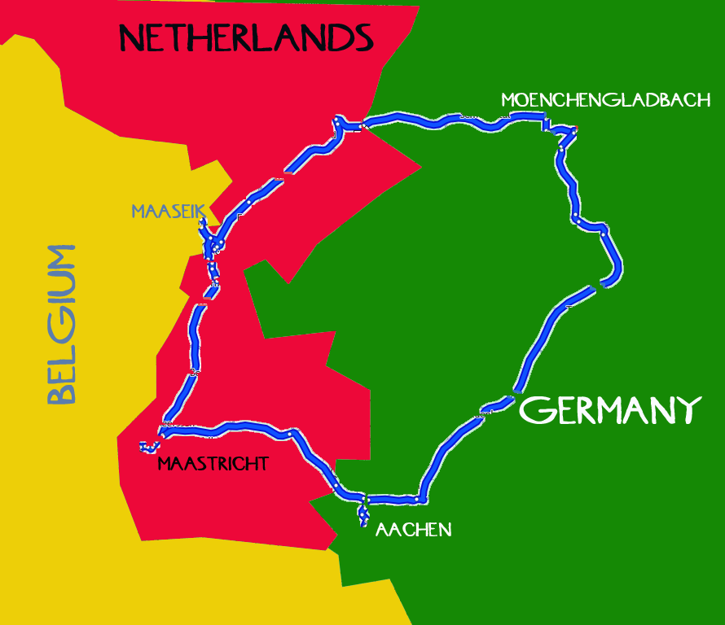
In our Region we have two neighbors

Slide 4
Three Countries, four Languages, one History, two World Wars ...
1200 years ago the whole region belonged to Germany.
During the regency of Napoleon the whole region
belonged to France.
Sometimes parts of Belgium and Germany belonged
to the Netherlands.
Belgium is quite young nearly 200 years old –
the North of France (Wallonie), the South of Netherlands
(Flandern) and a small piece of Germany have built
together Belgium, people speak French, Dutch, German
or English.
… but now we are friends, now we are living
without borders in the EU. We want to show our neighborhood to you.

Slide 5
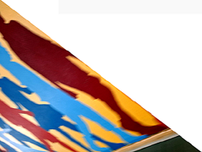
We can travel without being controlled
We can work where we find a job
We can live where we find a home
We can buy without customs duties
We can study where we find a university
We can feel like European citizens
We can marry whoever we fall in love with
And you?

Slide 6
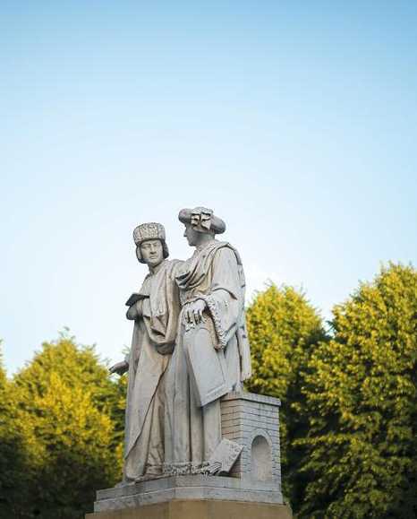
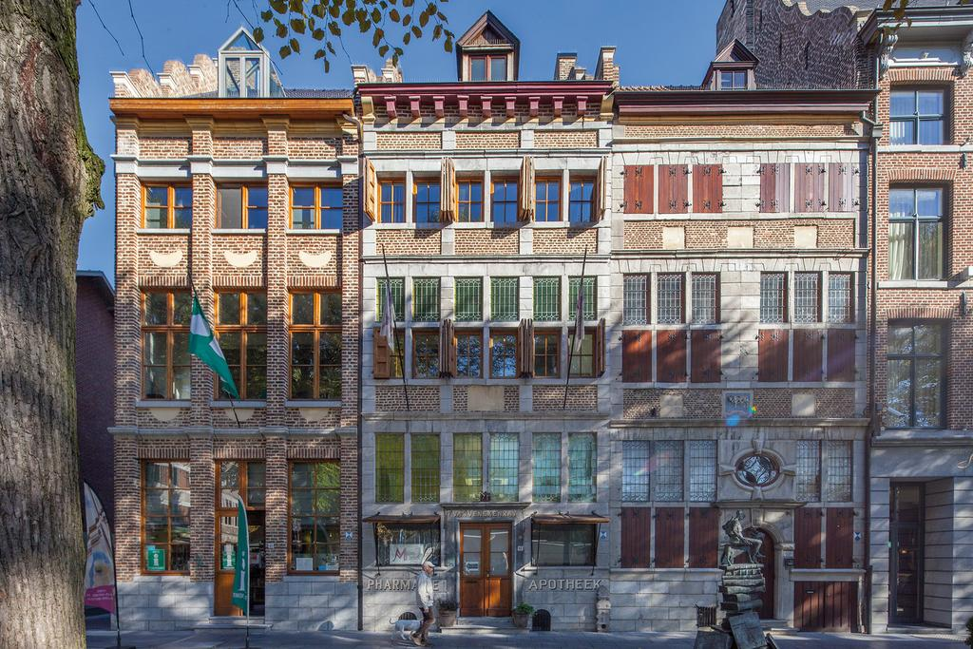

1. Step
Maaseik marketplace – less than one hour to look around – it is market time and you can hear different languages and see typical Belgium houses and eat typical Belgium food like French Fries and Belgium chocolate and look for de kleyne Kayser.
A man riding a goat
Jan und Hubert Van Eyck

Slide 7
2. Step
Maastricht - the capital of Limburg, Netherlands
Reasons to go to Maastricht:
It is such a beautiful old town at the river Maas
It has an excellent international university
It is well known for the Treaty of Maastricht, 1992

Slide 8
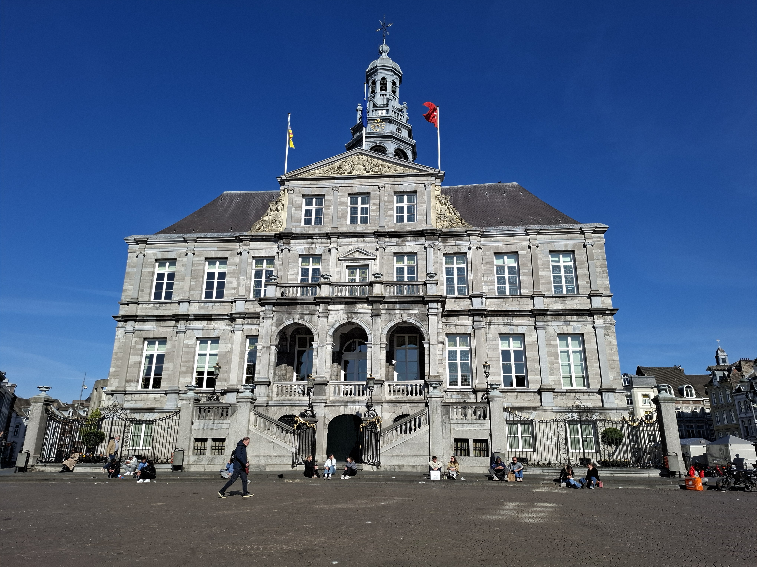
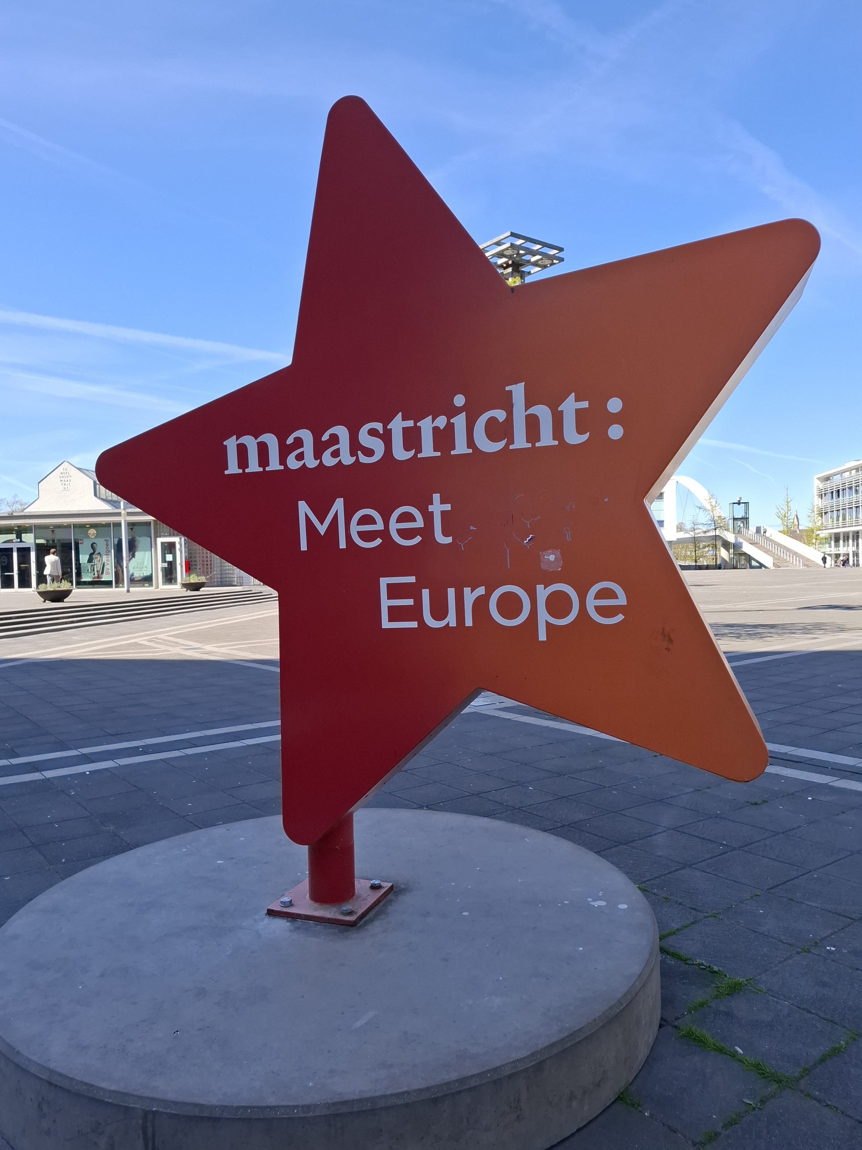
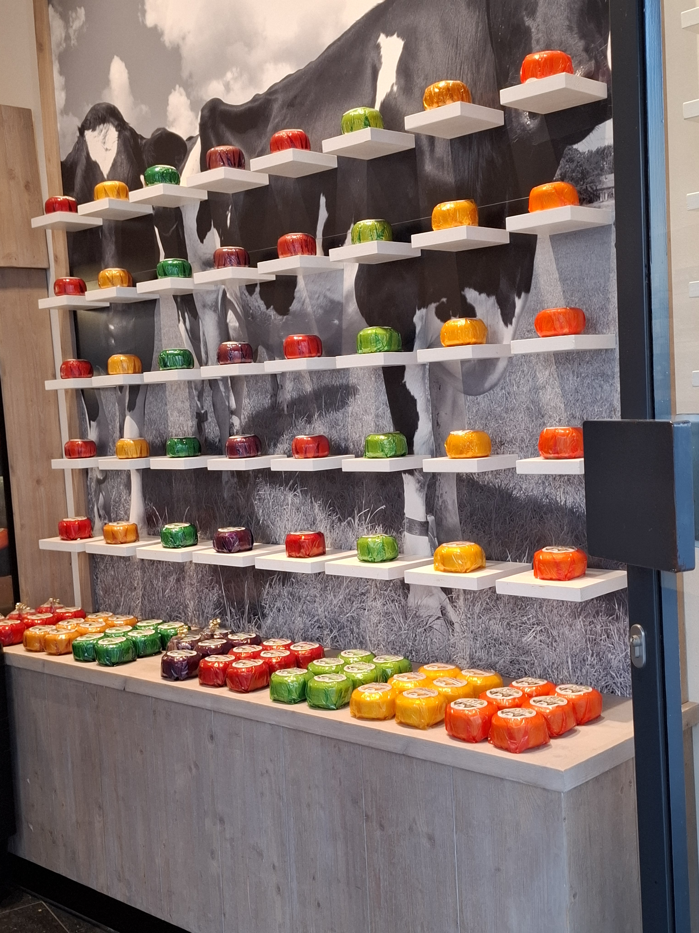
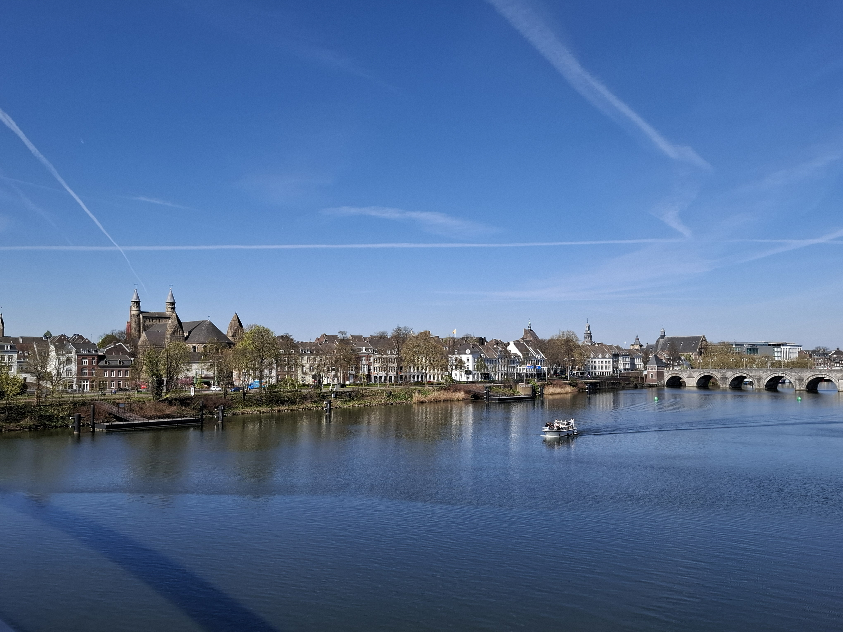
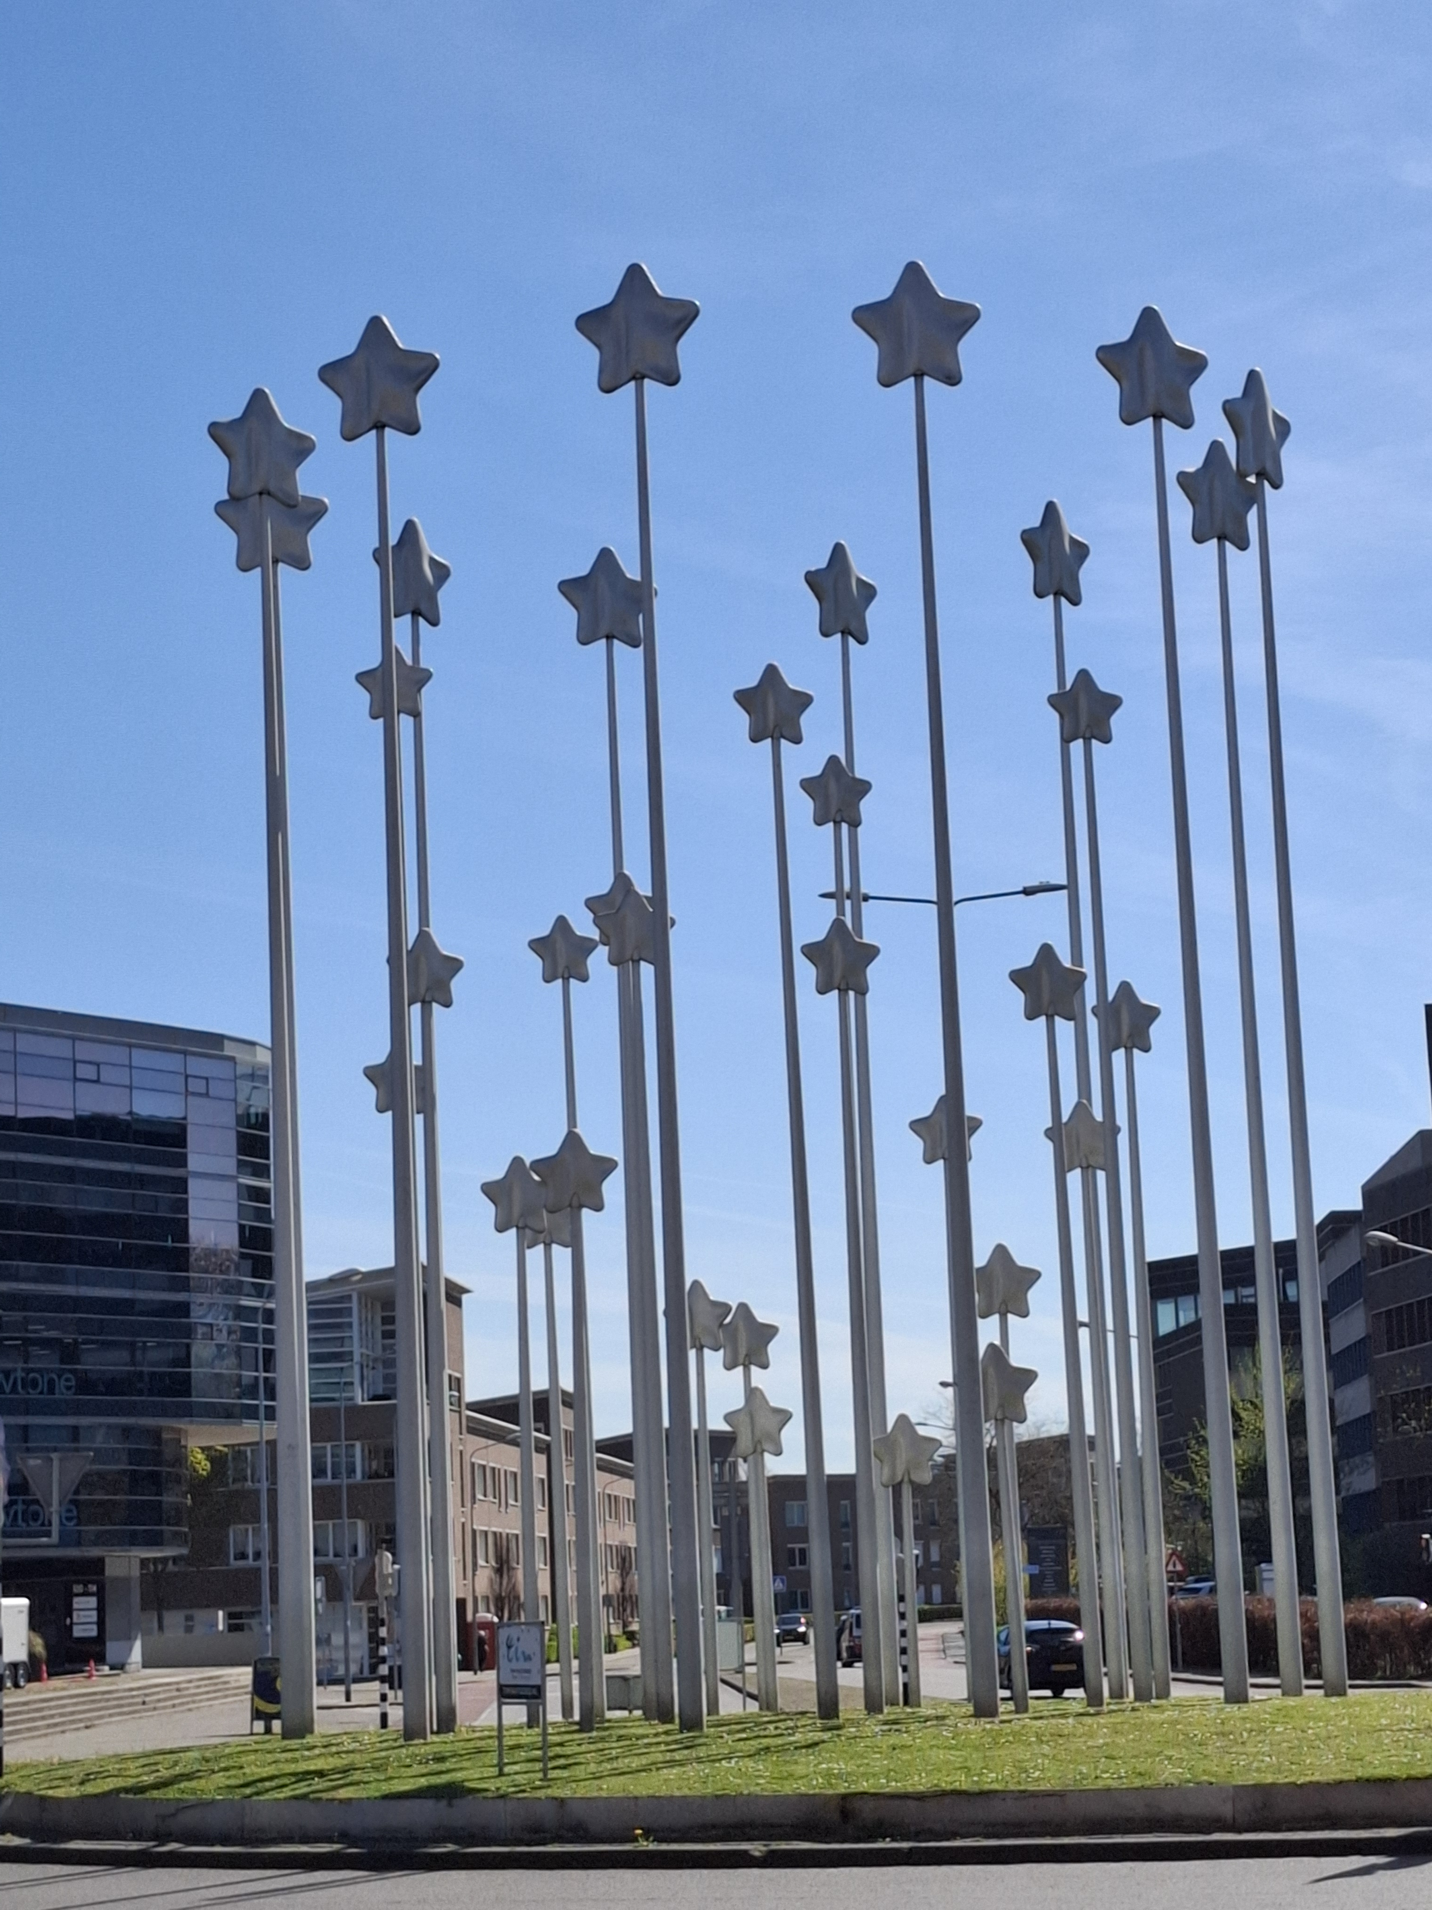
Beautiful town
Gouda
Townhall
Maas

Slide 9

Founded in 1976, it is the second youngest of the thirteen Dutch universities.
In 2023, 22,976 students studied at Maastricht University, 60% of whom were students from outside of the Netherlands. About half of the bachelor's programmes are fully offered in English, while the other half is taught wholly or partly in Dutch.
According to World University Rankings 2016, Maastricht University occupied 88th position in the world ranking.
Problem Based Learning as a motivating method
Tuition fees at Maastricht University vary, depending on nationality and
study programme. Regular tuition fees for public universities in
the Netherlands are determined annually by law. Statutory
tuition fees currently amount to € 2,060 annually for both
bachelor's and master's programmes.

Slide 10
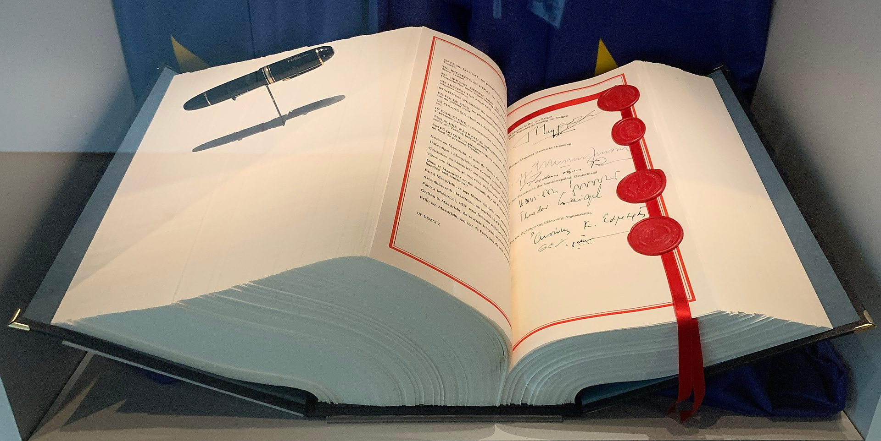
Maastricht Treaty
1992 founding treaty of the European Union

Slide 11
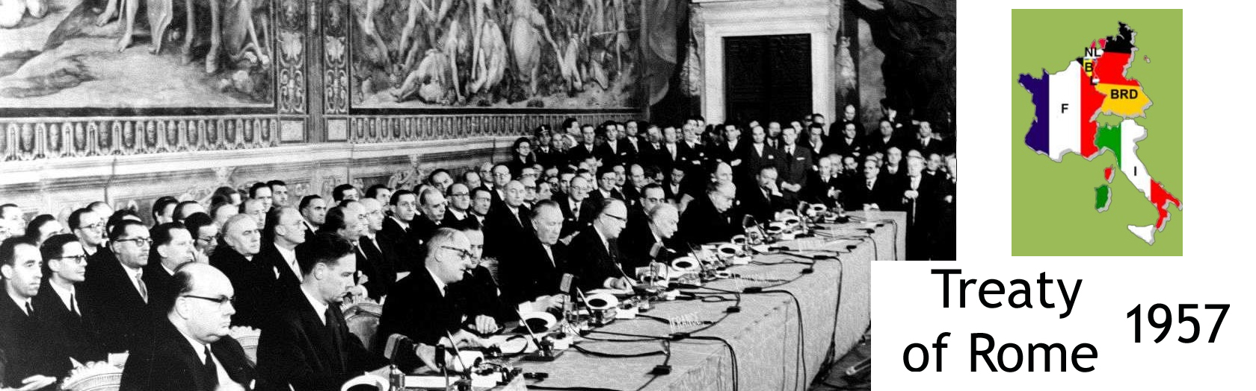
Short history lesson
In 1957 the forerunner of the EU was founded in Rome. The six founding states were DE, FR, IT, NL, BE and LU. That was called Treaty of Rome.

Slide 12
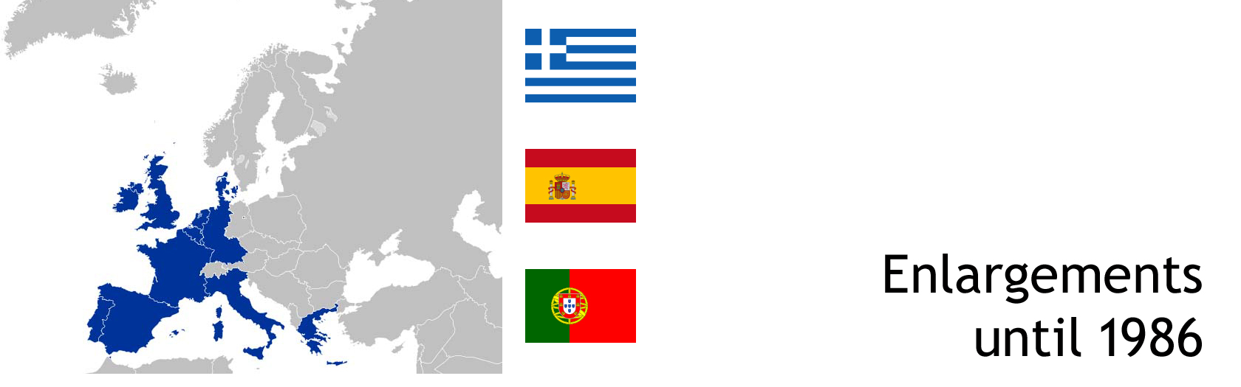
In 1992 the EU was founded, not longer called EEC or EC.
Now with 12 countries:
DE, FR, IT, NL, BE, LU and
GR, ES, PT, GB, IR and DK, not Finland and not Bulgaria

Slide 13
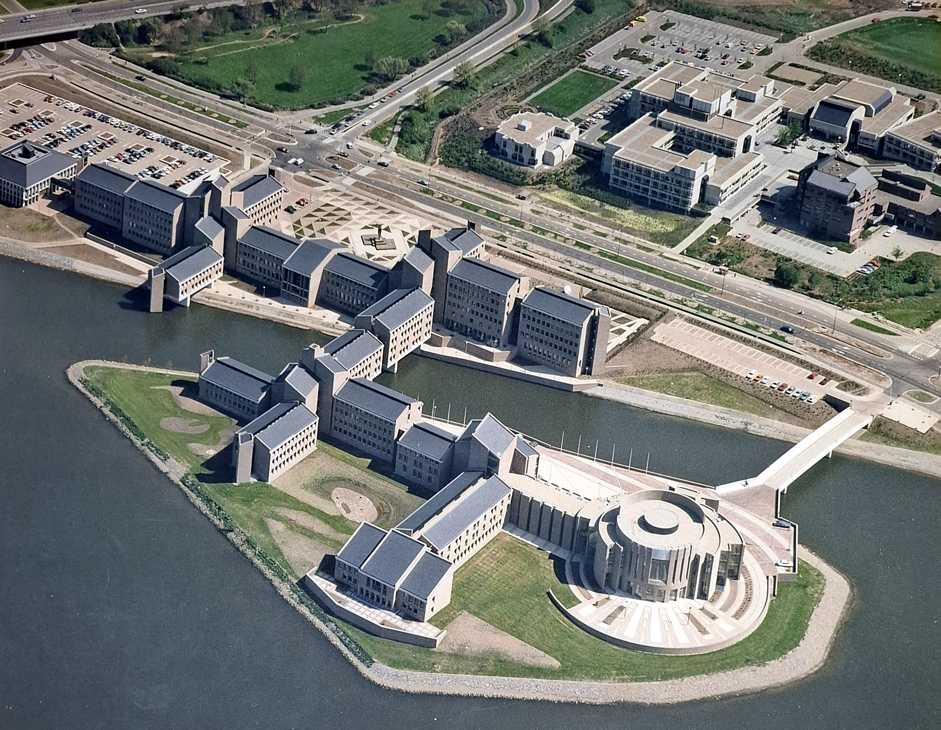
The place: Gouvernement Limburg in Maastricht

Slide 14
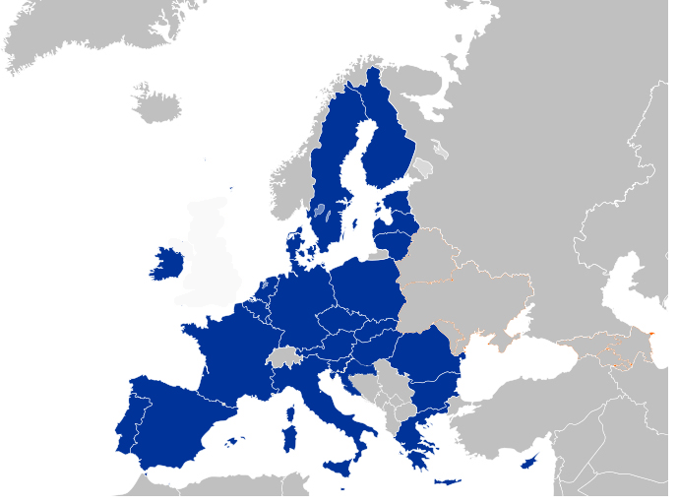
But now we are 27 nations
because the idea was so convincing
that a lot of countries joined the club.
Only Great Britain left the Union.

Slide 15
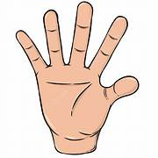
What is important to know?
Five things you need to know about the Maastricht Treaty
It established the European Union
It was signed by 12 countries
It laid the foundations for the euro €
It introduced the criteria that countries must meet to join the euro
It was a giant leap forward for European
integration

Slide 16

It established the European Union
Boring? No, very important in these days of confusion.
European citizenship
The Treaty introduced European citizenship, allowing citizens
to reside in and move freely between Member States.
Common foreign and security policy
The Treaty established a common foreign and security policy with the aim of "safeguarding the common values, fundamental interests and independence of the Union".
Justice and Home Affairs
The Treaty developed close cooperation on justice and home
affairs to ensure the safety and security of European citizens.

Slide 17
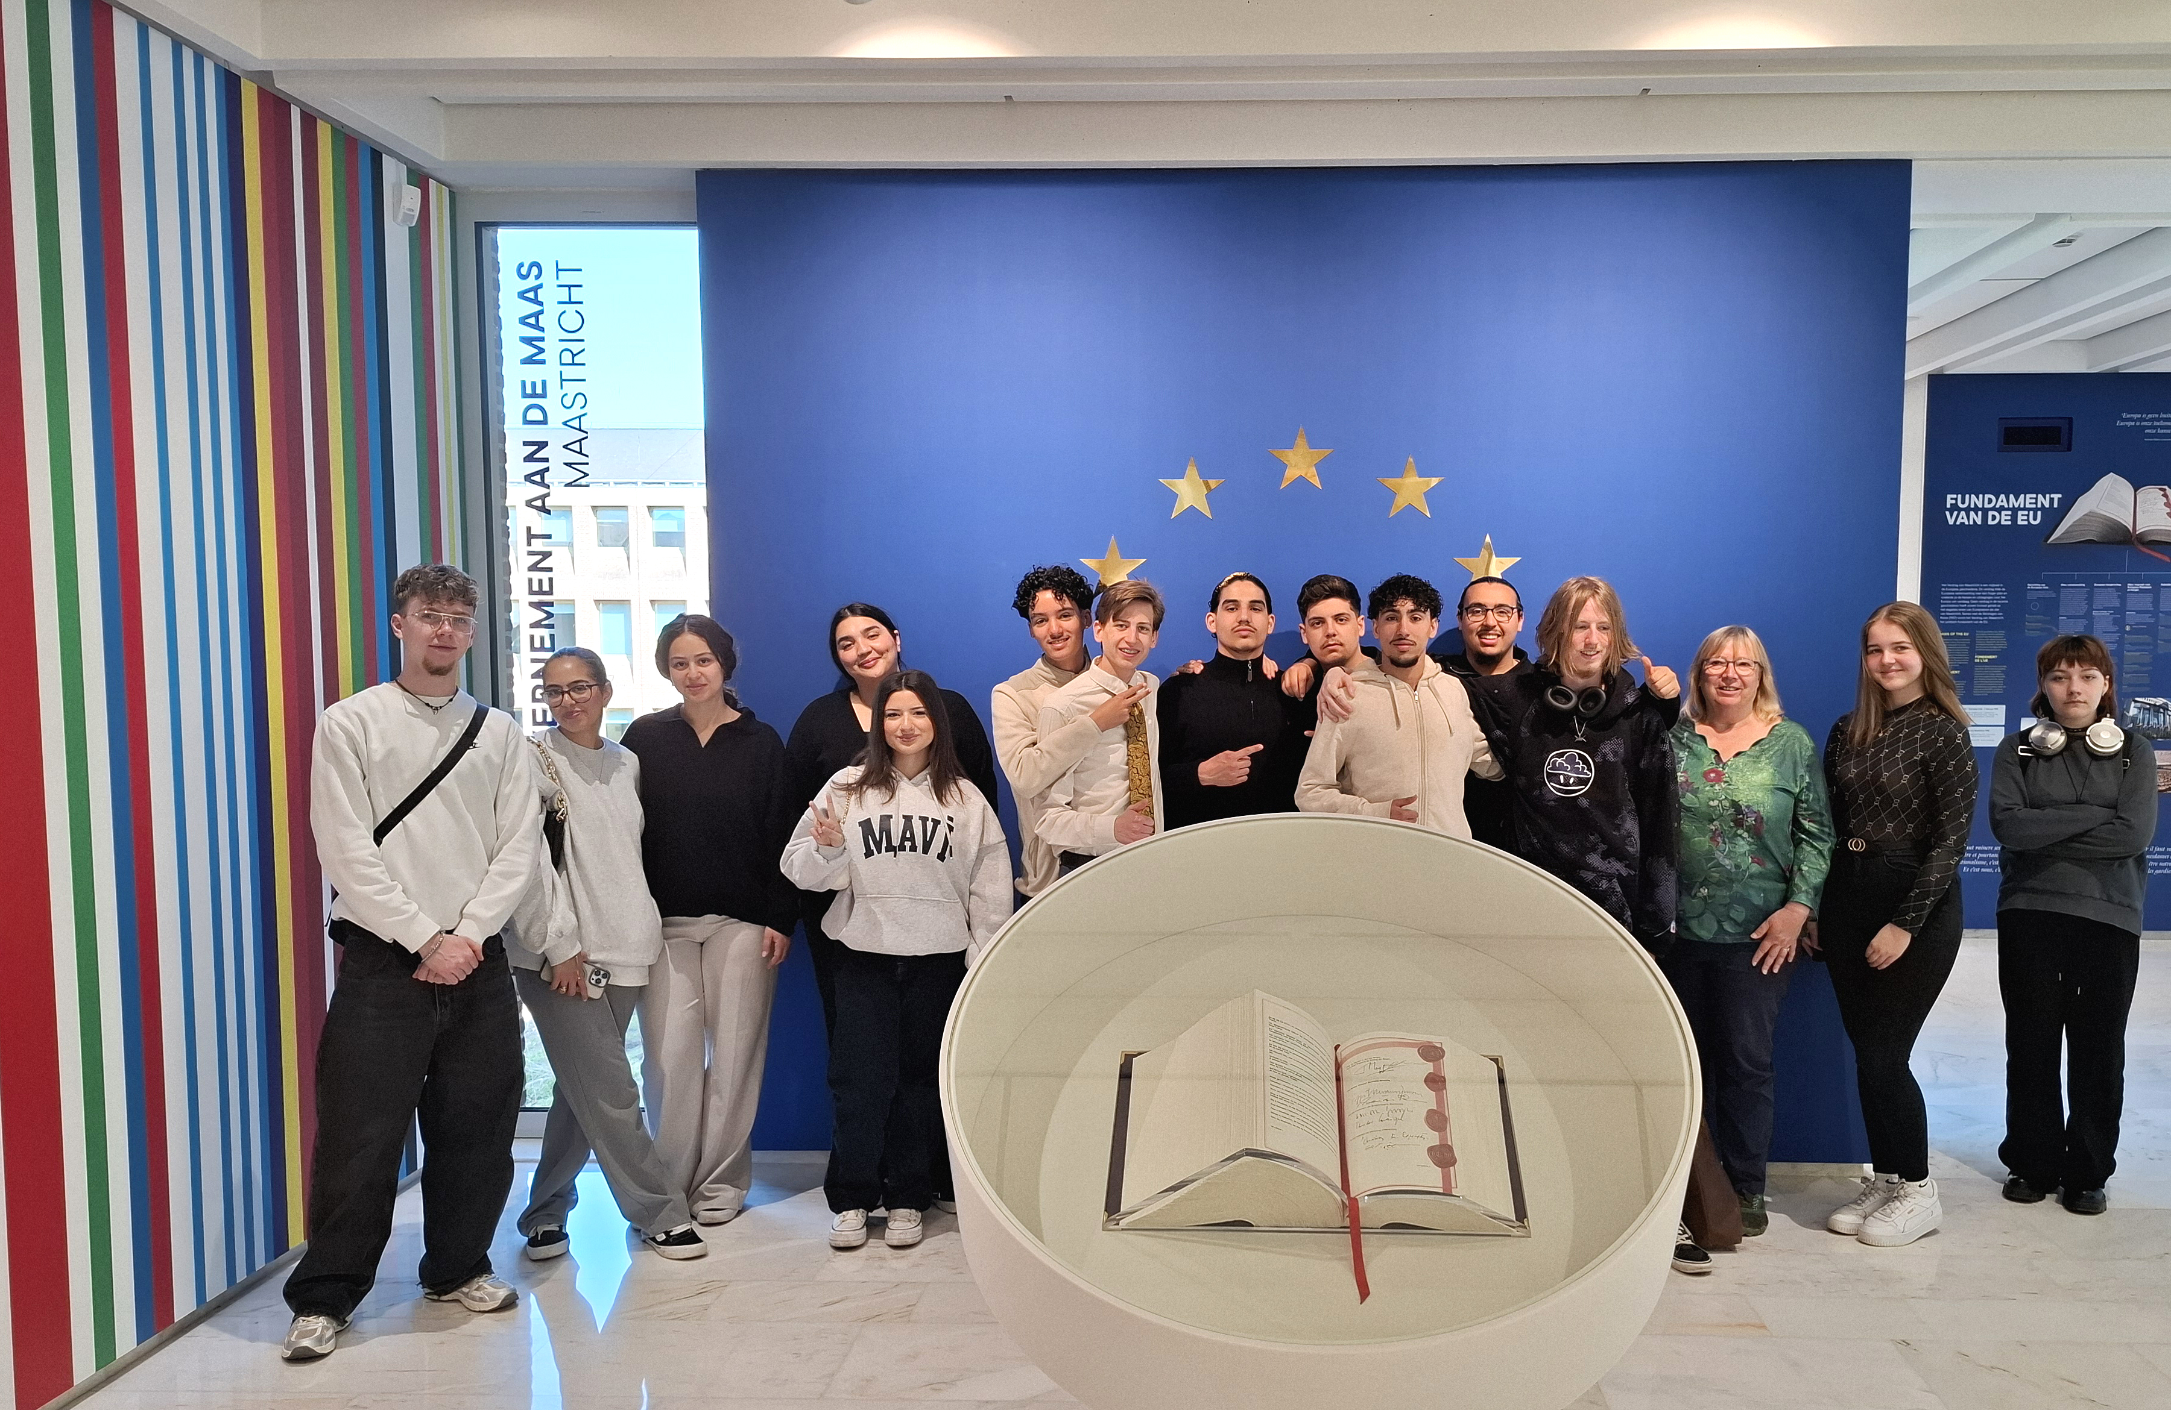
The junior ambassadors for the
European Parliament

Slide 18
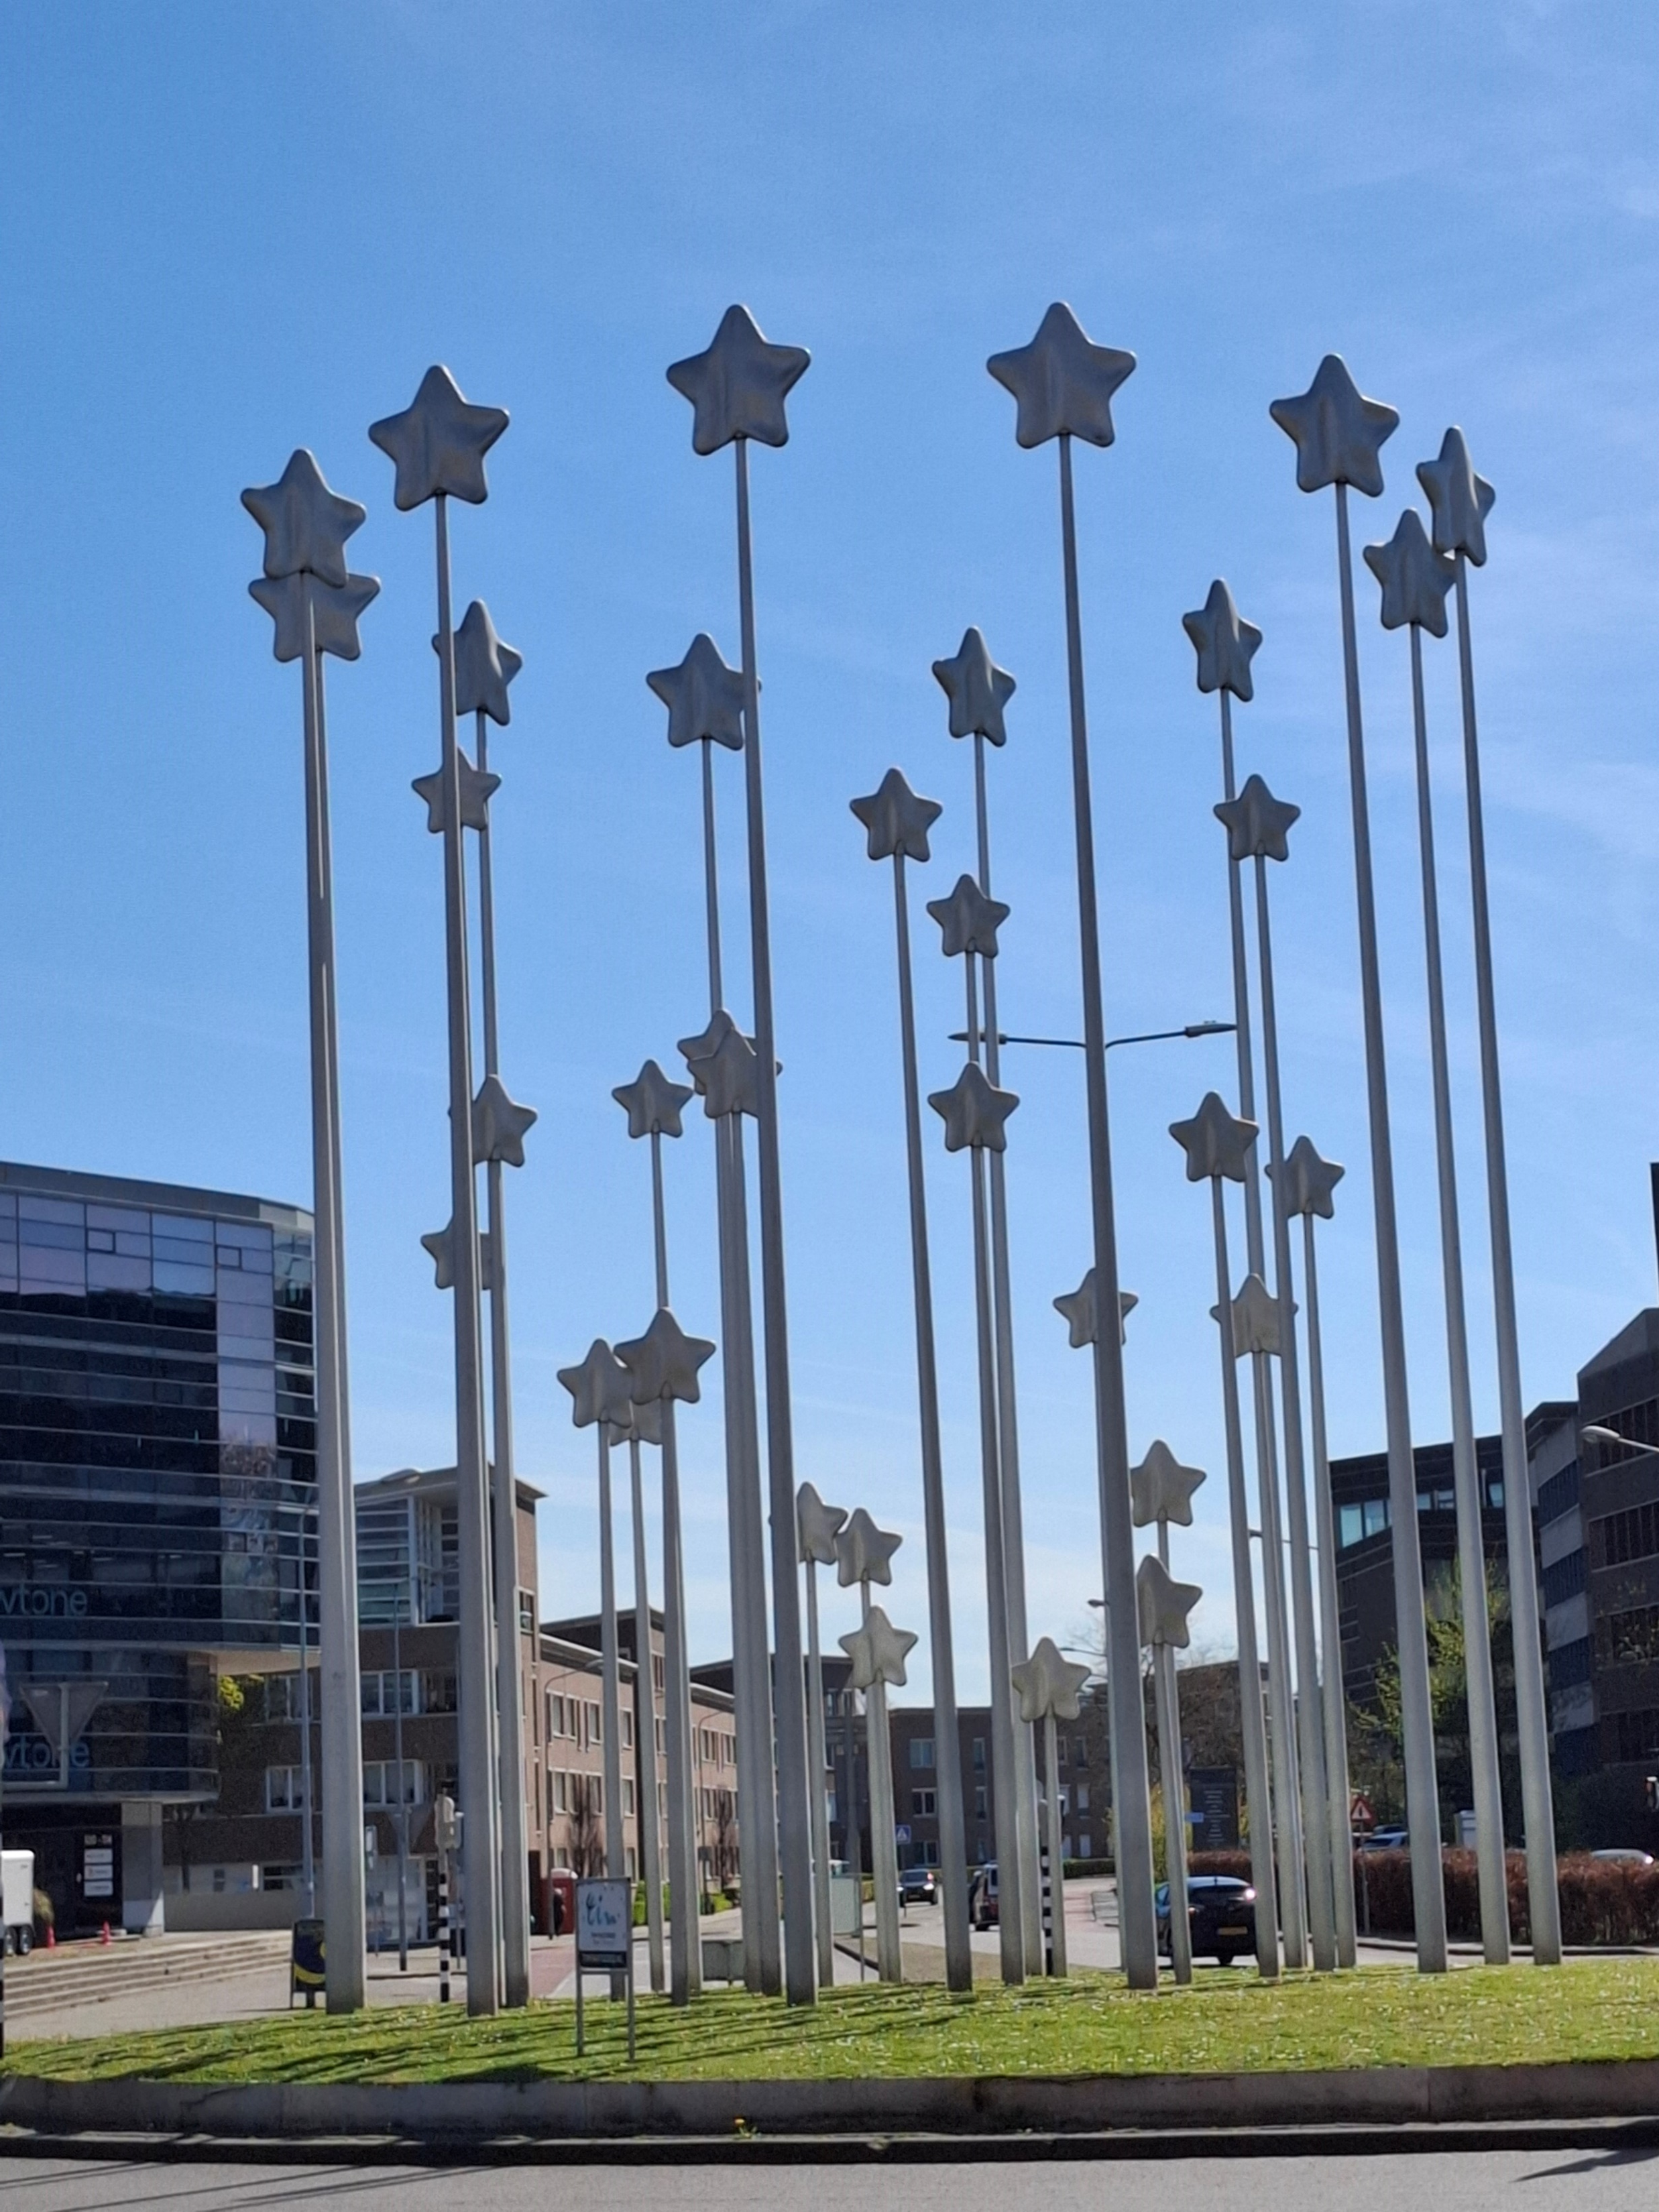
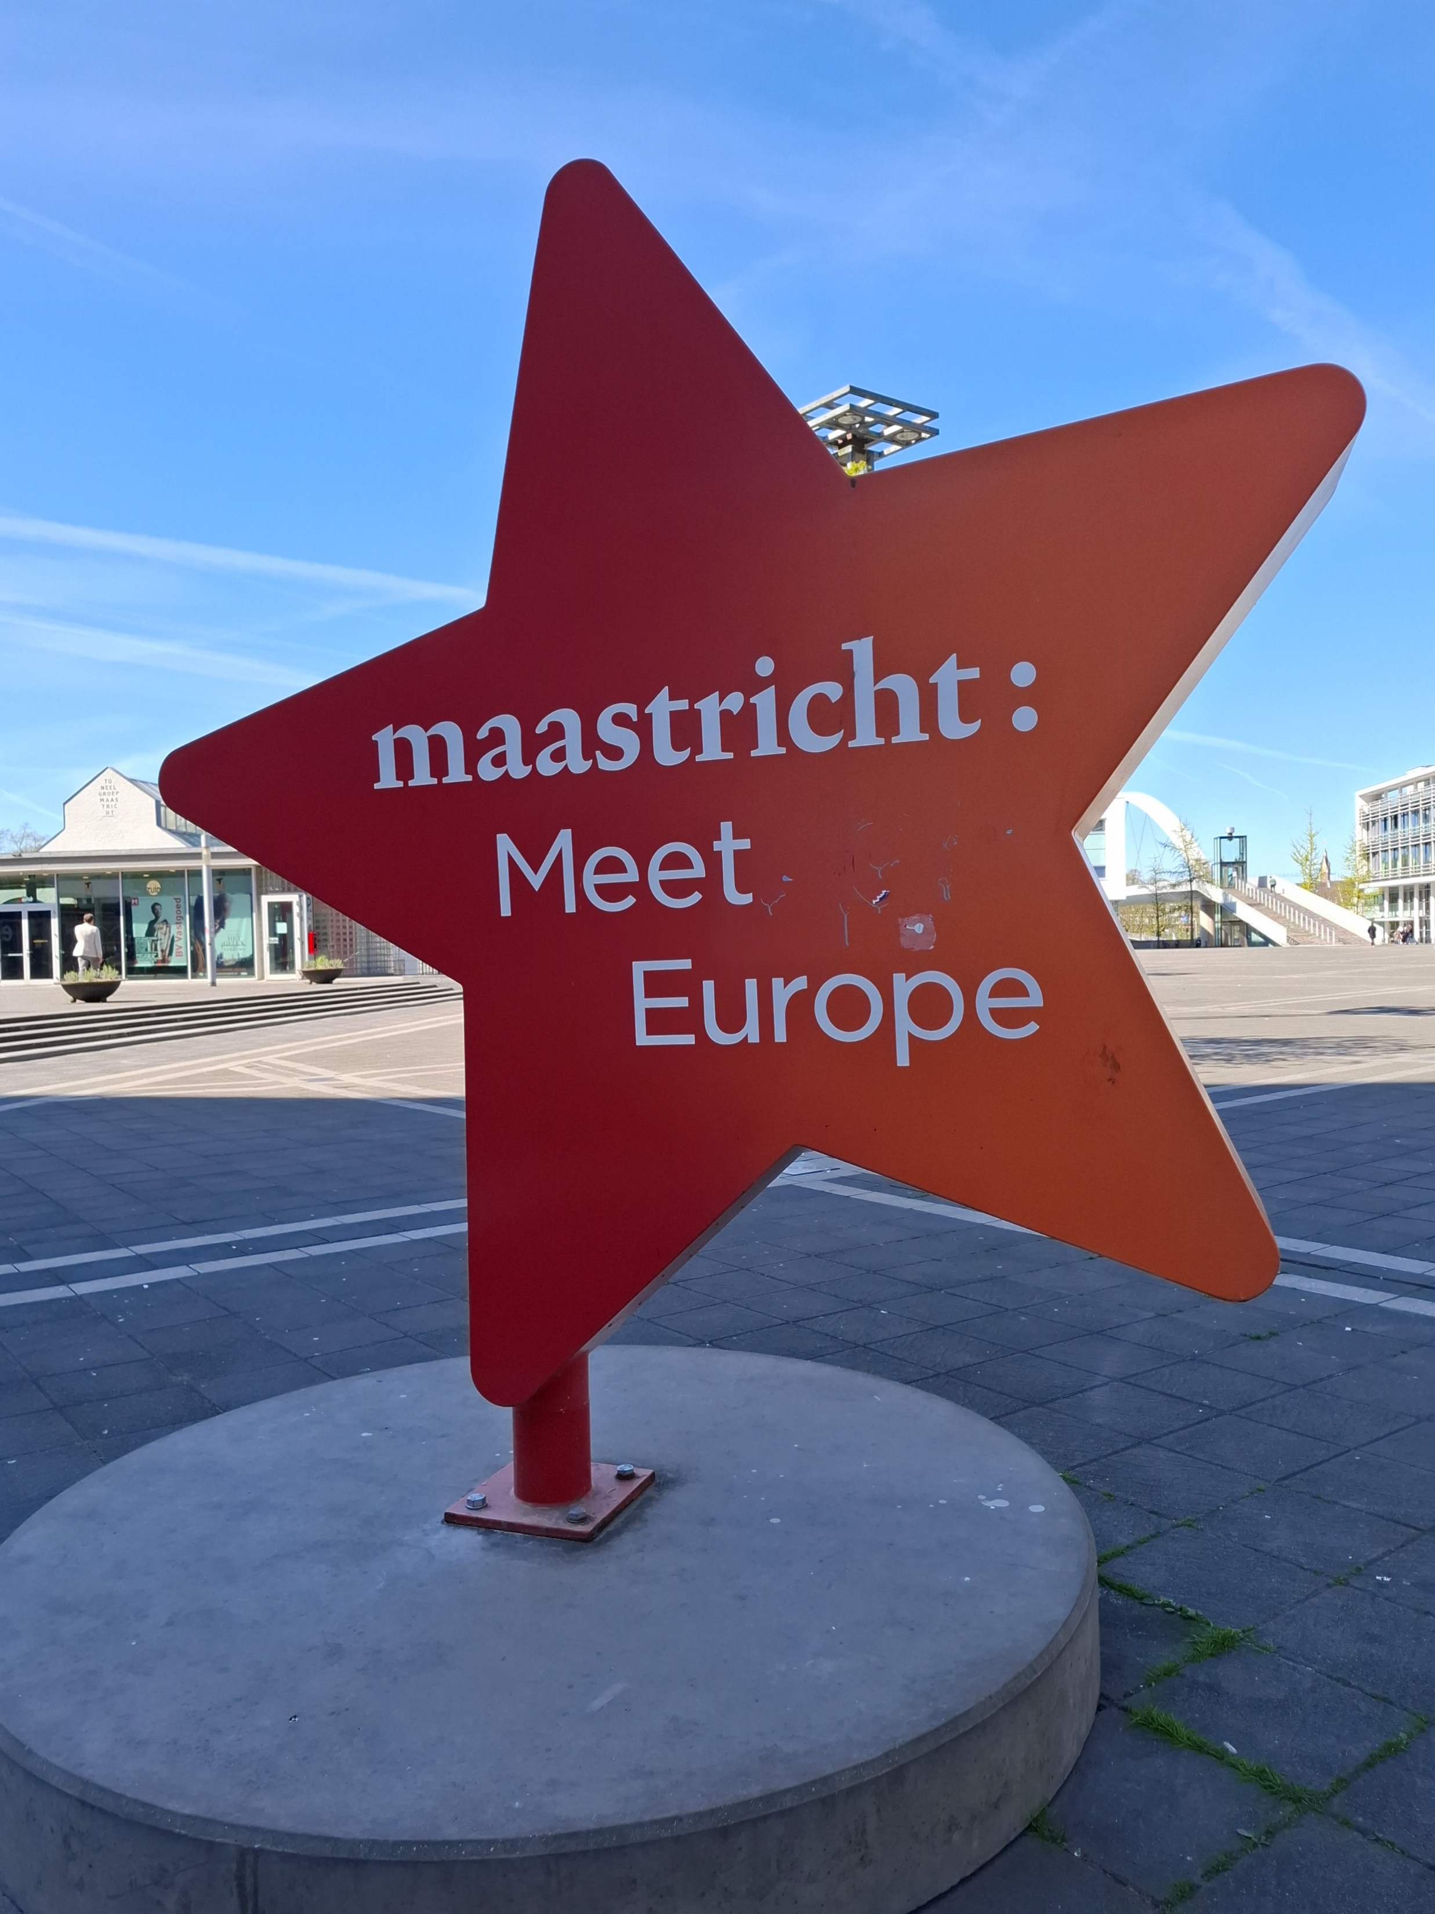
Some landmarks
Twelve large stars, complemented by smaller stars, symbolize the 12 countries that signed the treaty and the new member states that have since joined the EU. This is the Stars of Europe monument.
The place of 1992 with € signs in the pavement

Slide 19
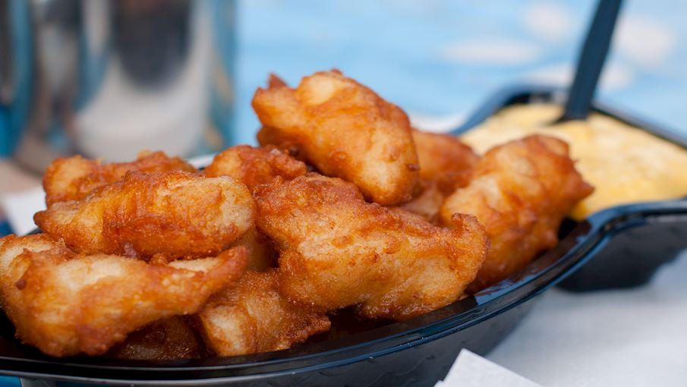
Dutch Street Food
Kibbeling: fish or other
seafood always fried
Kroket: fried rolls formed of pork or beef
Saucijzenbroodjes (= similar to Hot dog)
Patatje: fries topped with mayonnaise, onions, and peanut-based satay-style sauce
Broodje haring (= cold herring with onions)
Frikandel: skinless, deep-fried sausage

Slide 20
3. Step
Aachen – an old roman city in the west of Germany
Reasons to go to Aachen:
It is such a beautiful old town
It has an excellent international university
It is well known for the Emperor Charlemagne
in Germany called Karl der Große
You can apply for the Charlemagne Youth Prize

Slide 21
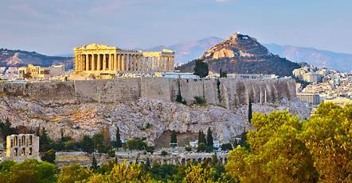
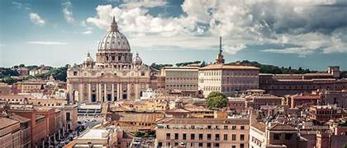
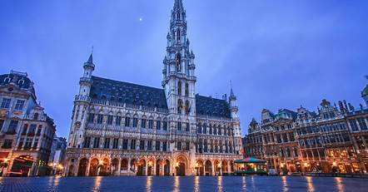
Europe has had a lot of capitals during history:
Athens
Rome
Brussels

Slide 22
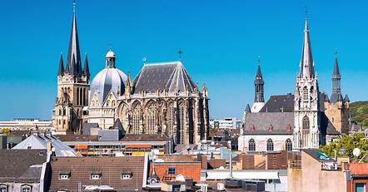
Europe has had a lot of capitals during history:
Athens
Rome
Brussels
and in between:
Aachen - Aken - Aix la Chapelle

Slide 23
Charlemagne – Karl der Große
You will learn a lot about Charlemagne
when we are in Aachen
Was crowed in the Dome of Aachen
Was the Emperor of a big part of Europe
Travelled a lot around his big country from Kaiserpfalz to Kaiserpfalz
Invented the Minuscules
Was buried in the Dome of Aachen

Slide 24
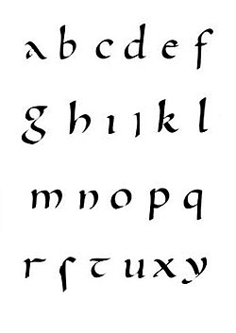
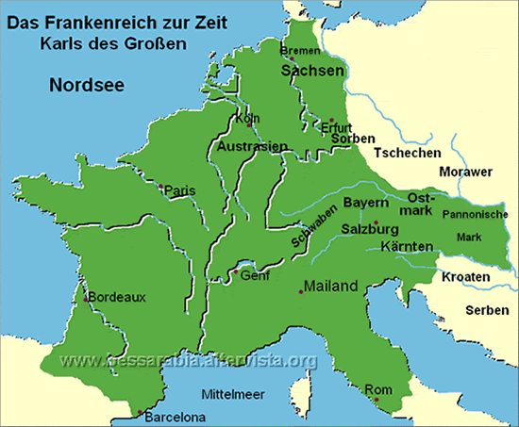
Borders are coming, borders are going, the people stay,
if they are not forced to go by bombs or terror or hunger.

Slide 25
We will arrive at Aachen – Dome at 3 p.m.
We will have a guided tour through the town at 4 p.m.
We leave Aachen at least at 7 p.m.
You have to decide where you want to eat for dinner in Aachen or in Mönchengladbach.

Slide 26

Charlemagne Prize of Aachen
The International Charlemagne Prize of Aachen, first awarded in 1950, is the oldest and most prestigious award given to individuals or institutions for work done in the service of European unification.
The Prize is named after Charlemagne, the Frankish-German king, who is considered the first unifier of Europe, who was revered by his contemporaries as the ‘Father of Europe’, and who chose Aachen as his favorite Palace at the end of the eighth century; thus, a bridge is built between European past and future.
This year – the 75th year of the prize - it goes to Ursula von der Leyen, the president of the European commission.

Slide 27
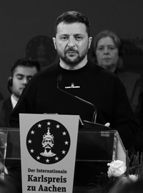
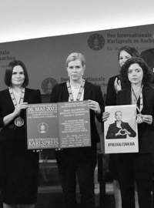
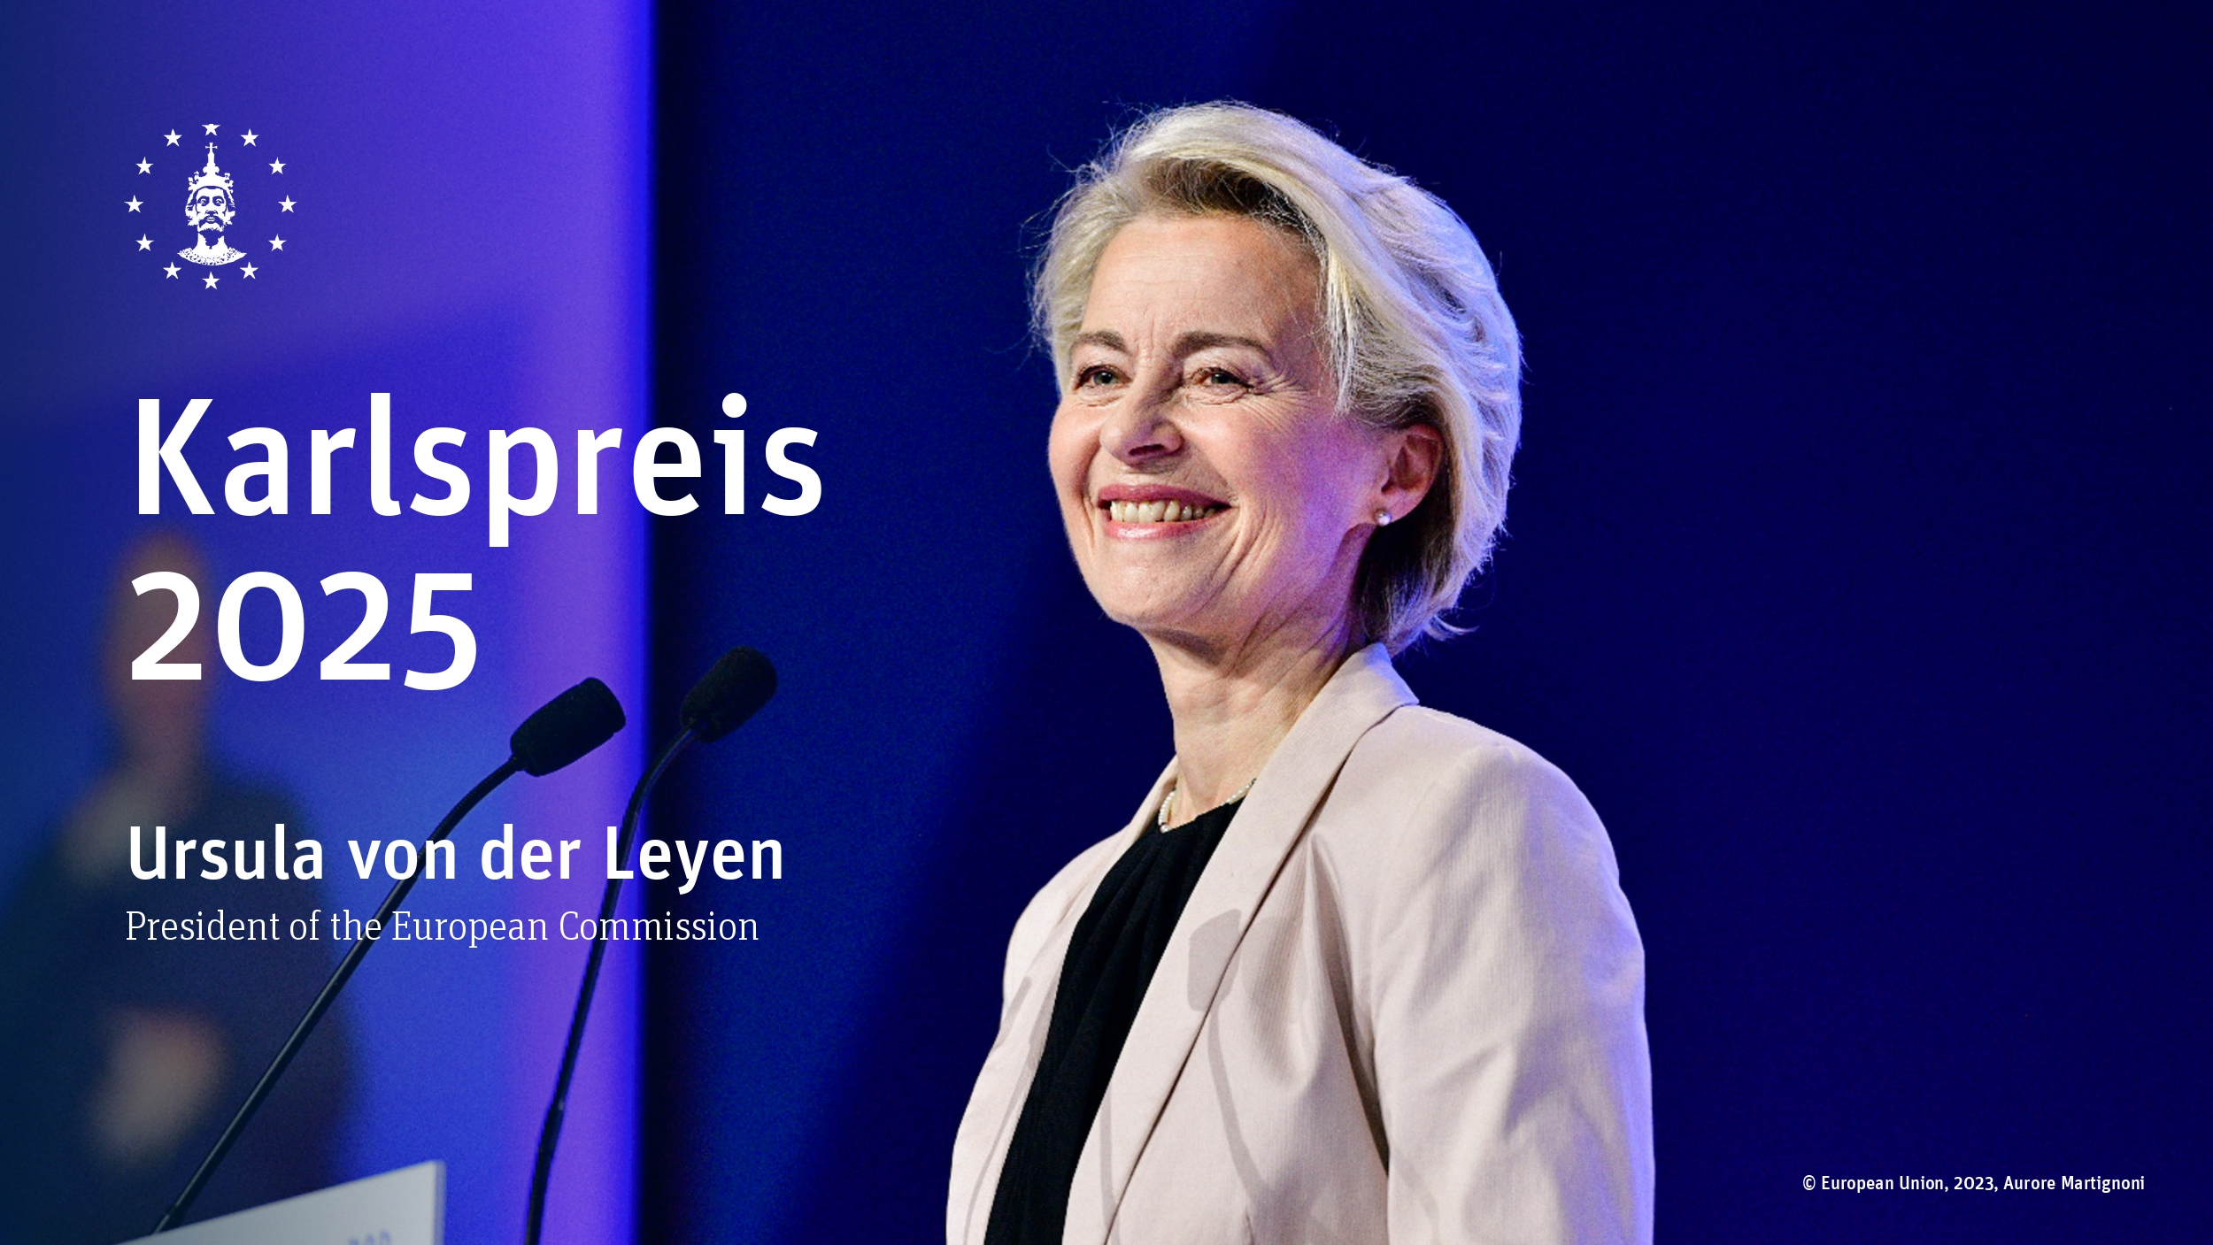
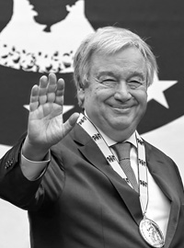
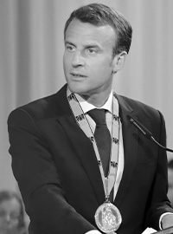
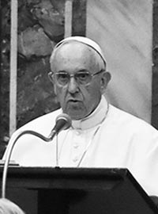
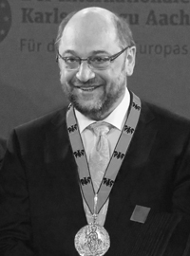
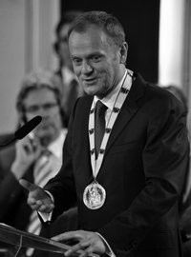
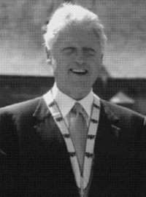
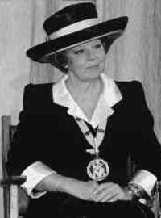
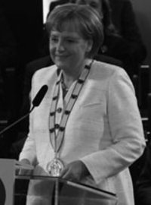
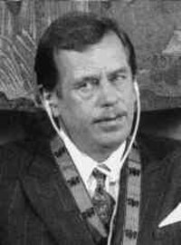
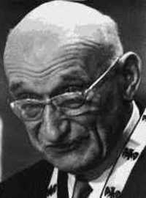
Some award winners

Slide 28
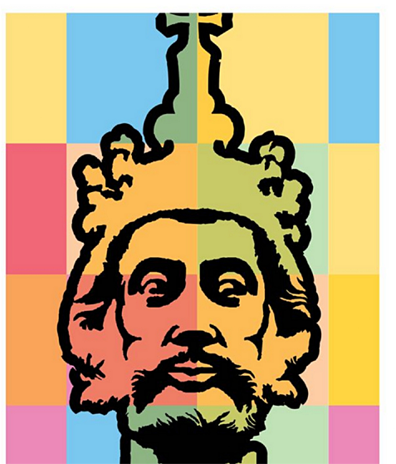
European Charlemagne
Youth Prize
The competition targets young people aged
between 16 and 30 in all EU member states,
inviting them to present projects that promote
European understanding.
From the best projects in each of the 27 member states, a jury comprising representatives from the European Parliament and the Charlemagne Prize Foundation selects the European winner of the European Charlemagne Youth Prize, as well as second and third place, who receive a total prize money of €15,000. submitted for the award.

Slide 29
Schengen versus border controls
Is the rise in internal border controls ending the EU dream?
More and more EU countries are bringing in internal border checks even as Bulgaria and Romania are set to become full Schengen Area members.
Checks along borders in the Schengen Area are morphing from an exception to the rule

Slide 30
Some links:
The Universities that might be interesting:
https://www.maastrichtuniversity.nl/
https://www.rwth-aachen.de/cms/~a/root/?lidx=1
The pages of the Charlemagne awards:
https://www.karlspreis.de/en/
https://www.karlspreis.de/en/charlemagne-youth-prize/information
The ambassador schools for the European Union:
https://youth.europarl.europa.eu/more-information/ambassador-school.html

Slide 31
Thank you for your attention and cooperation!
Have a nice day in Maaseik – Maastricht – Aachen

