Slide 1
Erasmus+ - Projekt
der Gesamtschule Volksgarten

Slide 2
LEO
Learn from Each Other

Slide 3
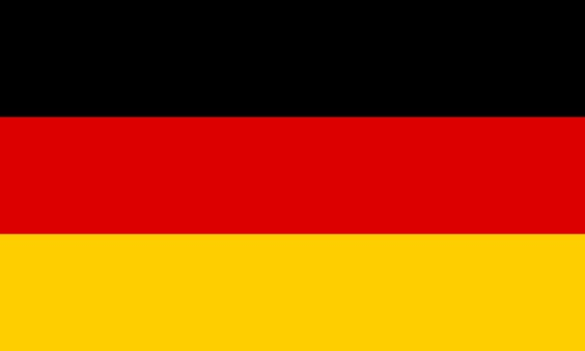
Ranuan lukio
Ranua
Finland
English Language School “Geo Milev”
Bourgas
Bulgaria
Gesamtschule Volksgarten
Mönchengladbach
Germany

Slide 4
Topics
Germany
Integration
Learning together and getting along despite differences in cultural and religious backgrounds
Finland
Nature and sustainability
Conflicting interests: preserving nature versus economic profit
Bulgaria
English language teaching
Using different methods, including computer games (English learning Minecraft)

Slide 5
Dates
Germany: 12.5. – 16.5.2025
Finland: 6.10. – 10.10.2025
Bulgaria: 9.2. – 13.2.2026

